Slide 1
INTRODUCTION
What is Rangeland?

Slide 2
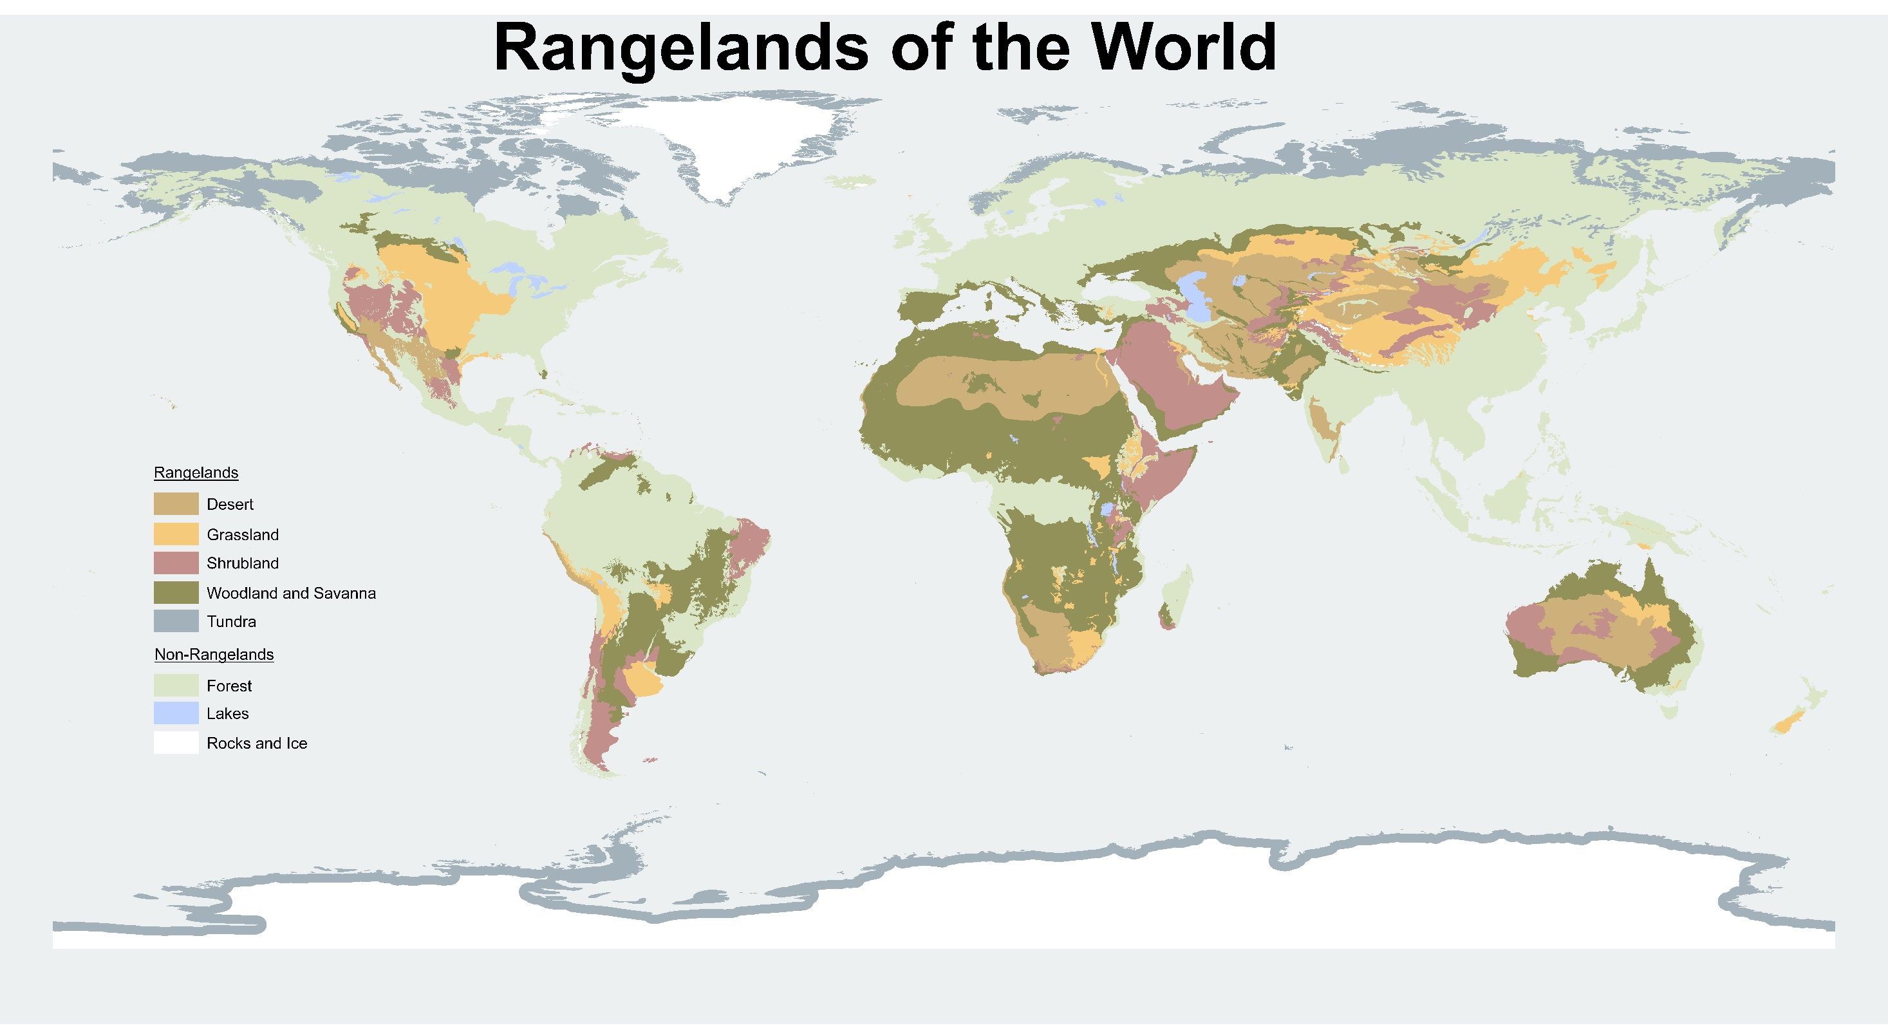
Notes:
Rangelands of the World
Deserts, grasslands, shrublands, woodlands, savannas, and tundra are rangeland that occur in a diverse array of forms across the globe, and extensively on every continent.
Deserts are the driest rangelands. Vegetation on these lands is often sparse and dominated by shrubs and succulent cactus plants.
Grasslands are lands dominated by grasses and grass-like plants.
Shrublands are lands dominated by shrubs that have an understory of grasses and forbs.
Woodlands and Savannas are lands dominated by widely-spaced trees with an understory of grasses and forbs.
Tundras are treeless plains in the arctic or high-elevation (cold) regions.

Slide 3
Notes:
Generalized map of rangeland vegetation types of the United States. Based mostly on A. S. Kuchler 1964. Potential natural vegetation of the conterminous Unites States. American Geographical Soc. Publ. #36.
Rangeland of the U.S.
Examples in North America:
Desert Shrubland and Grasslands: Mojave, Sonoran, and Chihuahuan deserts
Grasslands: Tallgrass Prairie, Mixed Prairie, Shortgrass Prairie, Intermountain Grasslands (e.g., Palouse Prairie), and Annual Grasslands
Shrublands: Sagebrush-Steppe, and Salt- Desert Shrublands
Woodlands and Savannas: Pinyon-Juniper Woodlands and Oak Woodlands

Slide 4
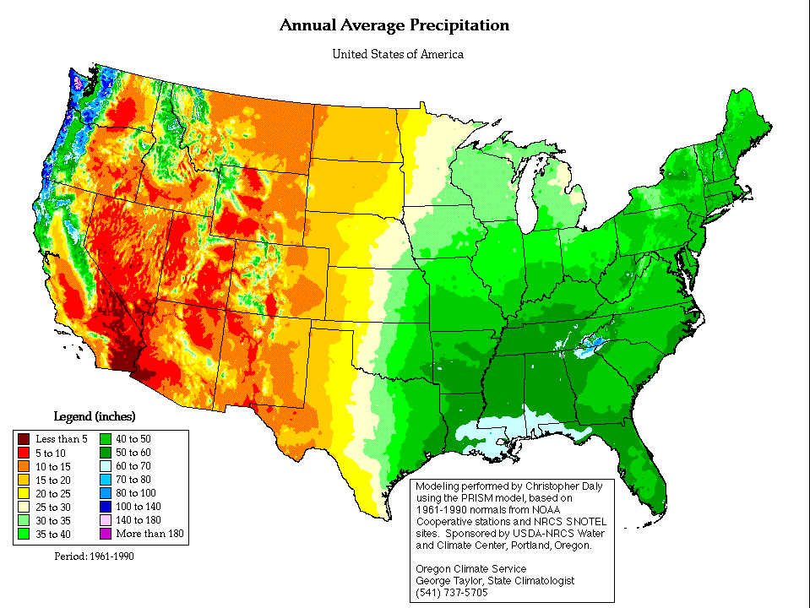
Variation in Annual Precipitation Across the U.S.
Notes:
Modeling performed by Christopher Daly using the PRISM model, based on 1961-1990 normal from NOAA Cooperative stations and NRCS SNOTEL sites. Sponsored by USDA-NRCS Water and Climate Center, Portland, Oregon.
Variation in Annual Precipitation across the U.S.
Rangeland receives between 6-28 inches of annual (yearly) precipitation.
The Sierra Nevada Mountains and Rocky Mountains create an orographic barrier which means they intercept moisture heading east from the Pacific Ocean; this creates a dry area (red and orange on the map) on the east or leeward side of the mountain. This effect is known as a rain shadow.

Slide 5
Notes:
Rangeland Stewardship
Public lands are lands that are managed by federal and state land management agencies. Private lands are owned by individuals, corporations, or non-governmental organizations (NGOs).
Federal Lands:
Federal lands are 26% of all U.S. land. Almost half (48.6%) of the thirteen western states are federal lands, most of which are rangeland.
Federal public land is to be managed for “multiple use” (discussed later) and for the greatest good of all Americans. These federal lands belong to all U.S. citizens and they are managed and cared for on our behalf by various federal agencies such as the Bureau of Land Management (BLM), U.S. Forest Service (USFS), National Park Service (NPS), U.S. Military and a few others.
State Endowment Lands
Through the Morrill Act in 1862, a portion of federal lands were granted to states. This act created the checkerboard pattern across much of Idaho’s landscape (red squares in the Rangeland Stewardship map).
State lands are actively managed to “secure the maximum long-term financial return” to public schools and other beneficiaries.
State endowment lands are managed to be sustainable (remain healthy, productive, and resilient) and promise to generate returns for generations to come.
Private Lands:
Private lands include those owned by individuals, corporations, or non-governmental organizations (NGOs). Just like people own homes and yards in the city, rangelands were homesteaded in the mid-1800s and many have been purchased since.
Prior to the 1930s, government policies encouraged the settlement of the West. The Homestead Act opened public lands to settlers and pioneers; U.S. citizens willing to settle on and improve the land for at least five years were given between 160-640 acres.
Private lands tend to be in areas where there is water; pioneers homesteading the land needed water for themselves, animals, and to grow crops. Lands with limited water that were difficult to homestead, tend to be the lands managed by state and federal agencies today.

Slide 6
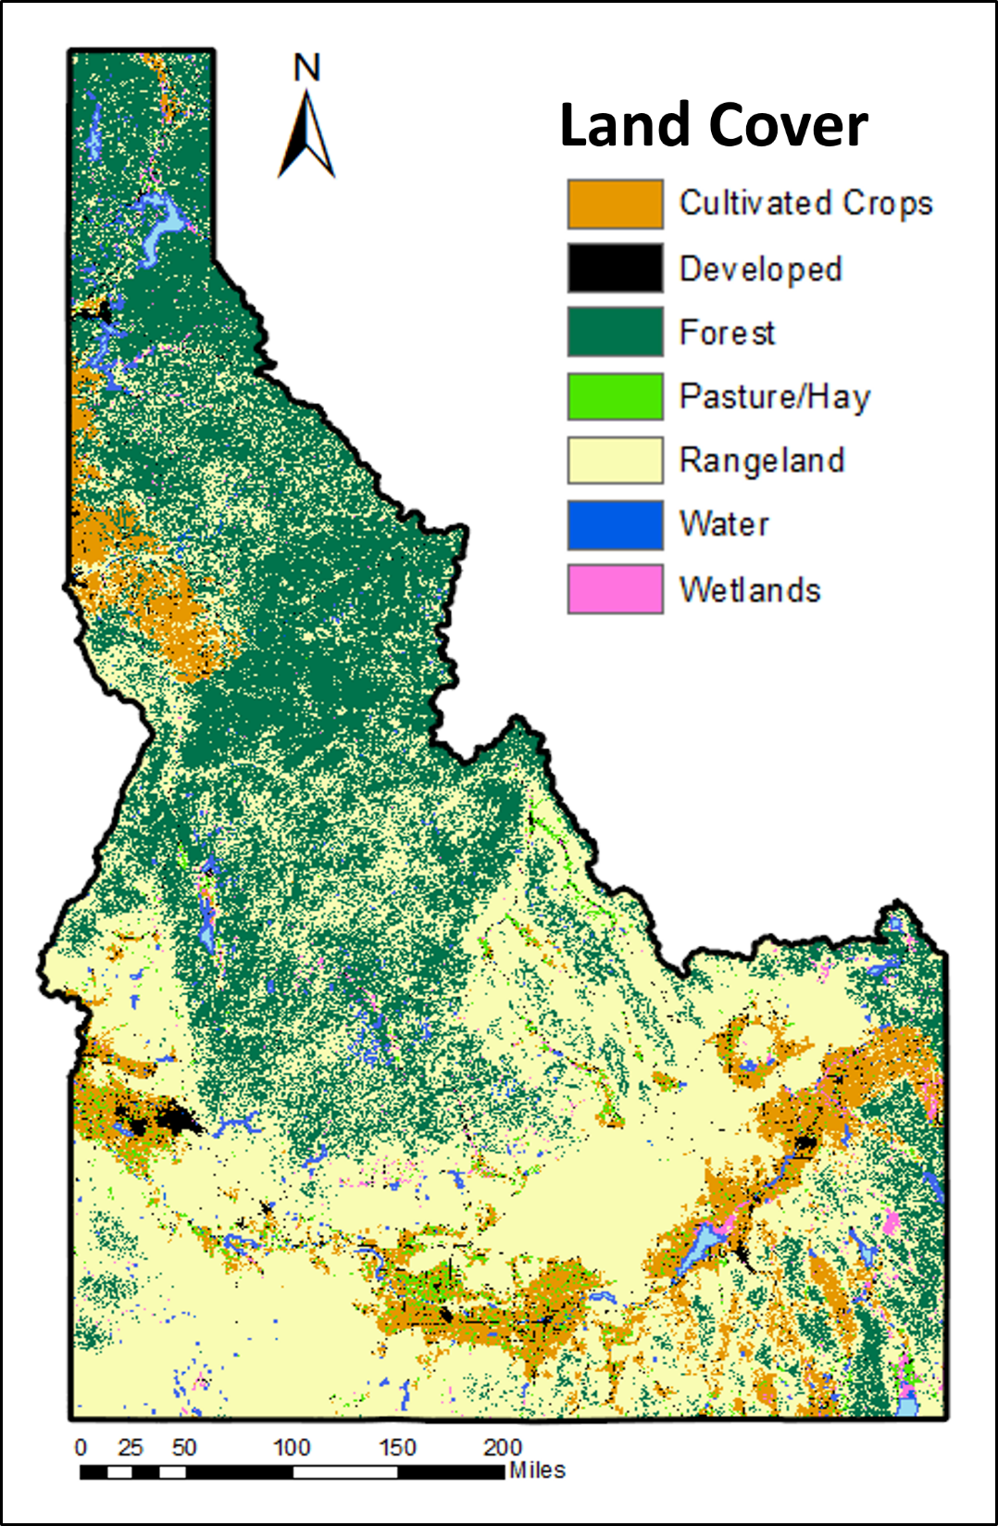
Notes:
Land cover describe the characteristics of the land surface (for example, urban, agriculture, forest, and rangeland). Land cover can change over time, for example as agricultural lands are development into urban properties, however, this changes often take time. In Idaho, land cover is as follows:
Rangeland = 54.4% or 28,793,382 acres
Forest = 32.0% or 16,950,807 acres
Cultivate Crops (or agricultural lands) = 9.3% or 4,898,404 acres
Urban = 1.7% or 918,048 acres
Irrigated Pastures = 1.7% 879,739 acres
Water = 0.9% or 491,743

Slide 7
Notes:
Rangeland Stewardship in Idaho: Who manages or owns Idaho rangelands?
Federal rangeland = 68.8%; Primarily managed by the
Bureau of Land Management (BLM)—38.1% or 10,961,030 acres (yellow)
US Forest Service (USFS)—25.9% or 7,443,705 acres (green)
State rangelands = 5.6%
Private rangelands = 24% or 6,827,264 acres (blue)

