Slide 1
Crested Wheatgrass Production over 35 years
Lee A. Sharp
Ken Sanders
Neil Rimby

Slide 2
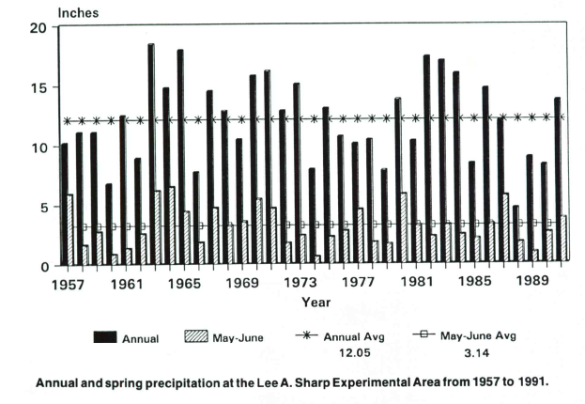
35-year study of Crested Wheatgrass
Notes:
Precipitation graph of crested wheatgrass study over 35 years. The black bars denote average annual precipitation. The hashmarked bars represent the precipitation received during May and June. The long term average annual precipitation on the research site was 12.05 inches. The long term average precipitation for May and June was 3.14 inches.

Slide 3
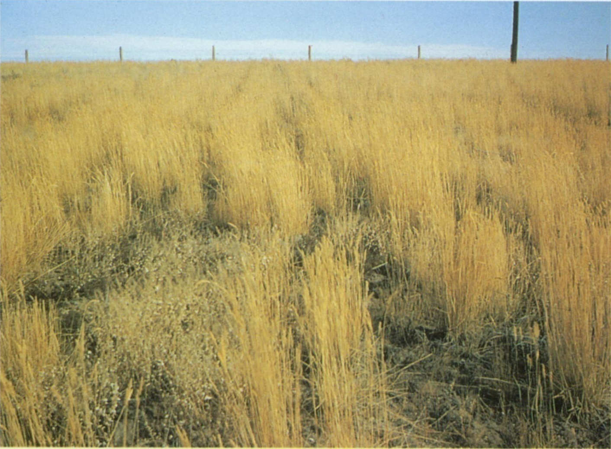
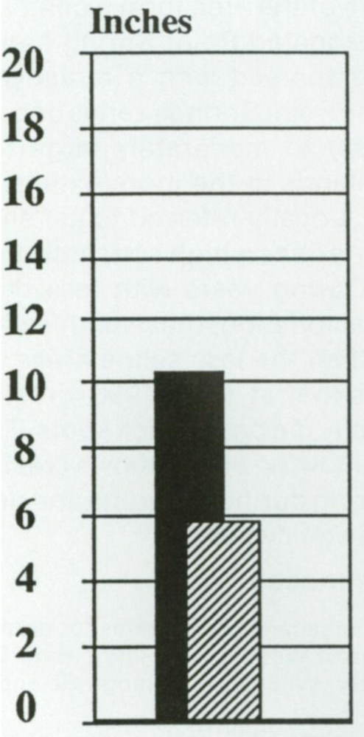
1957
Production
843 lb/acre
Notes:
1957 –Precipitation was above normal with the May-June precipitation totaling 5.9 (hashmarked bar), compared to an average of 3.1 inches for May-June. Crested wheatgrass production was 843 lb/acre.

Slide 4
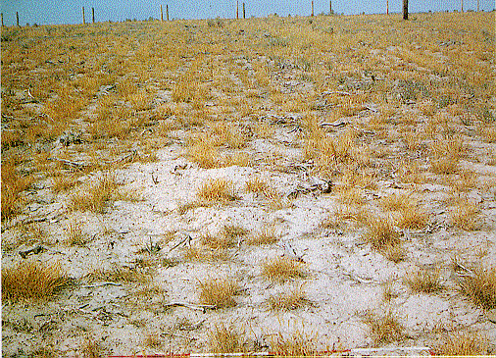
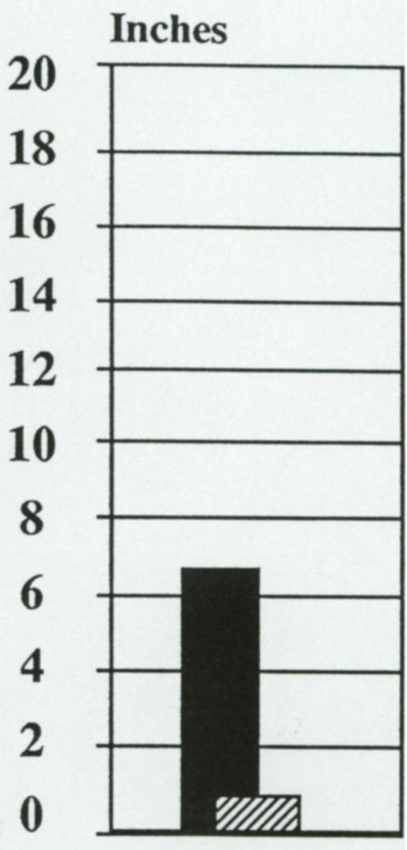
1960
Production
186 lb/acre
Notes:
1960 – This year was drier than normal, with only 0.9 inches of precipitation in May-June (hashmarked bar). As a result, production was much below normal at only 186 lb/acre.

Slide 5
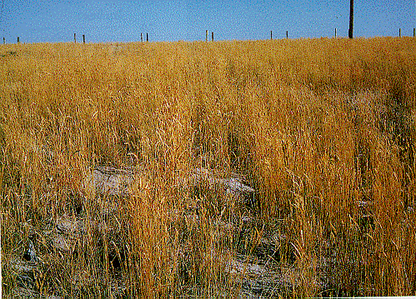
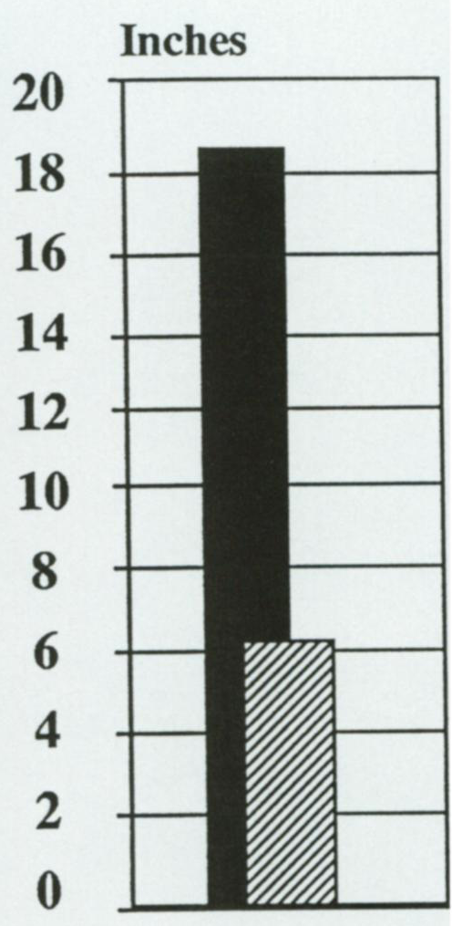
1963
Production
846 lb/acre
Notes:
1963 – Precipitation was much above normal during the growing season of 1963 and the rain fell during the summer. The grass remained green until about the time of the fall photograph. Grass production averaged 846 lb/acre.

Slide 6
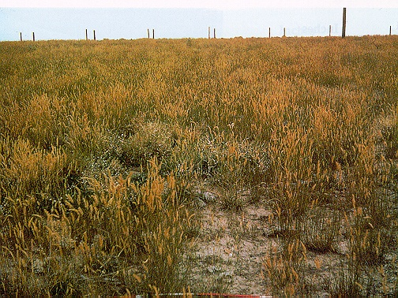
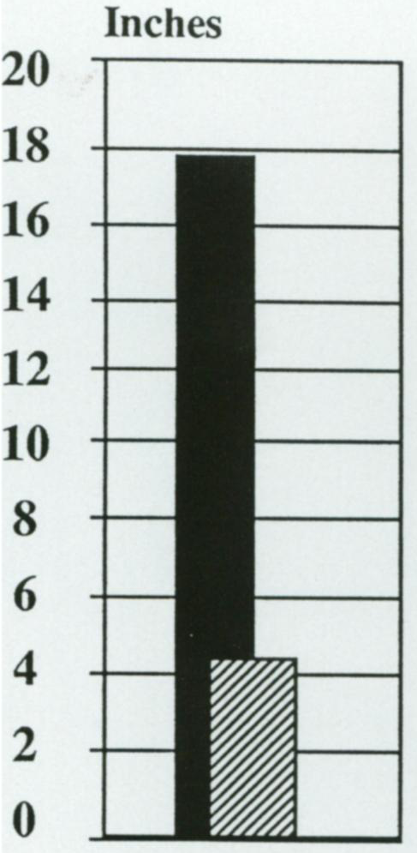
1965
Production
846 lb/acre
Notes:
1965 – This year was much above normal in precipitation and temperatures were lower than the previous year. The stems remained green through the time that the fall photograph was taken and production was 846 lb/acre.

Slide 7
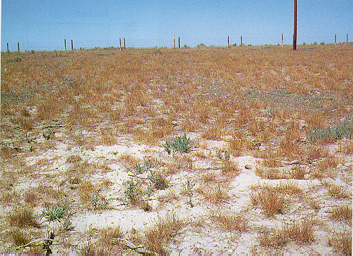
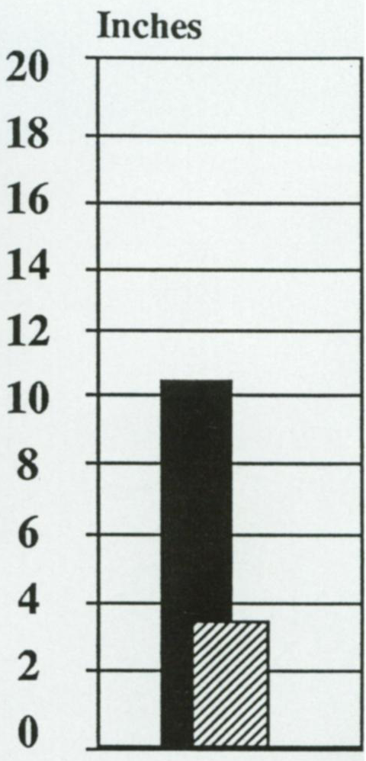
1969
Production
262 lb/acre
Notes:
1969 – May precipitation was much below normal. Although June precipitation was about normal, it came too late to compensate for May’s low precipitation level. Grass production was only 262 lb/acre.

Slide 8
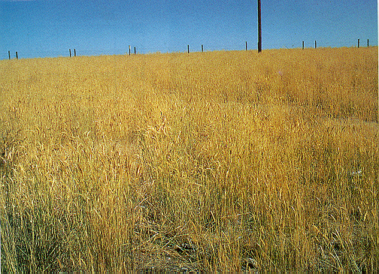
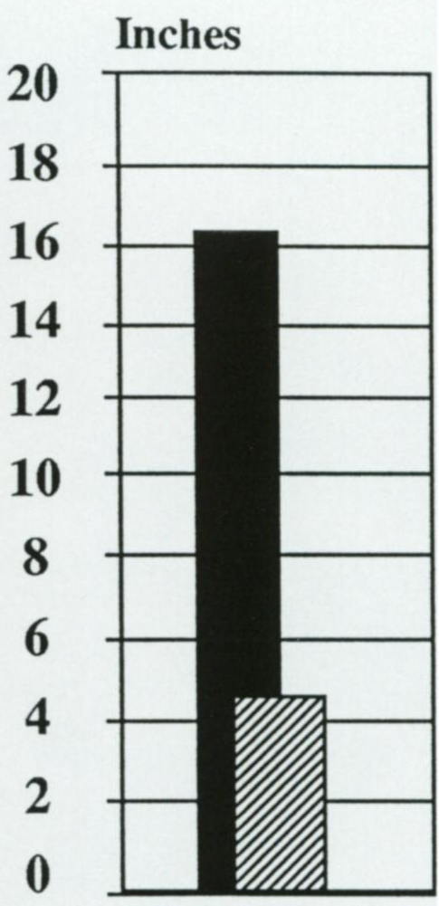
1971
Production
1,090 lb/acre
Notes:
1971 – Precipitation was above normal in May and June, as reflected in the crested wheatgrass production of 1,090 lb/acre.

Slide 9
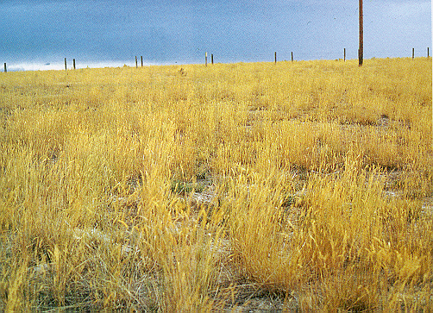
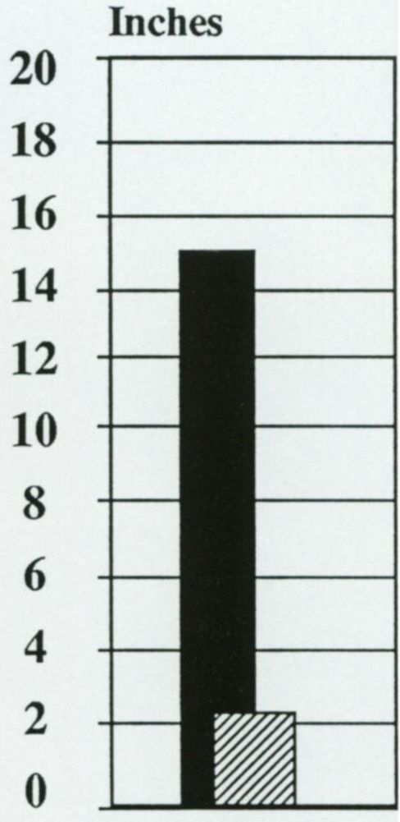
1973
Notes:
1973 – Precipitation was about average during the months of May and June but was above average during the summer months.

Slide 10
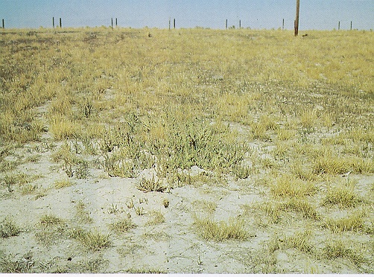
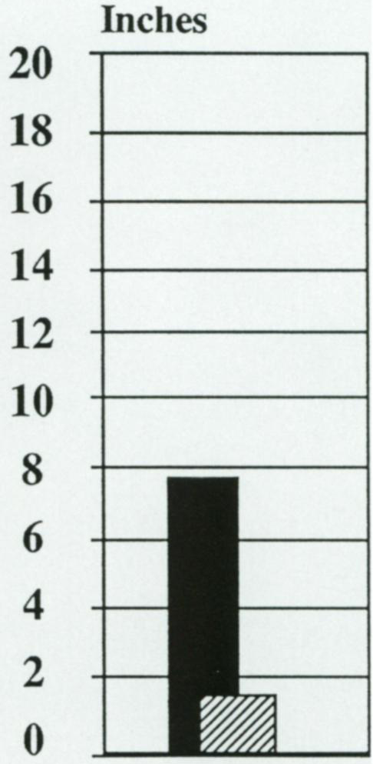
1979
Notes:
1979 – This photograph show the effects of the low precipitation in May and the slightly less than average precipitation in June. This was one of the drier years on record up to this time.

Slide 11
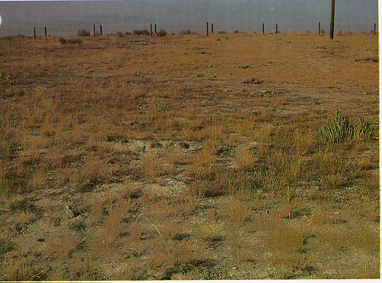
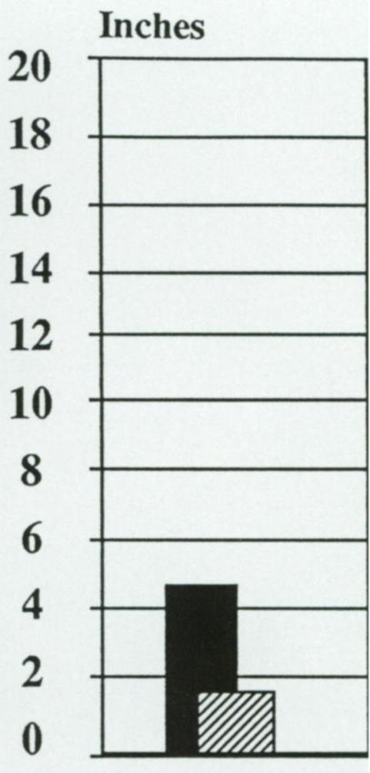
1988
Notes:
1988 – This was the beginning of a three-year dry period. November to April precipitation was well below normal. May precipitation was 1.1 inches below normal and no precipitation was received in Jun.

Slide 12
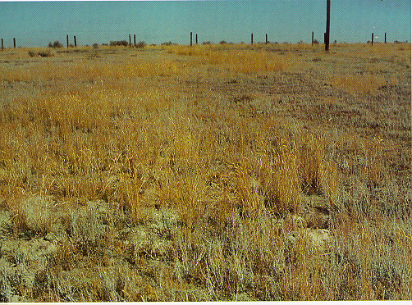
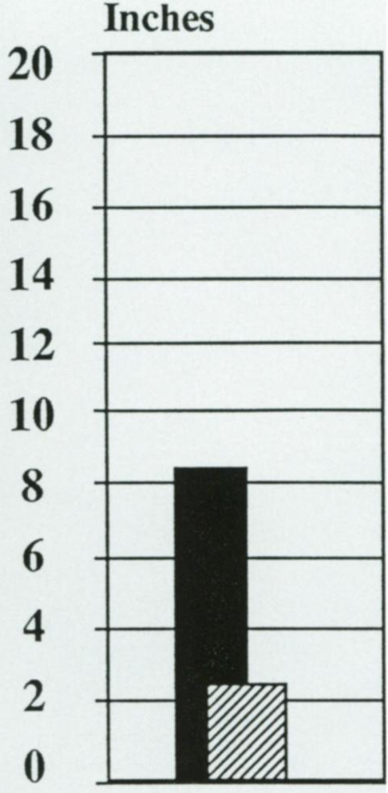
1990
Production
140 lb/acre
Notes:
1990 – November through April precipitation was about average, but May and June precipitation was much below normal, as reflected in production of 140 lb/acre.

Slide 13
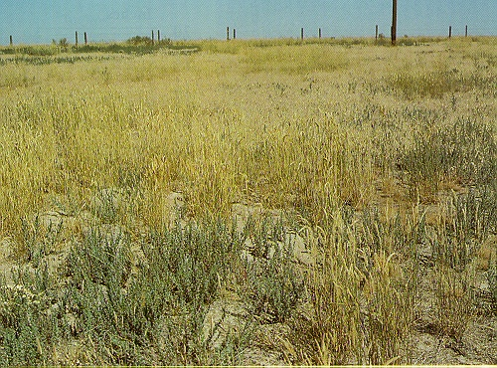
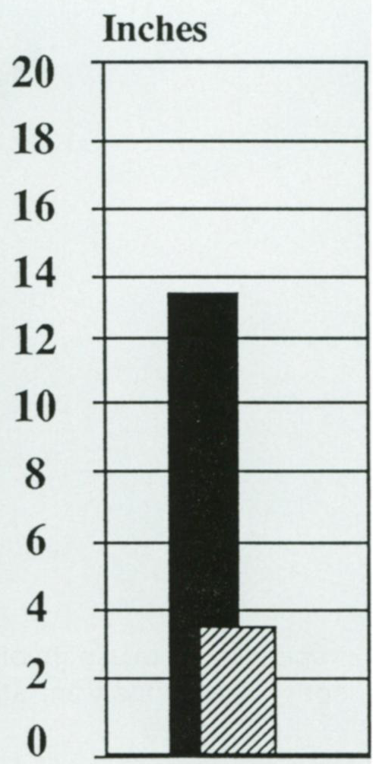
1991
Production
250 lb/acre
Notes:
1991 – Precipitation in November through April was above normal and May was well above normal. June precipitation was below normal. Crested wheatgrass seedlings were starting to appear on the alkali soils and production was up at 250 lb/acre.

