Slide 1
Objectives
To learn the basics of navigating web soil survey
Identify specific kinds of information that can be gained on web soil survey
Collect vegetation composition and biomass information for a specific ecological site

Slide 2
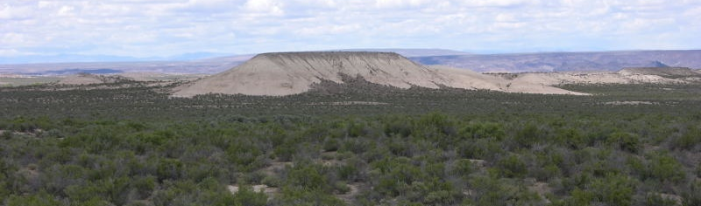
Ecological Site Composition & Biomass
With Web Soil Survey

Slide 3
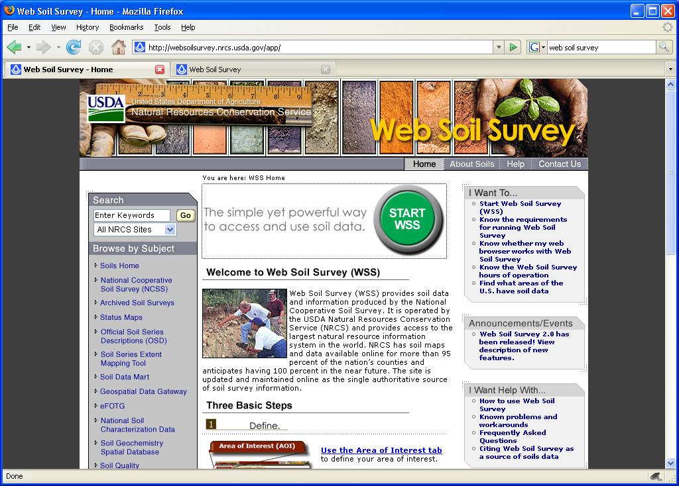
Web Soil Survey
http://websoilsurvey.nrcs.usda.gov/app/
Click on
“Start WSS”

Slide 4
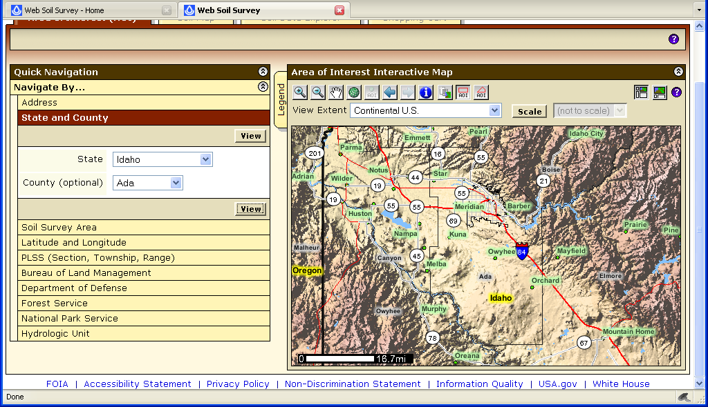
Find an Area of Interest (AOI)

Slide 5
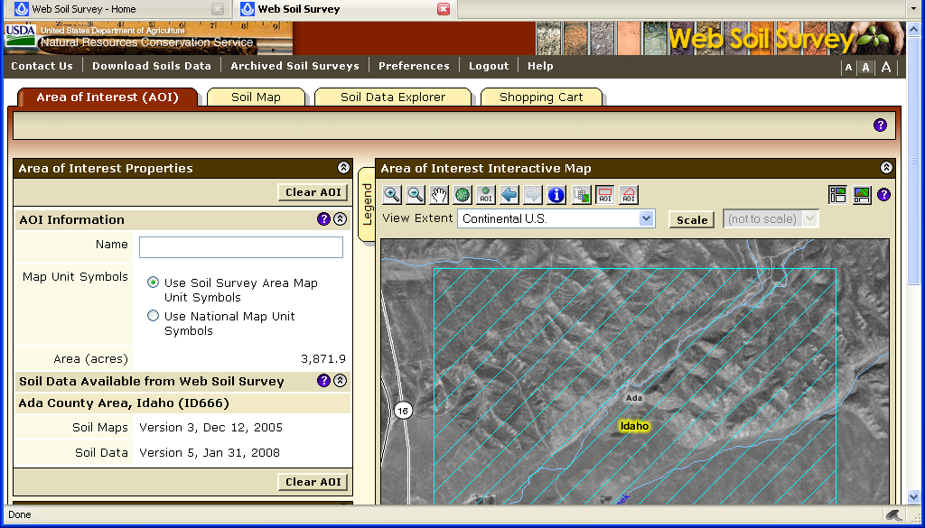
Zoom and set (AOI)

Slide 6
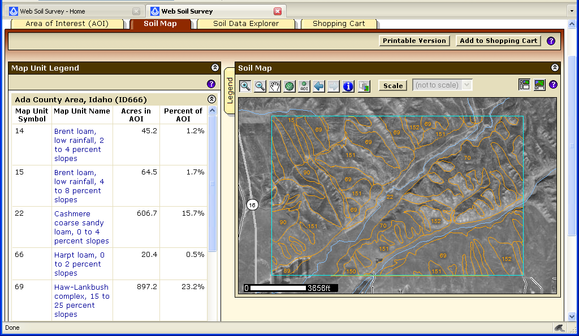
Select “Soil Map” Tab

Slide 7
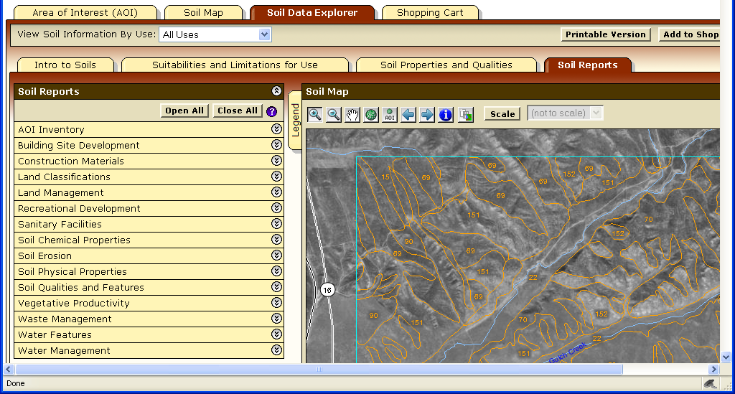
Select “Soil Data Explorer” Tab

Slide 8
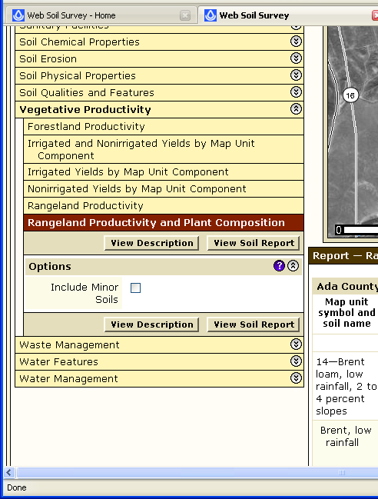
Select “Soil Reports”

Slide 9
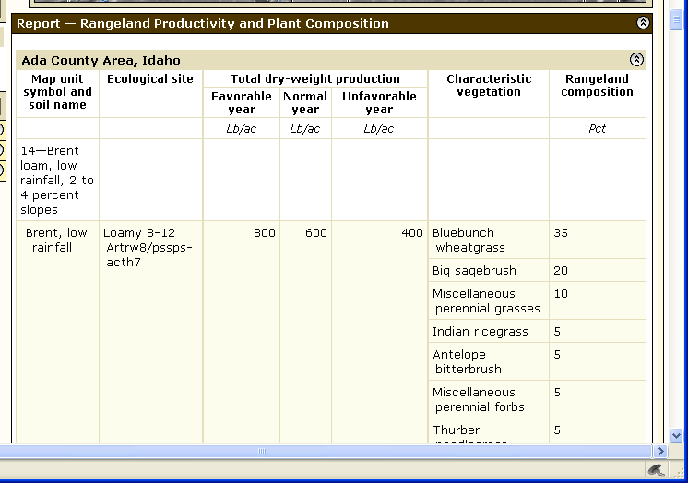
Final Soil Report of Productivity

