Slide 1
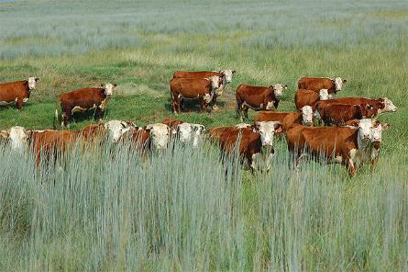
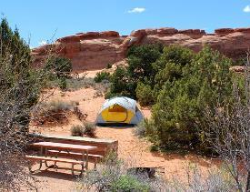
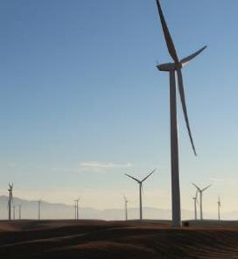

Value of Rangelands
NRCS USDA.gov
BLM.gov
Scott Flaherty USFWS
Rangeland Principles (REM 151)
Notes:
Why are rangelands important? List 5 goods or services rangeland provide.

Slide 2
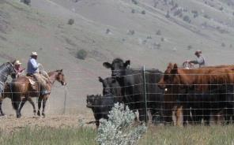

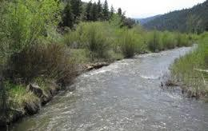
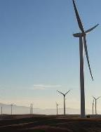
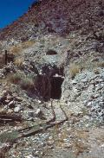
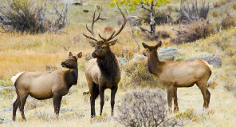
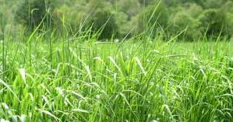
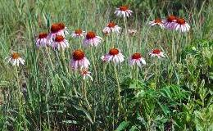
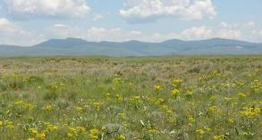
Multiple Use
There are many uses for rangelands and these uses need to be considered simultaneously.
The harmonious use of native rangeland for more than one purpose, such as livestock, recreation, wildlife, and water production (Society for Range Management 1989).
Livestock Production
Recreation
Water
Energy
Minerals
K. Launchbaugh
BLM.gov
BLM.gov
Scott Flaherty USFWS
BLM.gov
Open Space
Wildlife Habitat
Forage
Native Plants
BLM.gov
Jen Peterson
NPS.gov
NRCS.USDA.gov
Michale Haddock
Notes:
Often times when we discuss Rangeland Management and the various values of rangelands, we use the term multiple-use to describe the need to consider multiple uses or value simultaneously with care to avoid overuse or destruction of natural resources.
The Society for Range Management defines multiple use as the harmonious use of native rangeland for more than one purpose, such as livestock, recreation, wildlife, and water production.
The concept of multiple-use is at the center of many land management agencies and organization. Rangelands are used for many resources and it is not appropriate to manage for one without considering others.

Slide 3

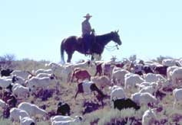
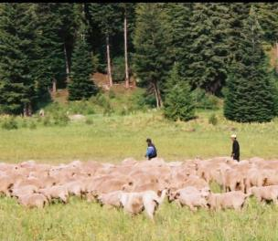
Livestock Production
Livestock production on rangeland is very important:
Supplies meat for American and World populations
Leather
Wool
Mohair
Etc.
Livestock grazing occurs on ~65% of Idaho’s total land area and in every county throughout the state.
K. Launchbaugh
Rangeland and pastureland in the 19 western states are home to about 58% of all beef cattle, 79% of sheep, and 88% of goats in the US.
Ron Daines
K. Launchbaugh
Notes:
Livestock grazing occurs on ~65% of Idaho’s total land area and in every county throughout the state. Range livestock production is one of the leading agricultural industries in Idaho (from ranchers, meat processors and plant workers, delivery truck drivers, restaurant operators, managers of supermarkets, to consumers). As of January 1, 2012, there were 2.2 million head of cattle and calves in Idaho (a value of ~2.7 billion dollar). http://www.idbeef.org/about
To put that into scale: as of Jan 1, 2017 Texas raised 12.3 million cattle/calves, Nebraska 6.45 million, and California 1.15 million (http://www.beefusa.org/beefindustrystatistics.aspx).
Rangeland and pastureland in the 19 western states are home to about 58% of all beef cattle in the US, they also harbor 79% of sheep and 88% of goats in the US.

Slide 4
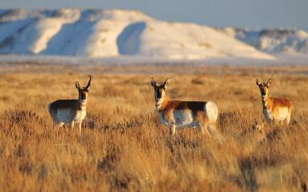
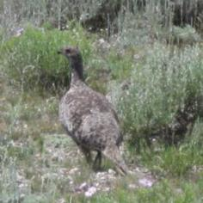
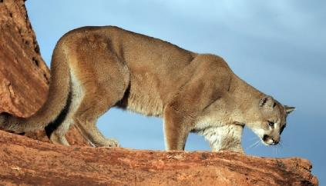
Wildlife Habitat
Rangelands provide habitat for countless mammals, birds, amphibians, fish, and insects.
Wildlife can be categorized into broad groups based on how they forage and their digestion system
Ruminants: specialized digestive systems to digest the cellulose in the cell walls of rangeland plants.
Concentrate-Selectors: find adequate diet on rangeland by carefully selecting berries, seeds, or roots low in cellulose.
Tom Koerner USFWS.gov
K. Launchbaugh
NPS.gov
Notes:
Wildlife provides both economic values (animal produces, sportsman, aesthetic), and ecological value.
Rangelands provide habitat for countless mammals, birds, amphibians, fish, and insects. Of the total number of animal species found in the US
84% of the mammals,
74% of the birds,
58% of the amphibians and
38% of the fish can be found in rangeland ecosystems sometime during their life.
Wildlife can be categorized into broad groups based on how they forage and their digestion system.
Ruminants (deer, elk, and moose) have specialized digestive systems to digest the cellulose in the cell walls of rangeland plants.
Rodent and Rabbits also have digestive systems that allow them to get energy out of cellulose.
Concentrate-selectors: are animals such as birds & bears that find an adequate diet on rangeland by carefully selecting berries, seeds, and roots low in cellulose.
Insects: can be generalist foragers or have very specific diet selection

Slide 5
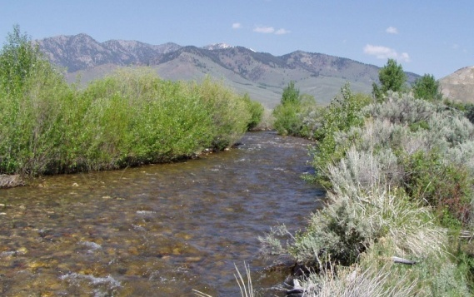
Water
In the western states, forested and alpine rangelands are the primary source of water for agricultural, industrial, and domestic use.
Julie Hankins-Smith
Soil Condition
Vegetation Complex
Quality and quantity of water available to human.
Notes:
In the western states, forested and alpine rangelands are the primary source of water for agricultural, industrial, and domestic use. The condition of the soil and vegetation complex on which precipitation falls has a major influence on the quality and quantity of water available for human use.
One of the main questions we ask as rangeland managers is: how can we improve water retention on the site, thus reducing sedimentation and improving recharge of the water table through better infiltration (how water enters the soil). When considering water and the hydrologic cycle, we have to consider environmental variables such as topography and aspect which influences a sites potential for overland flow (or erosion) when vegetation has been modified (logging or grazing practices).

Slide 6
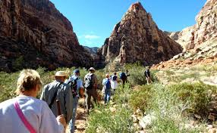
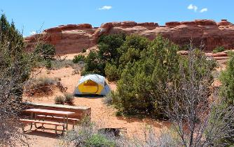
Recreation
Rangelands are increasingly important for recreational uses.
USDA National Survey on Recreation and the Environment
…demand for recreational uses on public lands across the US 1982-2009
Day Hiking
Driving off-road
Fishing and Hunting
Viewing & Photographing Birds
30 %
142%
287%
210%
BLM.gov
BLM.gov
Notes:
Rangelands are increasingly important for recreational uses, and many national parks are located on rangelands, such as: hiking, hunting, camping, mountain biking, cross-country skiing, and snowmobiling
The USDA National Survey on Recreation and the Environment conducted a survey looking at use of public lands across the US (so not rangeland specific) between 1982-2009. Take a minute to match the recreational activity with the percent increase that you believe happened over the 27 year period.
All had significant increases, however, viewing and photographing birds has the greatest increase while fishing and hunting and the smallest increase. If we look into the survey further, we can see the change in participants. When look a little further into the data (which I would always encourage you to do), you can see that although the percentages all increased, Fishing and Hunting still has the highest use out of the four recreational activities listed here.

Slide 7
Recreation
Rangelands are increasingly important for recreational uses.
USDA National Survey on Recreation and the Environment
…demand for recreational uses on public lands across the US 1982-2009
Day Hiking (210%)
Driving off-road (142%)
Fishing and Hunting (30%)
Viewing & Photographing Birds (287%)
24.3 to 75.3 million
19.1 to 46.2 million
79.8 to 104.6 million
20.8 to 80.5 million
BLM.gov
BLM.gov

Slide 8
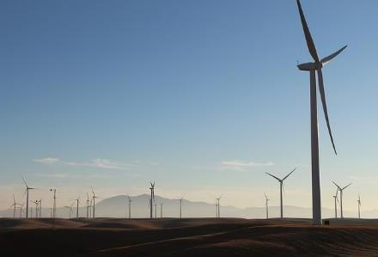
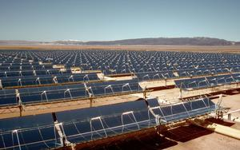
Renewable Energy
Wind
Solar
Geothermal
Biomass
Bioenergy
Scott Flaherty USFWS
USDI-BLM Photo
Notes:
Rangelands dominate much of the western half of the US, and represent a significant source of alternative energy resources. Energy is essential to sustainable development, nevertheless, energy development is controversial.
Wind energy accounts for 6% renewable electricity generated in US
Large tracks of land and high solar radiation levels create the optimal setting to capture solar energy, particularly in the desert SW.
Geothermal energy is largely produced by 12 western states (including Alaska) and powers electricity for about 1.2 million homes.
Energy from biomass is largely derived from by-products of manage, restoration, or hazardous fuel reduction treatment and bioenergy includes bio-based products such as ethanol, plastics and bio-diesel.

Slide 9
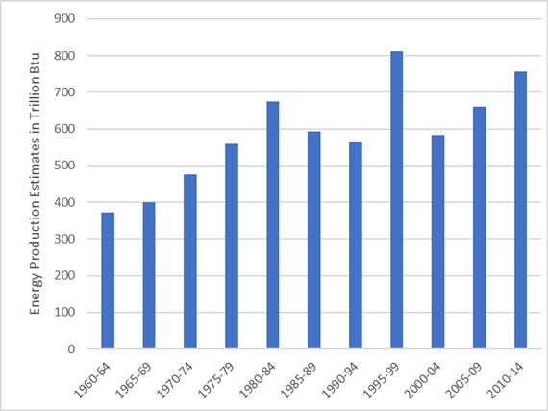
Renewable Energy
As with many land uses, trade-offs exist between costs and benefits.
Total energy consumption in Idaho in 2014 was
520 trillion Btu,
total energy production in 2014 was
155 trillion Btu.
(https://www.eia.gov/state/analysis.php?sid=ID)
Notes:
As of 2014, Idaho did not produce energy from fossil fuels such as coal, natural gas, and crude oil. Energy developed from renewable energy sources (biofuels, solar, wind, water, and geothermal) has increased by 51% since 1960.
Idaho consumes more than 3 times what was produced in Idaho in 2014.

Slide 10
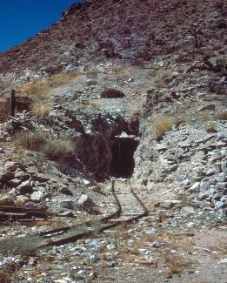
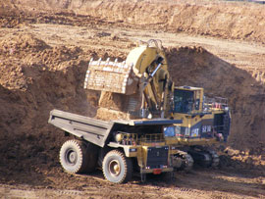
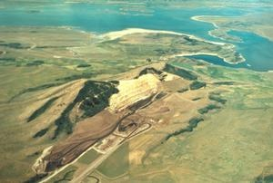
Minerals and Mining
Minerals and mining were historically important resources and are still today an important resource.
Sand, gravel, rock
Coal
Gold, silver, zinc, cobalt, phosphate
BLM.gov
www.idl.idaho.gov
BLM/Idaho
Notes:
Some of our most basic natural resources are mined from rangelands (sand, gravel, dirt, and rock are basic materials for construction and building.
Coal and oil shale mining provides resources to heat and power our society. Oil shale production is having a huge impact on rangeland in North Dakota, Montana, and Wyoming.
A wide array of mineral resources are found in Idaho:
Gold in north, central, and southern Idaho
Silver, lead, and zinc in the north
Molybdenum and cobalt in central Idaho
Phosphate in southern Idaho

Slide 11
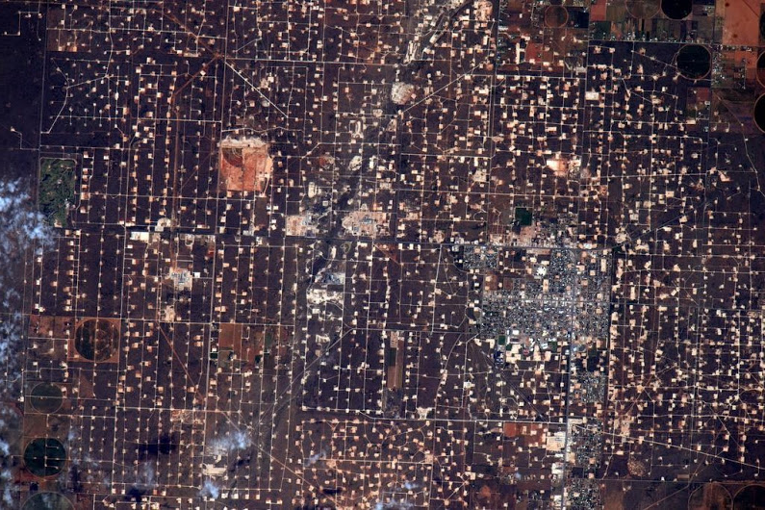
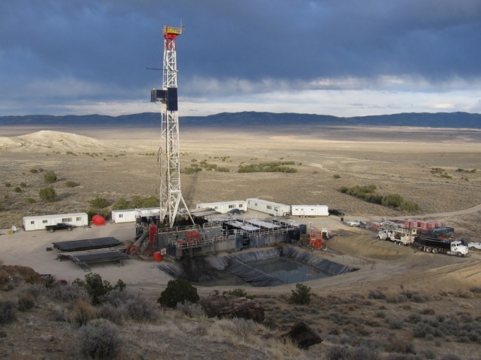
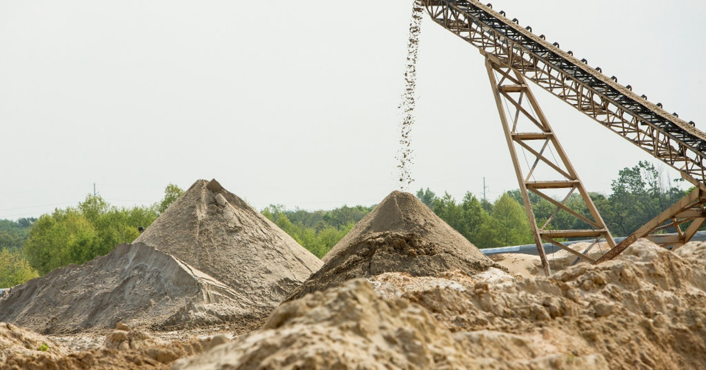
Non-renewable Energy
Relatively new use of rangelands (first well drilled in 1858)
  Crude oil
  Natural gas
  Sand mining for hydraulic fracturing (fracking)
10 Tg biomass lost between 2000-2010 (Allred et al. 2015)
  Equivalent of 5 million AUMs
blm.gov
dallasnews.com
NASA/JSC, U.S. Astronaut Scott Kelly

Slide 12
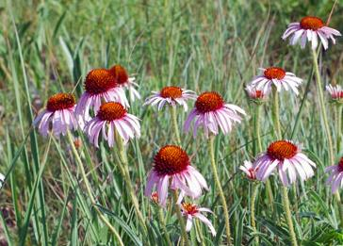
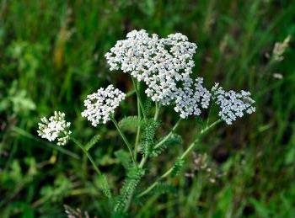
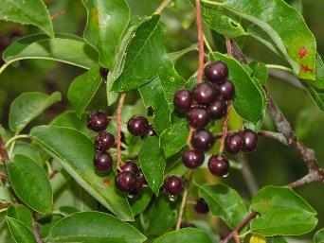
Native Plant Products
Michael Haddock
Michael Haddock
K. Launchbaugh
Historically important and still harvested today as “natural” foods and medicines
Native seed is becoming increasingly stressed in rangeland restoration
Notes:
Historically important and still harvested today as “natural” foods and medicines.
Natural Medicines (Echinacea, St. Johnswort)
A variety of wild foods (Camas, Huckleberries, Pinenuts)
Additionally, use of native seed is becoming increasingly stressed in rangeland restoration and with large mega-fires occurring often native seeds value increases.

Slide 13
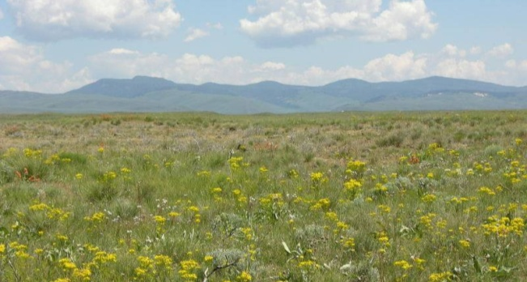
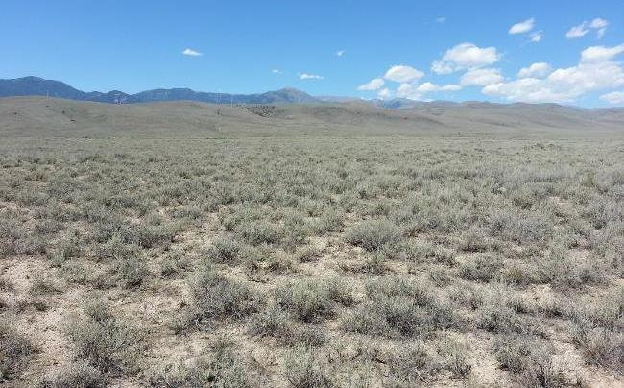
Open Space
Open space is a modern resource
“Working Wilderness”
Scenic Easements
J. Peterson
K. Launchbaugh
Notes:
Open space is a modern resource (it is unlikely many pioneers valued “open space” as much as most people do today). As our population becomes more urbanized, open space will become more valuable.
Livestock ranches are becoming “working wilderness” to maintain biodiversity and wildlife habitat quality.
Environmentally concerned citizens have paid ranchers to maintain open space through scenic easements.

Slide 14
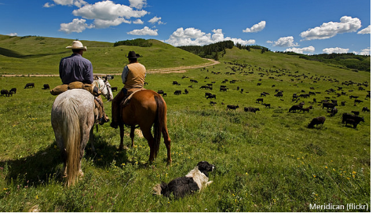
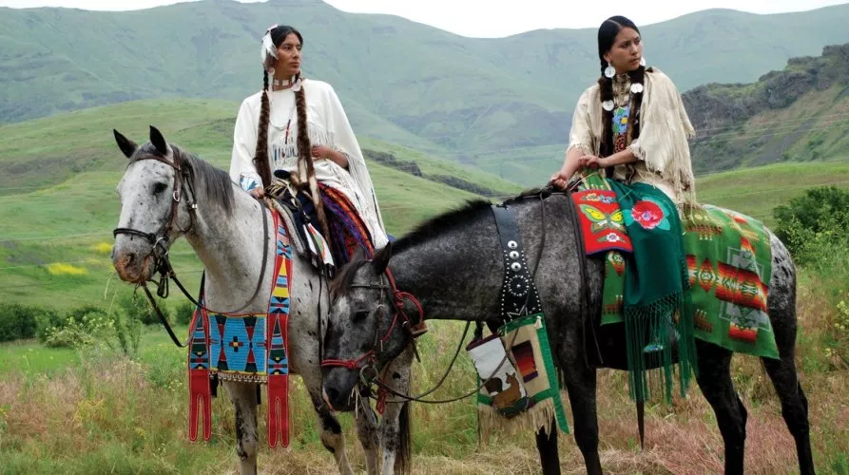
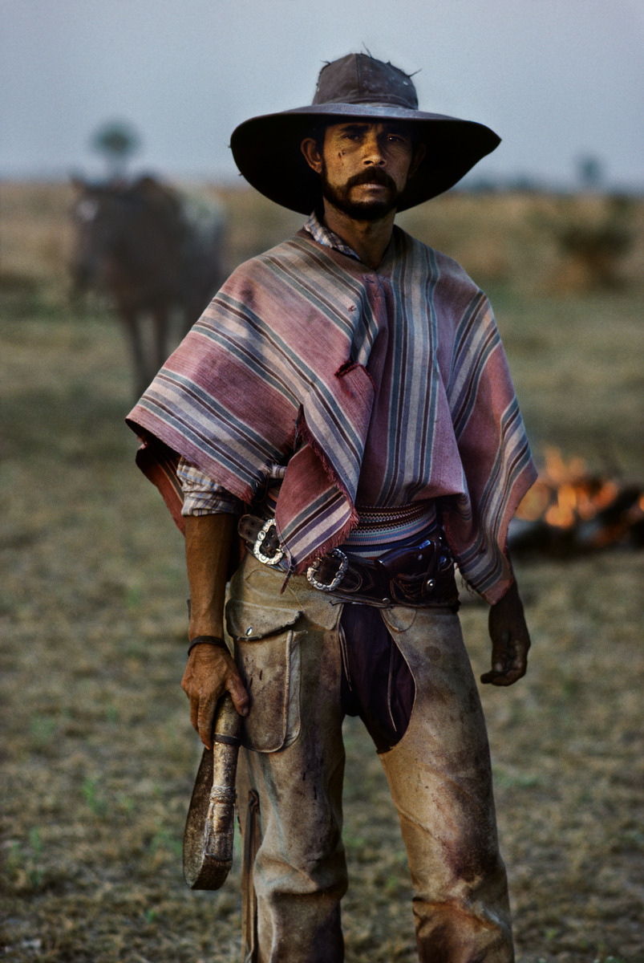
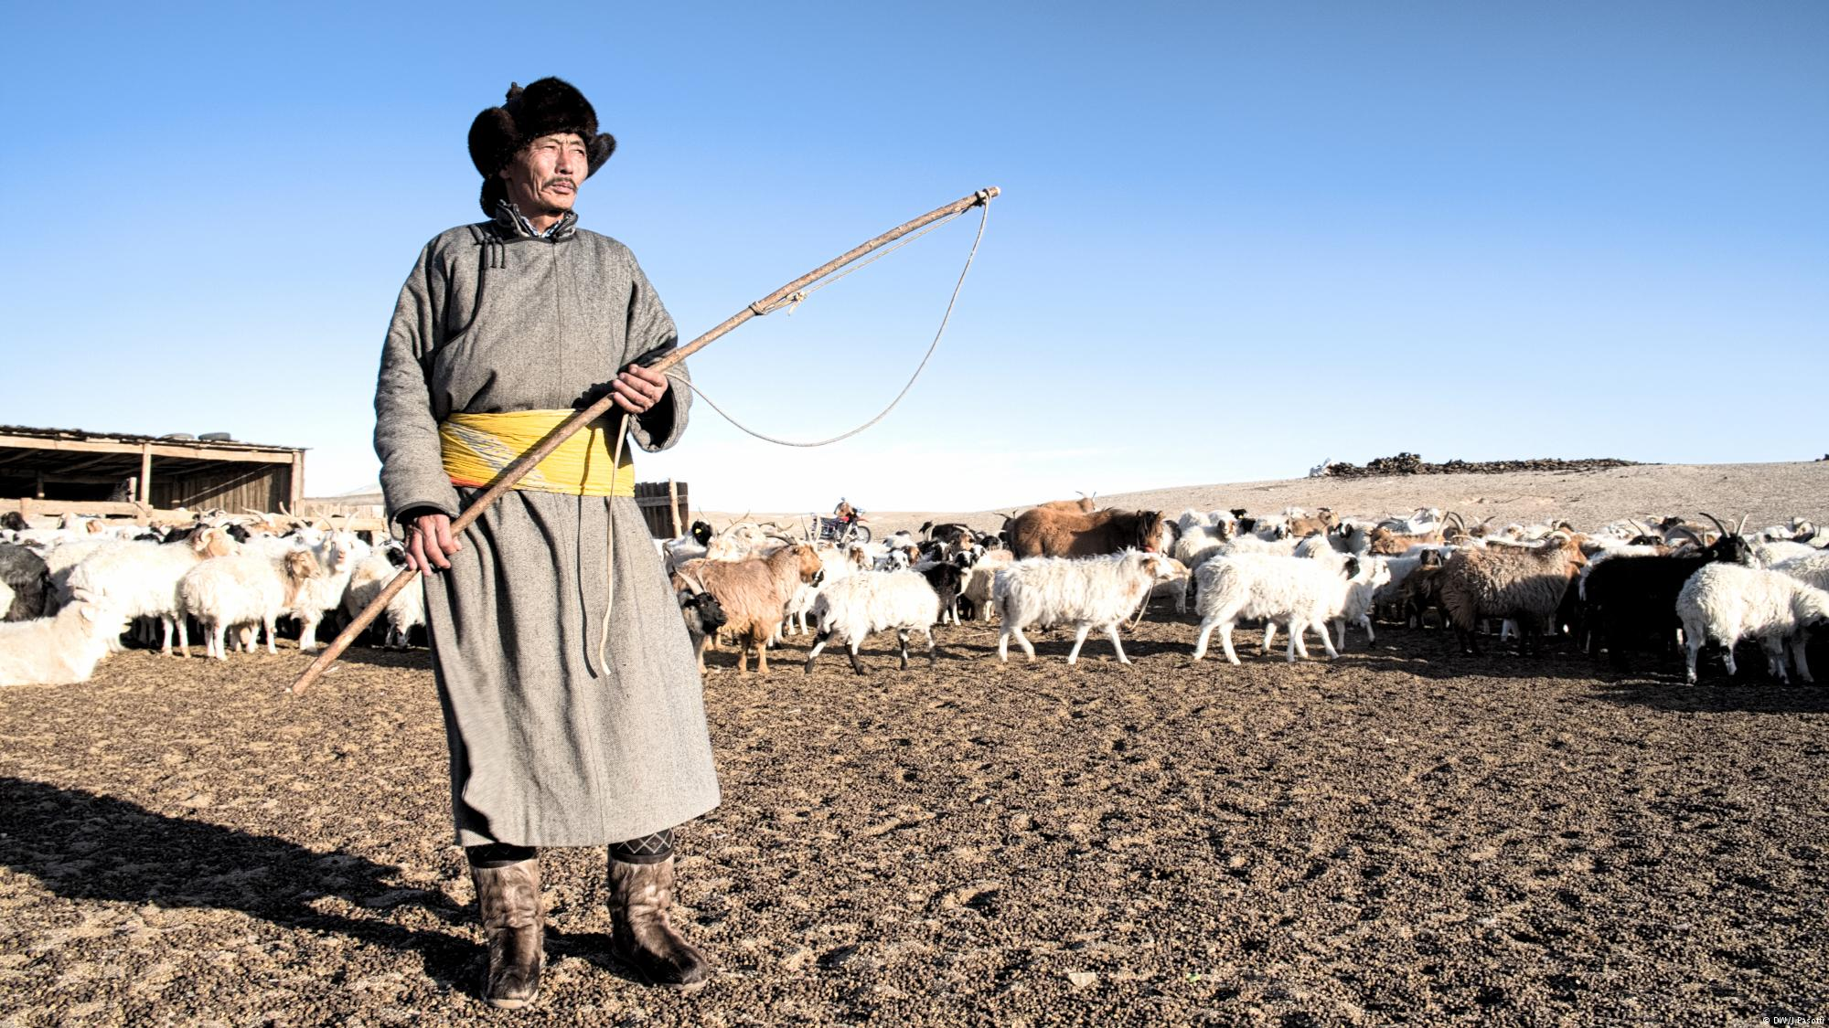
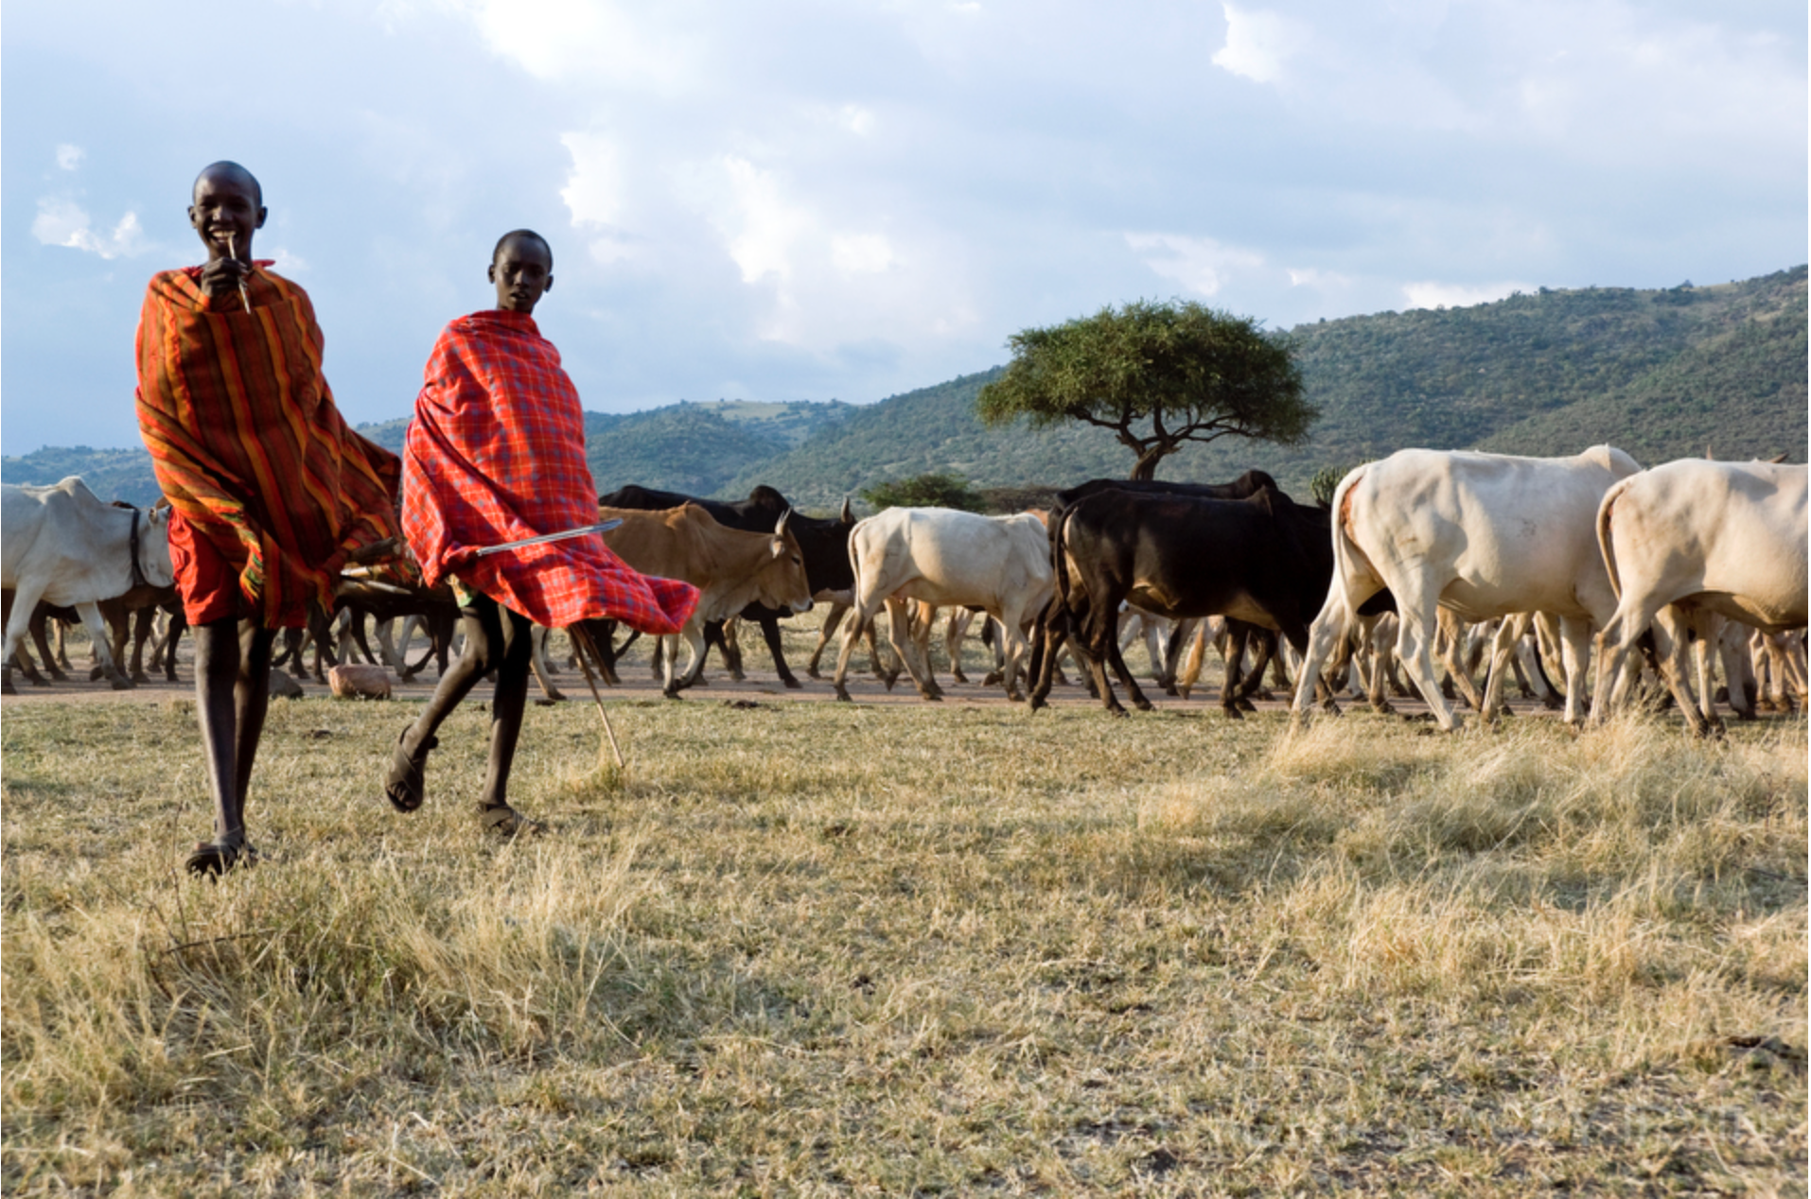
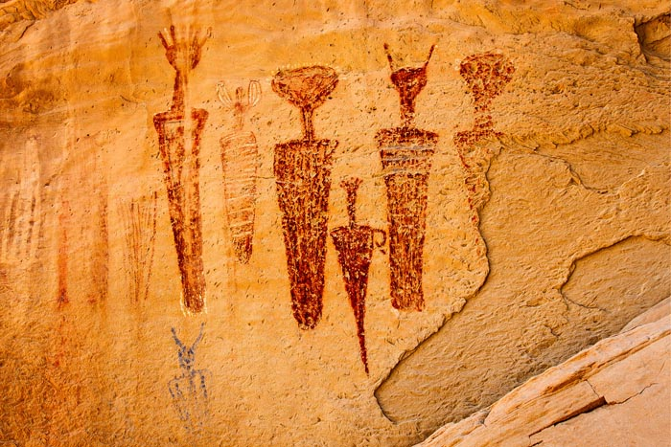
Cultural
A way of life
Historical sites and artifacts
Legacy and heritage of indigenous people
Nimiipuu
(Nez Perce)
idahoseniorindependent.com
Paraguay
Steve McCurry
Canyon Pintado, CO
Mongolia
landportal.org
Maasai
staceyirvin.com
theheraldtimes.com
Notes:
The “Western” way of life is appreciated by westerners and a draw for people from the US and throughout the world. Ranching is important to maintain the “Western Image” or “Brand” of the west (expansion, settlement, to tough western spirit). And the heritage of Native American Tribes that have a long legacy on rangelands.

Slide 15
Multiple Use on Rangelands
Social Science Research Unit (SSRU) at the University of Idaho Conducted a survey funded by the Idaho Rangeland Resource Commission
Notes:
Rangelands are managed for multiple uses to benefit the needs of society on a sustainable basis. These needs include managing wildlife habitats, water and soil conservation, livestock grazing, open spaces, energy development, urbanization, and recreation. In a study conducted by the Social Science Research Unit (SSRU) at the University of Idaho, Idaho residents were asked whether they approve or disapprove a series of specific uses that occur on public lands. Results suggest that the public values multiple uses and is interested in a balance management approach.

Slide 16
Value of Rangelands
NRCS USDA.gov
BLM.gov
Scott Flaherty USFWS
Rangeland Principles (REM 151)
Notes:
Why are rangelands important? List 5 goods or services rangeland provide.

