Slide 1
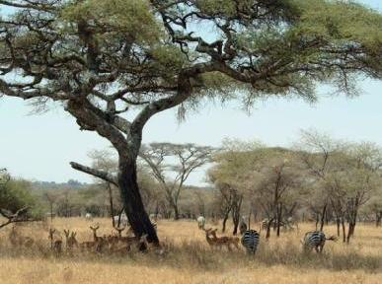
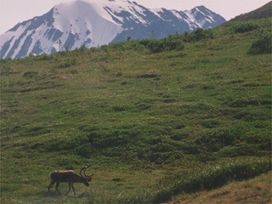
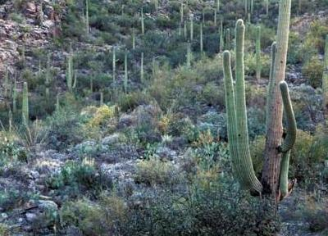
Rangelands of the World
Notes:
All photos in this presentation were taken from open source websites including EcoLibrary (http://ecolibrary.org/) , Pics4Learning (http://pics.tech4learning.com/)

Slide 2
Major World Biomes
BIOME:
Very large ecosystems recognized by major types of plants & animal communities.
Recognizable ecosystems based on predominant vegetation and adaptations of organisms to that particular environment.
Grasslands, Savannahs, Deserts, Shrublands, Forests, etc.
Notes:
Biomes are the largest recognizable unites.

Slide 3
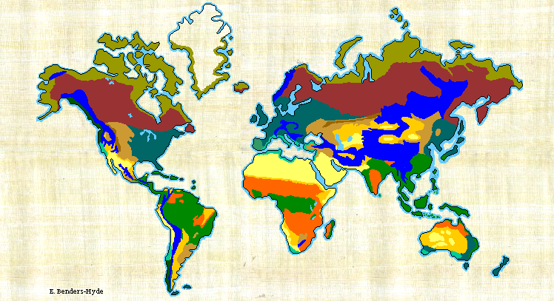
Biomes
www.blueplanetbiomes.org
Notes:
Major biomes on earth. Notes: Taiga = northern forests. Desert and Desert-Scrub are often combined to create 9 instead of 10 biomes.

Slide 4
Major World Biomes
Ecoregions:
Distinctive ecosystems that are unique types of vegetation within biomes.
867 land-based ecoregions across the globe have been mapped and defined by scientists.
http://gis.wwfus.org/wildfinder/
Similar biodiversity of flora, fauna, climate & soils.
Notes:
Ecoregions occur a smaller scale than biomes. They come about when biomes are divided into smaller units of similar vegetation.

Slide 5
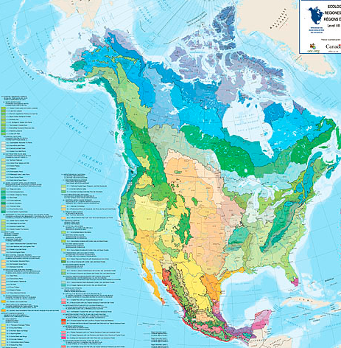
Ecoregions – More detail than biomes
Various Scales
More detail than Biomes
http://www.epa.gov/wed/pages/ecoregions.htm
Notes:
Even ecoregions occur at varying scales. This map depicts the largest scale recognized for ecoregions. At this website (http://www.epa.gov/wed/pages/ecoregions.htm) there are more classifications at finer scales.

Slide 6
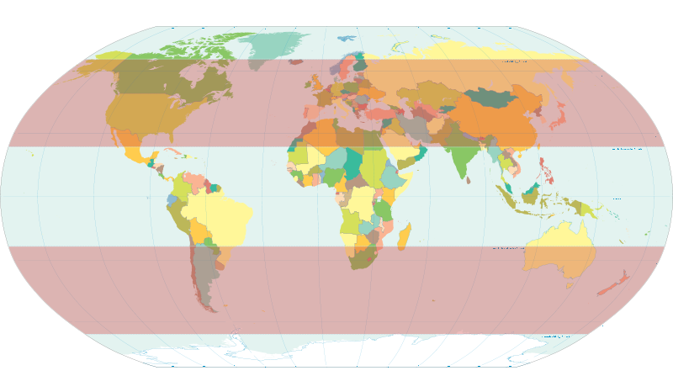
Biome & Climate Classification
Polar= Area near poles
Temperate = Areas between the tropics & polar circles
Tropical = Near equator
Polar
Temperate
Tropical
Notes:
Tropical have less seasonality and usually less diurnal variation.
Temperate region or between tropic and polar latitudes. Characterized by seasonal patterns

Slide 7
Biome & Climate Classification
Polar= Area near poles
Temperate = Areas between the tropics & polar circles
Tropical = Near equator
Polar
Temperate
Tropical
Notes:
Tropical have less seasonality and usually less diurnal variation.
Temperate region or between tropic and polar latitudes. Characterized by seasonal patterns

Slide 8
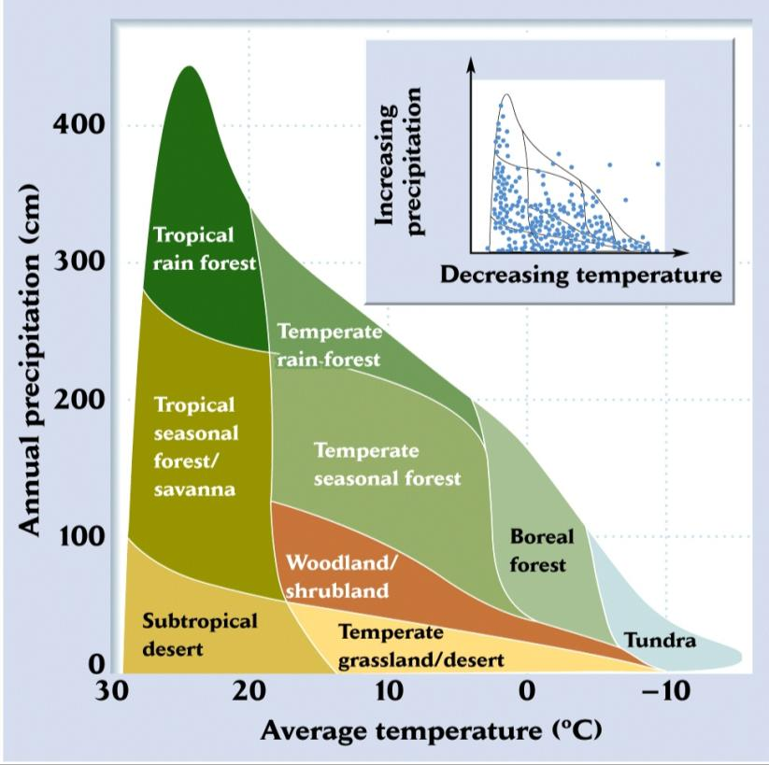
What creates different biomes?
Precipitation
Temperature
Also …
Soils
Topography
Robert Whittaker’s classification of biomes, based on annual precipitation, temperature

Slide 9
What creates different biomes?
Precipitation
Temperature
Also …
Soils
Topography
These are RANGELANDS
Robert Whittaker’s classification of biomes, based on annual precipitation, temperature

Slide 10
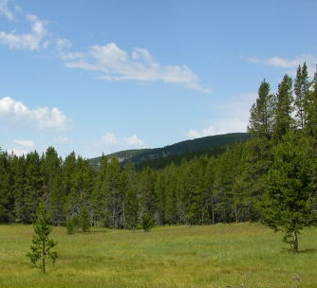
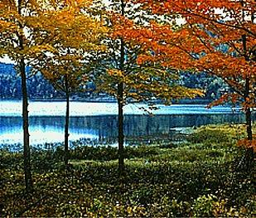
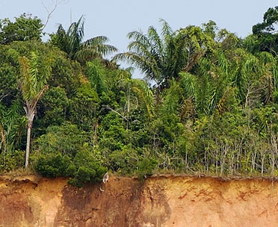
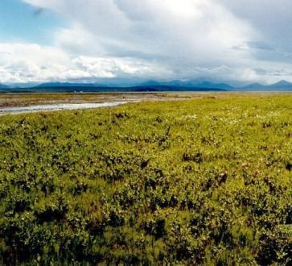
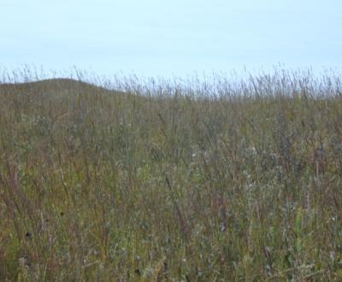
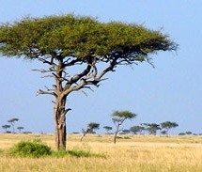
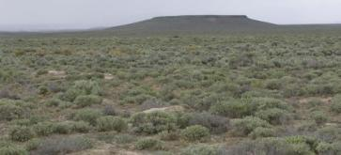
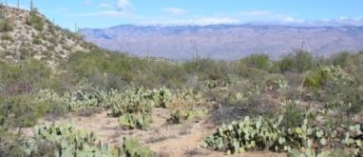
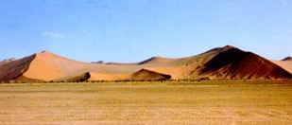
Forest
Northern Coniferous Forest
Deciduous Forest
Tropical Rain Forest
Precipitation
Grasslands
Tundra (Polar Grasslands)
Savanna (Tropical Grassland)
Temperate Grassland
Desert
Cold Desert
Temperate Desert
Tropical Desert
Temperature
Notes:
Major biomes – based on graphic depiction by G. Tyler Miller, 1990. Resource Conservation and Management. Belmont California Wadsworth Publishing Co.
Topical desert, Savanna, Deciduous Forest, and Tropical Rain Forest pictures from http://earthobservatory.nasa.gov/
Tundra picture from http://alaska.fws.gov/
Temperate grassland and temperate desert from K. Launchbaugh
Cold desert and N. Coniferous Forest compliments of Jennifer Peterson (www.cnr.uidaho.edu/range_tour/photo_search.asp)

Slide 11
Forest
Northern Coniferous Forest
Deciduous Forest
Tropical Rain Forest
Grasslands
Tundra (Polar Grasslands)
Savanna (Tropical Grassland)
Temperate Grassland
Desert
Cold Desert
Temperate Desert
Tropical Desert
Rangeland Biomes
Notes:
In this Rangeland Principles class we will focus on the driest biomes which are the Grasslands and the Desert (two bottom rows).

Slide 12
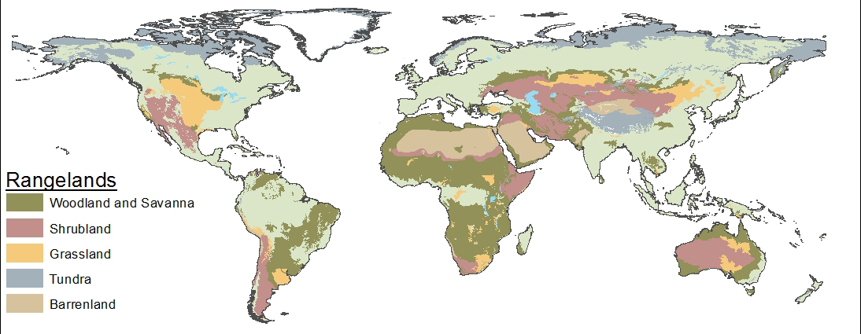
Rangelands of the World
Notes:
Map created by Eva Strand, Karen Launchbaugh, and Christopher Bernau of the University of Idaho based on a global database created by the World Wildlife Fund http://www.worldwildlife.org/science/ecoregions/item1847.html

Slide 13
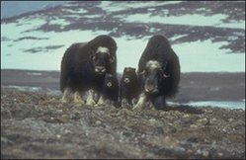
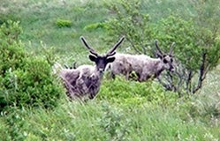
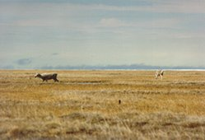
Tundra
Treeless plains characterized by low temperatures, poor nutrients, little precipitation and short growing seasons.
Arctic vs. Alpine
Notes:
Photo Credits: From http://www.eoearth.org. Musk oxen (''Ovibos moschatus''), northern Greenland (Denmark). (Photograph by Peter Schmidt Mikkelsen). Caribou (''Rangifer tarandus''), Bristol Bay, Alaska, USA. (Source: Photograph by Annette Helms)

Slide 14
Tundra
Arctic: located in the northern hemisphere, encircling the north pole and extending south to the boreal forests taiga. Noted for its permafrost soils.
Alpine: located in high mountainous altitude where trees cannot grow
Notes:
Photo Credits: From http://www.eoearth.org. Musk oxen (''Ovibos moschatus''), northern Greenland (Denmark). (Photograph by Peter Schmidt Mikkelsen). Caribou (''Rangifer tarandus''), Bristol Bay, Alaska, USA. (Source: Photograph by Annette Helms). Reindeer (Rangifer tarandus), near Tabor, Sakha Republic, Russia. (Photograph by John Lamoreux)

Slide 15
Tundra
Visit Gigapan.org to explore the Tundra
http://gigapan.org/gigapans/80659/
Notes:
Photo Credits: From http://www.eoearth.org. Musk oxen (''Ovibos moschatus''), northern Greenland (Denmark). (Photograph by Peter Schmidt Mikkelsen). Caribou (''Rangifer tarandus''), Bristol Bay, Alaska, USA. (Source: Photograph by Annette Helms). Reindeer (Rangifer tarandus), near Tabor, Sakha Republic, Russia. (Photograph by John Lamoreux)
The suggested gigapan site requires an internet access. But, it is a great site.

Slide 16
Tundra
Large herbivores, such as musk oxen, caribou, and reindeer are well adapted to survive in these harsh climates.
Musk Oxen in Greenland
Caribou in Alaska
Reindeer in Russia
Notes:
Photo Credits: From http://www.eoearth.org. Musk oxen (''Ovibos moschatus''), northern Greenland (Denmark). (Photograph by Peter Schmidt Mikkelsen). Caribou (''Rangifer tarandus''), Bristol Bay, Alaska, USA. (Source: Photograph by Annette Helms). Reindeer (Rangifer tarandus), near Tabor, Sakha Republic, Russia. (Photograph by John Lamoreux)

Slide 17
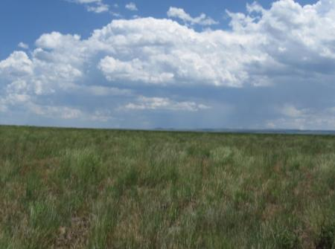
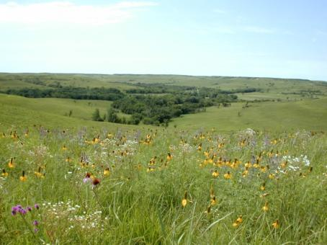
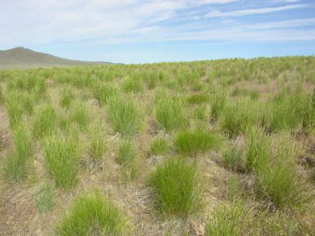
Grasslands
Vegetation is dominated by grasses and other non-woody (herbaceous) plants
Occur on all continents except Antarctica
Temperate vs. Tropical
Notes:
Dominated by grasses – herbaceous or non-woody plants well adapted to grazing and fire.

Slide 18
Grasslands
Steppe: grassland plain without trees
Cold Steppe: Eurasian Steppe (spans southwest Russia and Central Asia), Patagonian Steppe (Argentina), Anatolia (Turkey), Pannonian Plain (Central Europe), Puszta (Hungary), South Island (New Zealand)
Notes:
Photos: Chimbulak, Kazakstan (Photograph by Perry Tourtellotte)

Slide 19
Grasslands
Steppe Cont…
Subtropical Steppe: Pampas (South America), Europe (parts of Sicily, Spain and Greese), Asia (fringes of Thar Desert), and Australia (surrounding deserts)
Notes:
The term “steppe” means grasslands or extensive plains without trees

Slide 20
Video Feature: Mongolian Steppe
http://www.youtube.com/v/TqQ76EPP5Rg&feature=related

Slide 21
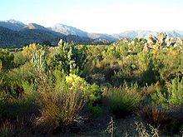
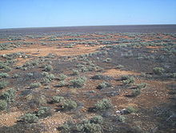
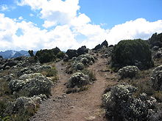
Shrublands
Plant community dominated by shrubs
Can be the mature vegetation type or a transitory vegetation type as the result of disturbance such as fire, logging, or overgrazing
Notes:
Shrublands can be dominated by shrubs. But, also can be transitional between grasslands and forests.

Slide 22
Shrublands
Xeric vs. Mesic
Notes:
Xeric means “dry” and mesic means “moderate” in terms of moisture.

Slide 23
Shrublands
Xeric vs. Mesic
Xeric: Related or adapted to a dry climate. Loss of moisture due to evapotransporation exceeds moisture received as rainfall.
Mesic: Moderate or well-balance supply of moisture.
Notes:
Detailed definition. Evapotransproation = amount of moisture lost by evaporation from leaf surfaces and soil and transporation from plants. In this case, evaporation is not “actual” evaporation. It is “potential” evaporation when water is placed in a pan and the amount evaporated each day is measured.

Slide 24
Shrublands
Desert Shrublands: plants have small leaves to limit water loss (Xeric)
Mediterranean Shrublands: Occur in Mediterranean climates of the world, commonly near the sea (Mesic)
Examples: Garrigue in France, Phrygana in Greece, tomillares in Spain, and batha in Israel.
Notes:
Shurbland types occur in both xeric and mesic ecosystesm.

Slide 25
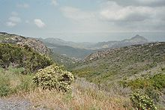
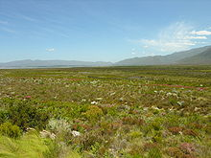
Shrublands
Matorral in Chile and southern Spain
Maquis in France and elsewhere around the Mediterranean
Macchia in Italy
Fynbos in South Africa
Kwongan in Southwest Australia
Notes:
Shrubland have a huge variety of names across the globe. They all share the same dominance by shrubs.

Slide 26
Savanna
YouTube on Savannas
www.youtube.com/watch?v=Tuk-JW-wng0
Notes:
Vast expanses of grasslands

Slide 27
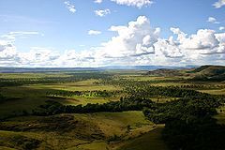
Savanna
A type of tropical grassland with scattered trees or an open canopy of trees
Characterized by high temperatures, seasonally dry in winter and summer with abundant rain the rest of the year
Frequently a transition zone between forest and desert
Notes:
Vast expanses of grasslands

Slide 28
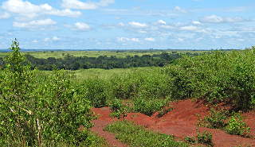
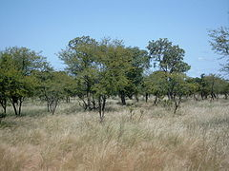
Savanna
Wide belt along equator beyond tropical rainforests
Two common factors of all savanna ecosystems:
Notes:
Overstoy of trees with understory of grass

Slide 29
Savanna
Wide belt along equator beyond tropical rainforests
Two common factors of all savanna ecosystems:
Varying Rainfall
Dry Season Wildfires
Notes:
Wildfires are very important to maintain grasses in the understory and the tall trees are not damaged by the cool ground fires.

Slide 30
Savannas
Tropical and subtropical savannas
Equatorial savannas (Serengeti of Africa)
Temperate savannas
Mid-latitude savannas with wetter summers and drier winters.
Montane savannas
high-altitude savannas,
highland savannas of the Angolan Scarp
Notes:
Savannas through the world

Slide 31
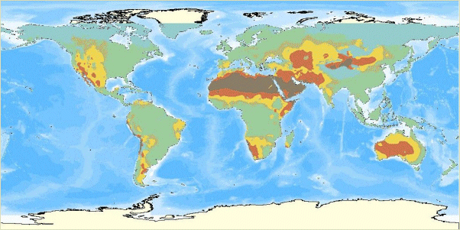
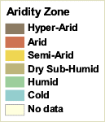
Deserts
Map published by World Resources Institute.
Notes:
Semi-arid = characterized by rainfall receiving low annual rainfall from 9.8 inches (250 mm) to 19.7 inches (500 mm) per year. The amount of annual rainfall that creates a semi-arid climate depends on temperature of the region.
Arid = characterized by lack of rain. Arid climates are characterized by generally low precipitation (usually less than 7.9 inches/year) and high evaporation.
Hyper-arid would then be < 7.9 inches (or 200 mm)/year.
Based on Köppen classification: www.meteorologyclimate.com
Map from WRI. 2002. World Resources Institute. Drylands, People, and Ecosystem Goods and Services: A Web-based Geospatial Analysis.Available online at: http://www.wri.org
http://www.wri.org/publication/drylands-people-and-ecosystem-goods-and-services

Slide 32
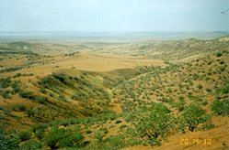
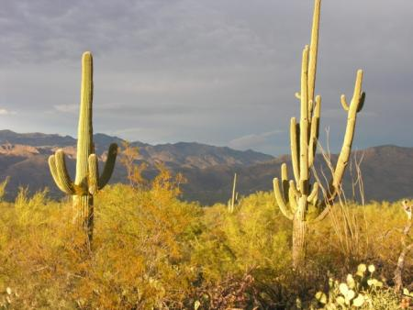
Deserts
Can occur as desert grasslands, desert shrublands, or barren land.
Arid vs. Semi-Arid
Notes:
Not all deserts are “hot.” The sagebrush steppe and salt-desert shrubland regions of North America are called “cold” deserts

Slide 33
Deserts
Cool deserts and temperate deserts are categorized as rangelands
Arid vs. Semi-Arid
Arid: Characterized by severe lack of available water – lack vegetation
Semi-Arid: Lack of precipitation is not extreme
Notes:
All deserts are dry. But, some are drier than others.

Slide 34
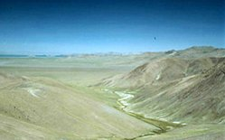
Deserts
Examples:
Nearctic realm (Newfoundland, Greenland, Russia, Europe and northern Asia)
Gobi in Syberia
Notes:
Deserts occur across the earth and have various names.

Slide 35
Rangelands of the World
Notes:
All photos in this presentation were taken from open source websites including EcoLibrary (http://ecolibrary.org/) , Pics4Learning (http://pics.tech4learning.com/)

