Slide 1
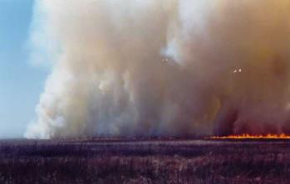
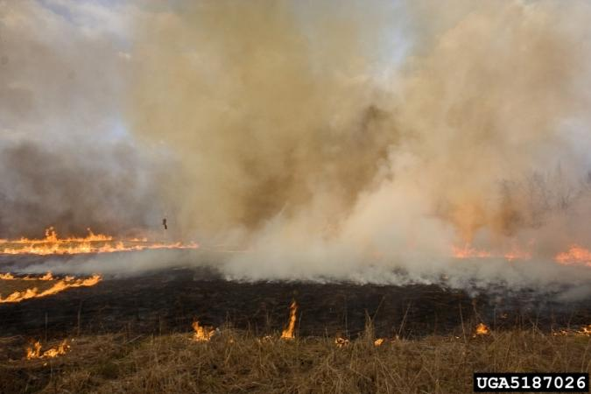
Land management and Response to Fire
Dr. Stephen Bunting and Lovina Roselle
Rangeland Center, University of Idaho
Notes:
U-Idaho Rangeland Center. http://www.uidaho.edu/range

Slide 2
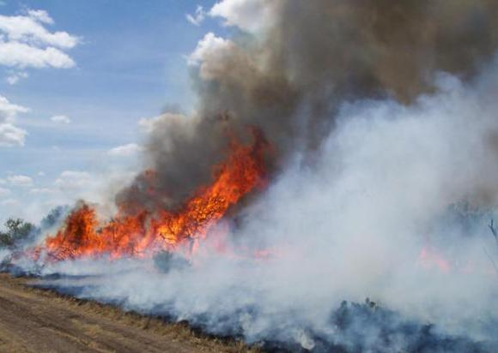
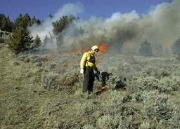
Types of Fires
Wildfire
Wildland Fire Use
Prescribed Fire
Photo: US Geological Survey
Photo: Sagebrush Sea
Notes:
Three types of fires on rangelands:
Wildfire started by lightening or by humans
Prescribed Fire – intentionally set under specific conditions
Wildland Fire Use – unintentional ignition, but not suppressed because it meets guidelines in wildland fire plan.
Exact terminology changes from time to time. But, the concept stays the same

Slide 3
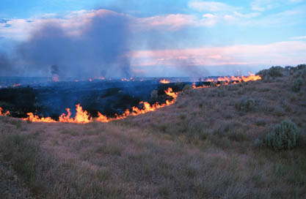
Factors that Influence Recovery
Fire characteristics
fire intensity
burn severity
duration of combustion
time of the year
Environmental Factors
time since the last fire
pre-fire weather
post-fire weather
post-fire animal use
plant competition
Plant Characteristics
adaptations to fire
mechanisms of recovery
growing season
age
Photo: Mike Munts, NPS.gov
Notes:
Recovery after fire is influenced by:
Fire Characteristics – Fire intensity is how much the fire changed the community but burn severity reflects the damage to plants and the plant community.
Environmental Factors – conditions before and after fire affect recovery.
Plant Characteristics – plants vary in how well they are adapted to fire and how they respond.

Slide 4
Principles of Fire Effects
Plant Mortality
Depends on temperature and duration
Some plant tissue can survive up to 140° F (60° C)
Growing points heat sensitive
Especially while actively growing compared to dormant
Plant adaptations include:
Bark
Bud scales
Buried growing points
Note: Plants can die from1st and 2nd order effects
Notes:
In an ideal world, plants that we don’t want would die and those that we want would live. But, it is more complex than this.
Plant, just like us, can handle some level or heat – but it depends on time. For example, we can put our hand it water that is 140 F, but we can’t leave our hand in hot water for very long.
First order effects are the direct result of the fire … when the fire is actually burning or smoldering.
Second order effects are the complicating factors such as being grazed after fire, drought after fire or susceptibility to disease.

Slide 5
Principles of Fire Effects
Crown mortality
Depends on structural and physical characteristics
Crown density & size
Crown = base of the plant where stems arise.
Crown characteristics affect fire intensity
Ratio of live to dead of leaves and stems
Location of buds relative to surface fuels
Flammable foliage
Some trees and shrubs contain flammable compounds that allow foliage to burn more readily
Notes:
Plant characteristics that affect mortality of the crown of the plant. (Crown is area the soil surface where stems and roots meet).
Some plants accumulate dead material at the crown and increase temperature at the crown. For example, plants in the chaparral region can accumulate significant amounts of dead material

Slide 6
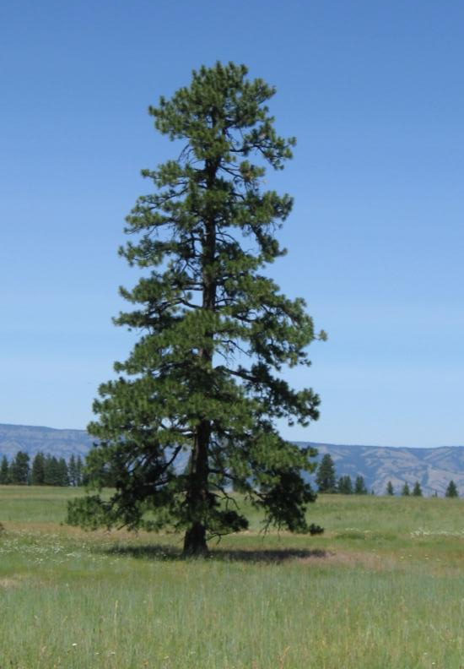
Principles of Fire Effects
Stem mortality
Cambium layer heating
Layer beneath bark
Kills trees and shrubs
Cambium and buds affected by:
Bark thickness
Bark texture
Presence of wounds or pitch
Fuel at plant base
Photo of Ponderosa Pine by K. Launchbaugh
BLM
Notes:
Ponderosa Pine has characteristics making it well adapted to fire.

Slide 7
Principles of Fire Effects
Root mortality
Greatest loss of lateral roots near the surface
Roots in organic layers more likely to be consumed or lethally heated
Burn severity good indicator of root mortality
Soil moisture affects penetration of heat
Notes:
Fuel levels and moisture near the surface affect heating and death of roods.
Soil moisture takes longer to heat up than a dry soil, but it holds heat longer so it will affect root morality.

Slide 8
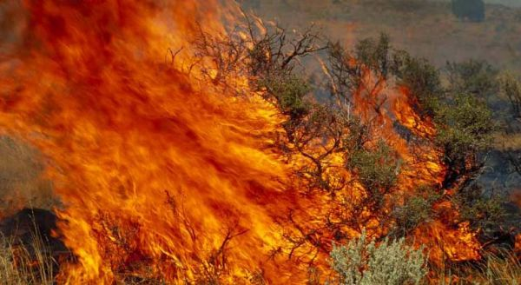
Fire Characteristics - Influence Recovery
Fire Intensity
Rate of heat release per linear foot
Burn Severity
Assessment of heat pulse toward the ground for effect on herbaceous plants and soil. But, heat upward may have stronger effects on shrubs and trees.
Season of fire
Higher temps affect fire severity
Duration
Related to fuel properties
Fire pattern
Seed sources
BLM
Notes:
Fireline intensity describes the fire in terms of energy release
Burn severity is the term that qualitatively describes classes of surface fuel and duff consumption. Fire pattern can change seed sources.
Duration is most closely related to type and density of fuel. Really dense fuels are difficult start, but burn longer and hotter.
How the fire affects seeds depends on the type and location of seed. Seed or plant propagules can come from on plants or on top of soil surface, below soil, from surrounding areas.

Slide 9
Fire Characteristics - Influence Recovery
Sprouting ability is strongly related to burn severity
Low severity fire = highest chance sprouting
Few reproductive parts are damaged (stolons, stem buds)
Moderate severity fire = sprouting from below duff or soil
Kills or consumes plant structures in litter (stolons, shallow rhizomes, buds at root crowns)
High severity fire = significant soil heating greatly reduces sprouting
Can destroy reproductive parts both above and below ground (sprouting can only occur from deeply rooted parts)

Slide 10
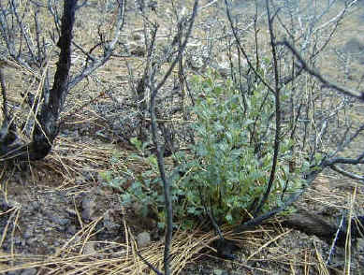
Plant Characteristics - Influence Recovery
Vegetative Regeneration = sprouting
Depending on the plant, sprouts can be above ground or below litter, duff, or soil
Sprouting stimulated chemically or by light
Varies with plant age
Notes:
Some plants sprout from base. Others do not. This determines how well an individual will survive the fire.

Slide 11
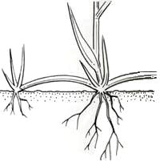
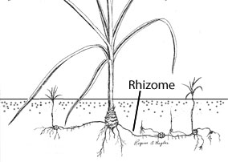
Plant Characteristics - Influence Recovery
Vegetative Regeneration = sprouting
Buds located on laterally growing stems
Stolons: aboveground stems
Rhizomes: below ground stems
Buds located in tissue of crown (rabbitbrush, bitterbrush)
Buds located on roots (aspen, horsebrush, fireweed)
Images from: www.ipm.ucdavis.edu/PMG/WEEDS/ID/sedroots.html
Notes:
Images from UC IPM online http://www.ipm.ucdavis.edu/PMG/WEEDS/ID/sedroots.html
Stolons more susceptible than rhizomes. Bud, sod forming grasses are generally more able to survive fire than those that do not have rhizomes and stonlons.
Stolons are more susceptible than rhizomes during the fire, but stoloniferous plants can spread more quickly after a fire.
Buds located in tissue of upright stems
Above ground (e.g. rabbitbrush, bitterbrush)
Below ground (e.g. serviceberry, ninebark)
Buds located on roots
E.g. aspen, fireweed, horsebrush

Slide 12
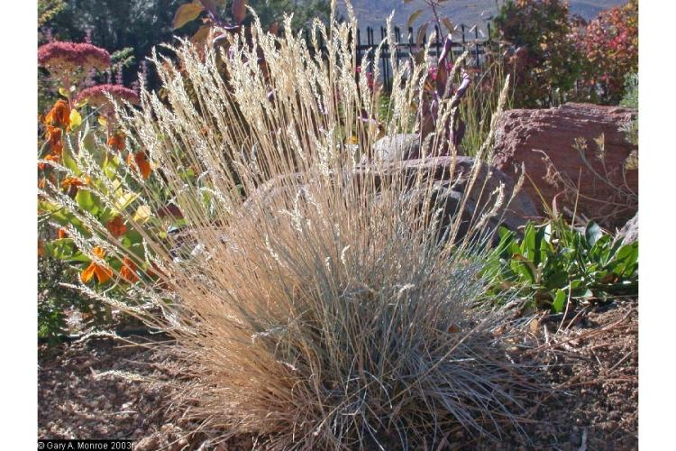
Plant Characteristics - Influence Recovery
Grass type affects intensity and duration of fire
Bunchgrasses have accumulation of dense culms at the base
Extended smoldering can cause mortality
Notes:
Sodgrasses generally more able to survive fire than bunchgrasses.
Fire is generally more lethal to very dense bunchgrasses than bunchgrasses with fewer stems that are more widely spaced.

Slide 13
Seedling establishment after fire
Seedbed requirements
Exposed mineral soil
Soil microsites
Benefits of fire:
May volatilize allelopathic chemicals
Some nutrients become more available
Ash
Soil
Fire enhanced seed production (pinegrass, wiregrass)
Notes:
Seedling vary widely in how they respond to fire. Nearly every plant has a different relationship to fire and how fire affects seeding establishment.
Fire is one way we can create microsites for plants that need bare soil to establish.
Pinegrass is a plant from northern areas that a stimulated by fire. Wiregrass is a grass from the southeast almost never produce seeds unless

Slide 14
Seedling establishment after fire
Seedbank = supply of seeds on a site
Includes buried seeds, those stored in canopy, and seeds deposited annually
Seed longevity varies by species
Seed dispersed by wind, animals, or rain and snow
Seed dispersal from unburned areas depends on:
Amount of available seed
Distance from the seed source to burned area
Prevailing wind direction
Type of seed transport mechanism
Notes:
The characteristics of the seeds determine if it can establish after fire.

Slide 15
Factors that influence recovery - Climate
Pre-fire Climate
Available fuels influenced by pre-fire climate
Drought, high winds, low humidity all affect fire climate
Post-fire Climate
Affects plant survival
Plants must restore carbohydrate reserves
Restoration occurs when photosynthesis exceeds demands for growth and respiration
Primary factor for determining range readiness for post-fire grazing
Notes:
Weather = warmer soil conditions may increase sprouting after a fire.

Slide 16
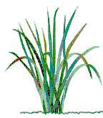
Factors that influence recovery - Carbohydrates
Degree of regrowth depends on survival of photosynthetic material
Clipping study
Recovery of grass – based on growing points remaining, not carbohydrate level at time of defoliation
What is one major difference between fire and grazing?

Slide 17
Factors that influence recovery - Competition
Competition = growth and reproduction of one plant is hampered by another; or resources required by one plant are reduced by another
Depends on:
timing of germination and growth
germination and establishment requirements
rate of growth
requirements for water and nutrients
reproduction method
Examples of plants with competitive advantages?

Slide 18
Factors that influence recovery - Competition
Fire effects competition by:
changing the numbers and species of existing plants
altering site conditions
inducing a situation where many plants must re-establish on a site
Advantages of perennial plants vs. seedlings and annual plants
Lack of fire can also increase competition
Notes:
Plants that are well adapted to fire have a competitive edge

Slide 19
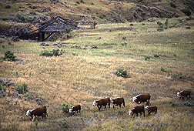
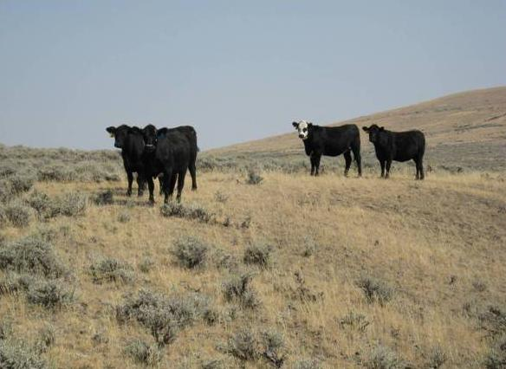
Pre-fire management- Prescribed fires
Management of fuels
Photo: USDA ARS
Photo: USDA NRCS
Notes:
Livestock to grazing can be applied in specific areas to reduce fuels on the landscape.

Slide 20
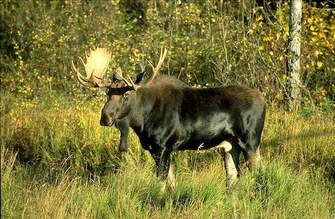
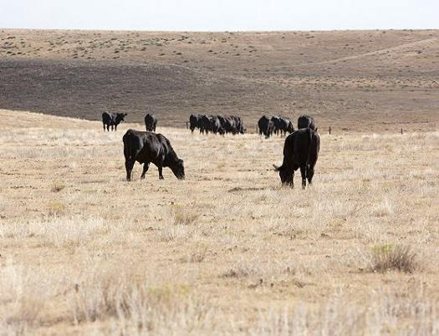
Post-fire management
Management of herbivory
Wildlife
Livestock
Photo: Alaska Dept Fish & Game
Notes:
Fairly easy to control livestock grazing after fire. Land management agencies have policies on how soon a pasture can be grazed after fire.
Wildlife are more difficult to control.

Slide 21
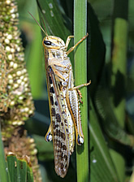
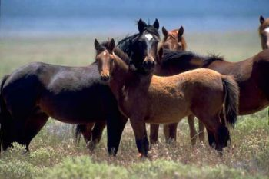
Factors that influence recovery – Animal use
Post-fire animal use
Grazing animals attracted to burned areas
Vegetation is more accessible, palatable, and nutritious
Photo: USDA ARS
Photo: USDI BLM
Notes:
Vegetation after a fire has higher protein, lower structural carbohydrates, lower lignin. In general burned areas have more nutritious plants and animals (wild and domestic) are attracted to these areas.

Slide 22
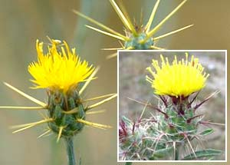
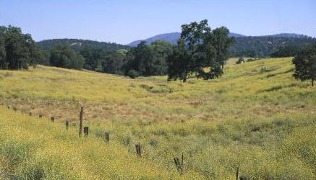
Post-fire management
Management of herbivory (livestock, wildlife)
Monitor for and control invasive species
Photo: US National Park Service
Photo: Joseph DiTomaso, UC Davis
Notes:
Some plants are stimulated by fire. Others can be controlled by fire.

Slide 23
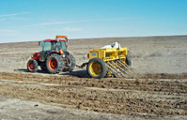
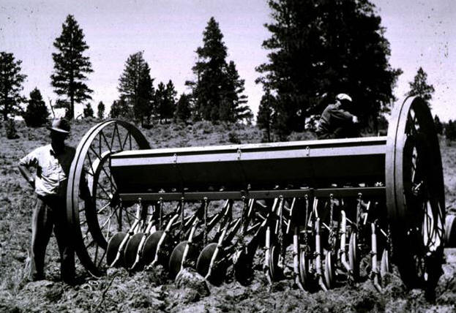
Post-fire management
Management of herbivory (livestock, wildlife)
Monitor for and control invasive species
Reseeding and soil erosion control measures
Photo: USDA Forest Service
Photo: Rangeland Technology and Equipment Council
Notes:
Most post-fire revegetation is conducted to reduces subsequent soil erosion.

Slide 24
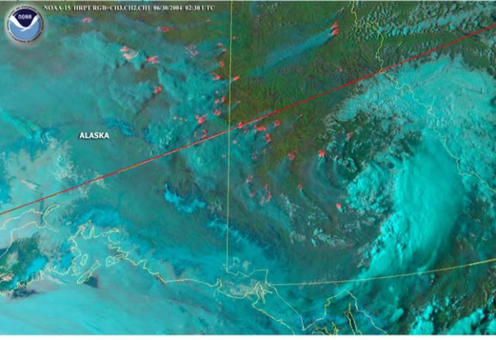
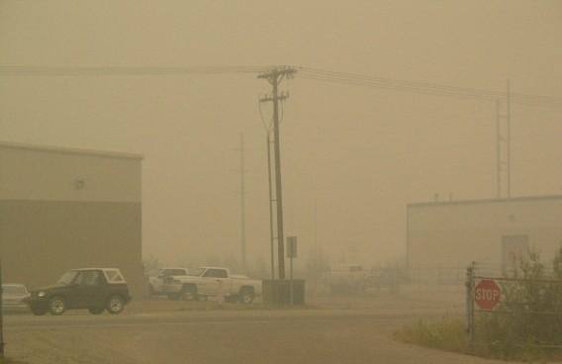
Other fire management issues
Sensitive species
Smoke (air quality)
Agency and personal risk
Lousy weather
Photo: NOAA
Photo: Alaska Division of Air Quality
Notes:
Air quality, weather, and person risk influence weather a fire is allowed to burn or if a prescribed fire can be conducted and whether a fire is allowed to burn.

Slide 25
Living with wildfire?
Learn to use prescribed fire
Prepare for wildfires in terms of personnel
Plan for wildfire occurrence and condition – long term based on environmental conditions.
Communication and education people to accept wildfire
Establish relationships for managing wildfire across land ownerships.
Notes:
How do we learn to live with fire in terms of land management?

Slide 26
Wildfire and Wildlife
www.youtube.com/watch?v=CjCkMqzHlf0&list=PL5A268F0CA7807D00&index=25&feature=plpp_video

Slide 27
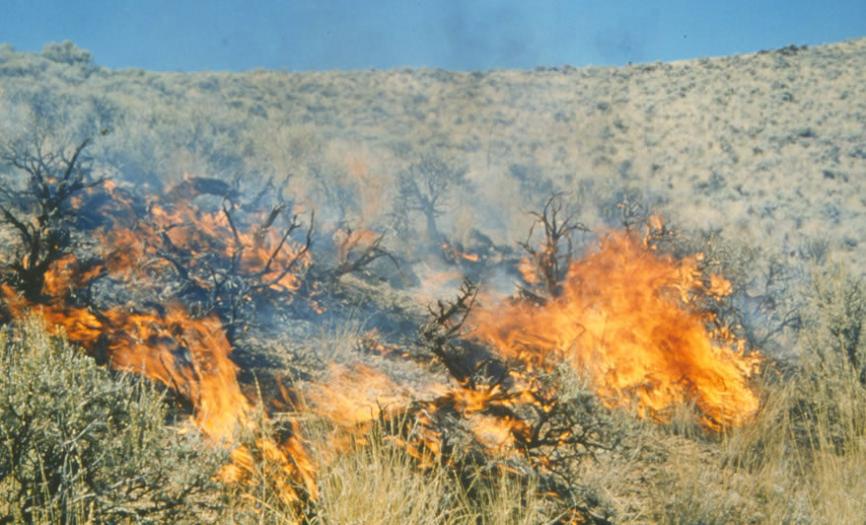
Putting it All Together
“Fire effects on plants cannot be understood unless their survival and reproductive strategies with respect to fire are understood.” – Fire Effects Guide
WFSP

