Slide 1
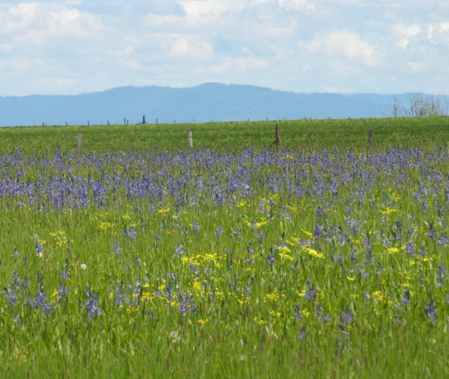
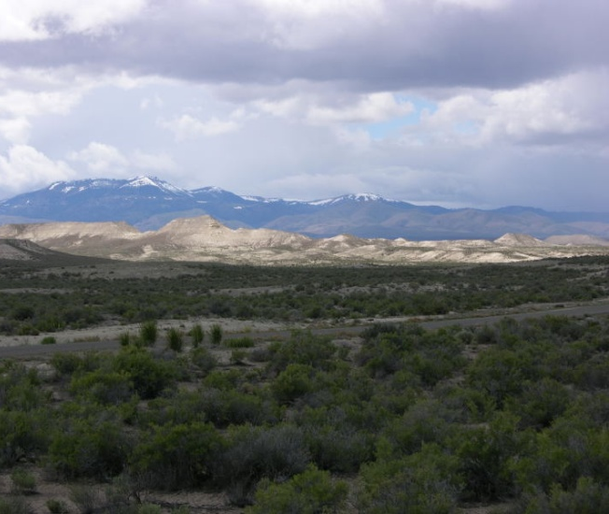
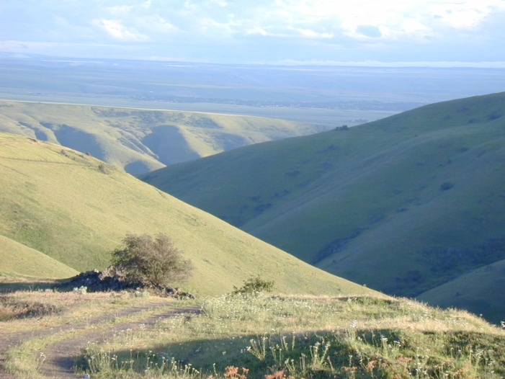
What are Rangelands?
K. Launchbaugh
J. Peterson
K. Launchbaugh
Notes:
All photos in this presentation were taken by Jennifer Peterson, Karen Launchbaugh or Karl Launchbaugh, unless otherwise noted. Pictures can be used without written permission as long as they are used for education and non-profit.

Slide 2
Wild Open Spaces of the West
What is rangeland?
How much rangeland?
Who owns rangeland?
What is rangeland good for?
  Multiple uses of rangeland
Notes:
Overview of topics in presentation

Slide 3
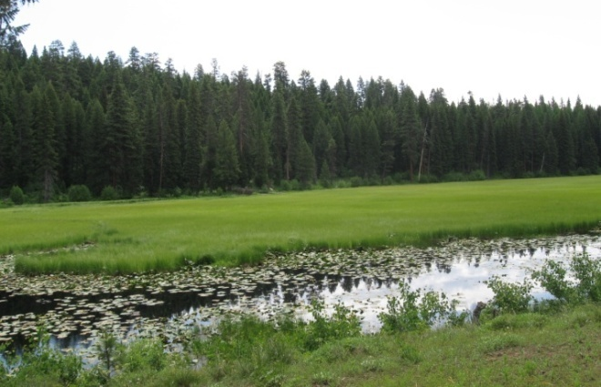
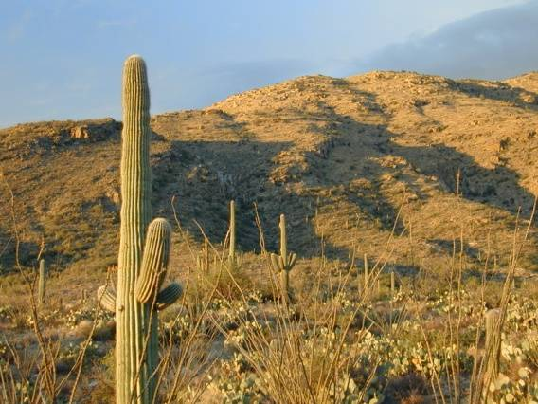
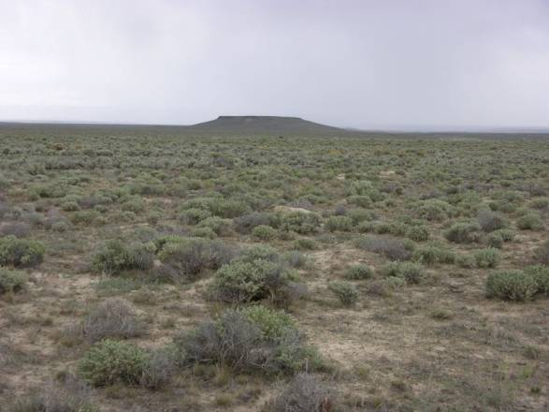
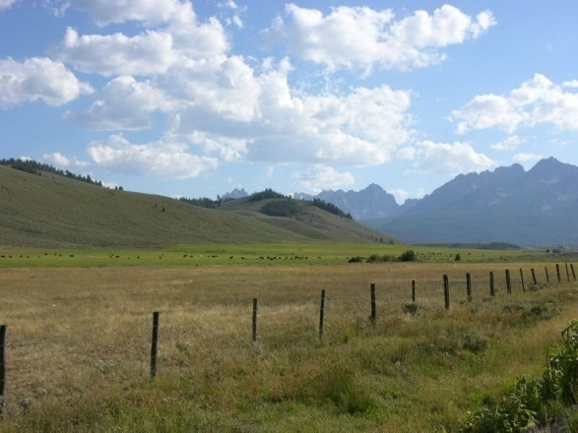
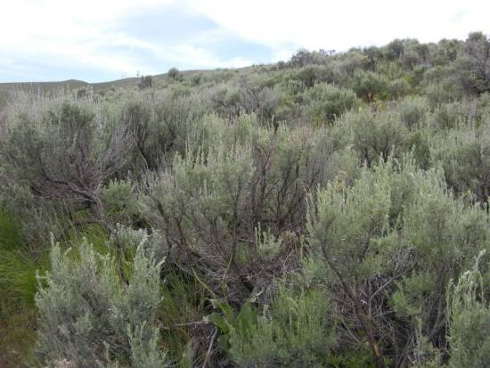
What are Rangelands?
Which of these are rangeland?
Deserts
Tundra
Wetlands
Savannas
Shrublands
Forests
Grasslands
K. Launchbaugh
K. Launchbaugh
J. Peterson
J. Peterson
J. Peterson
Notes:
Ask group which are rangelands and which arenot

Slide 4
What are Rangelands?
Which of these are rangeland?
Deserts?
Tundra?
Wetlands?
Savannas?
Shrublands?
Forests?
Grasslands?
Forage pasture?
All deserts except barren deserts
All tundra
Vegetation around wetlands
All savannas
All shrublands
Only open forests
All grasslands
Not highly managed pastures
Notes:
Give examples of each type of rangeland category (e.g. sagebrush steppe, oak woodlands of CA, etc.)

Slide 5
Pasture vs Range
Pastureland is differentiated from rangeland:
  They have periodic cultivation is used to maintain
  Generally introduced (or non-native) forage species
  Agronomic inputs such as irrigation and fertilization are applied annually
Notes:
Notes on pasturelands from Chuck Butterfield of Chadron State University.

Slide 6
What are Rangelands?
All areas of the world that are not:
  Barren Desert
  Farmland
  Closed-Canopy Forest
  Covered by solid rock, concrete or glaciers
Notes:
It is often easiest to describe what rangelands are not than to describe what they are.

Slide 7
What are Rangelands?
Rangelands are shrublands, grasslands, deserts, woodlands, and open forest.
Several factors can preclude farming or timber production on these:
  Limited precipitation
  Sandy, saline, or wet soils
  Steep topography
  Rocks
Notes:
If it there weren’t restrictions for farming, rangelands would generally have become farmland. Some grasslands such as the tall grass prairie and the Palouse prairie exist today only as small remnants today because these rangelands types were converted to high quality croplands.

Slide 8
What are Rangelands?
Are all rangelands grazed?
  Grazing as an important ecological process in all rangeland, but not all rangelands are grazed by livestock.
Rangelands are a kind of land – not a specific land use.
Notes:
All rangelands are grazed in some form or another – herbivory is a key factor in defining rangelands. However, not all rangelands are grazed by livestock. Ask audience if they can think of other important herbivores (e.g. insects and wildlife). Insects generally eat more on rangelands than livestock.

Slide 9
What are Rangelands?
Most types of rangelands have in common:
  Native and naturalized plants – mostly perennial
  History of or currently used for livestock grazing
  Extensively managed (rather than intensively) based on ecological (rather than agronomic) principles.
Notes:
Native plants are ones that evolved where they live today. Naturalized plant are those that came from some other continent, but they were pre-adapted to the climate and they live as if they were “native.”
Ask audience to give examples of naturalized species (e.g. crested wheatgrass, cheatgrass, etc.)
Extensively managed -- rangelands are typically managed in large blocks, with little input. For example, it is common for rangeland managers working for a federal agency to manage up to 1 million acres.

Slide 10

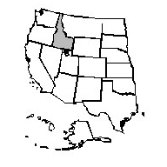
Why are rangelands important?
They cover a lot of ground
47% of the EARTH is rangeland
(some estimates as high as 70%)
36% of the US is rangeland
53% of Western States is rangeland
48% of Idaho is rangeland
80 % of Nevada
Notes:
Not much land east of the Mississippi is classified as rangeland because it is mostly forested land, cropland, or pastureland.

Slide 11
Why are rangelands important?
They cover a lot of ground
Half of the earth’s surface is rangeland
  47% = Rangeland
  25% = Dense Forest
  10% = Cropland
  3% = Urban
  15% = Ice, rock, and barren desert
Notes:
Although rangelands comprise a large portion of the earth’s land surface, most of the biomass is in dense forests. Urban expansion is mostly taking place on cropland.

Slide 12
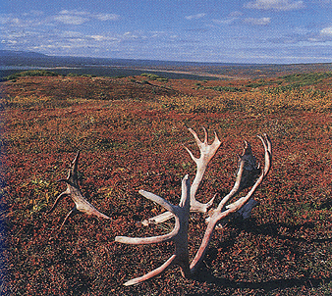
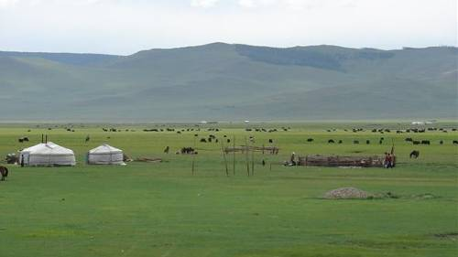
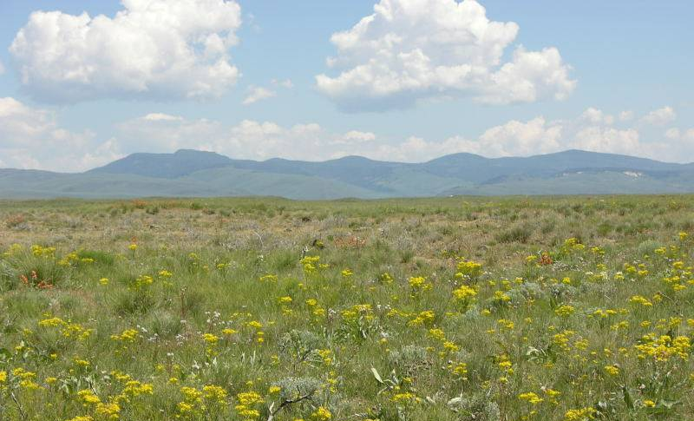
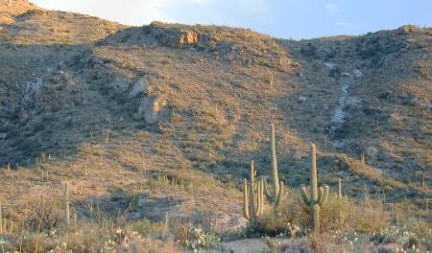
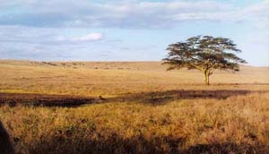
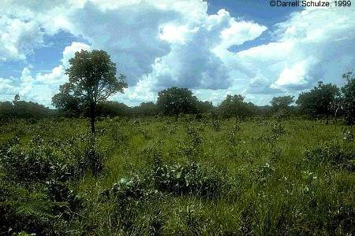
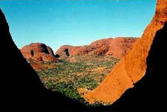
Rangelands are Diverse and Extensive!
Across the globe
Tundra of the Arctic
Sagebrush Steppe
Mongolian Plains
Sonoran Desert
African Savannah
Cerrados of Brazil
Outback of Australia

Slide 13

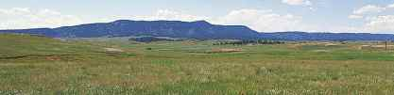
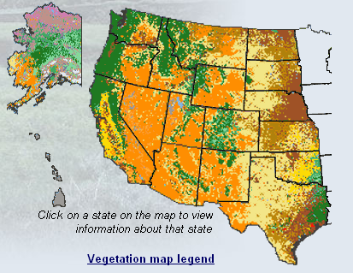
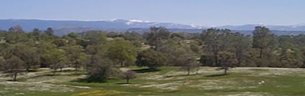
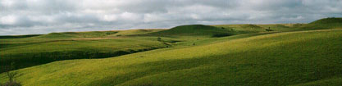
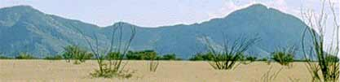
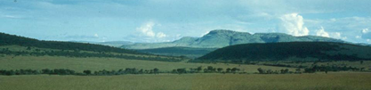
Rangelands are Diverse and Extensive!
Across the North America
Arctic Tundra
Mountain Grasslands
Oak Woodlands
Plains Grasslands
Sonoran Desert
Mixed Prairie

Slide 14
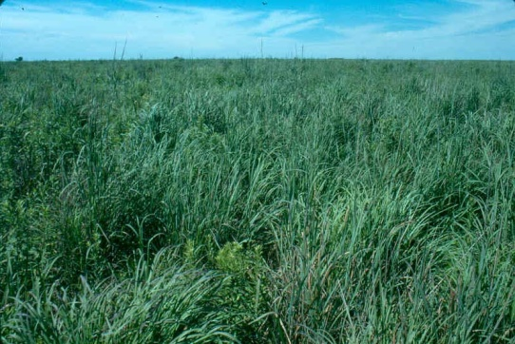
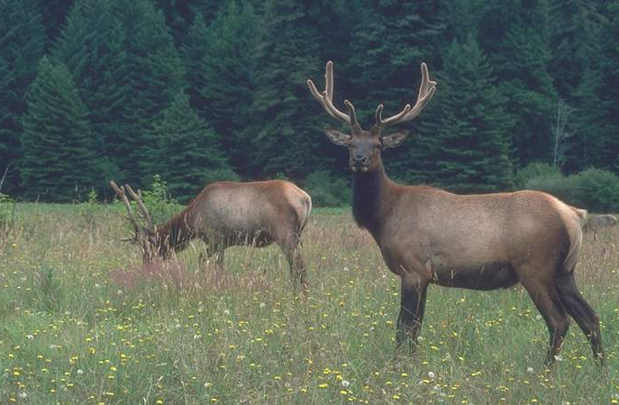
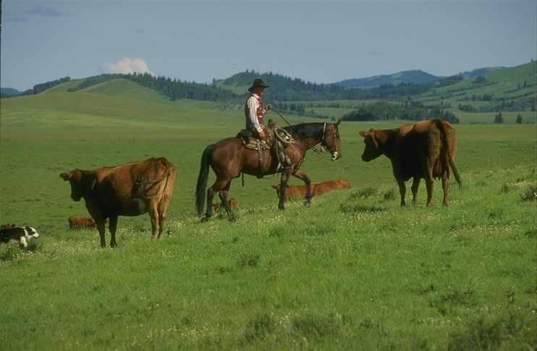
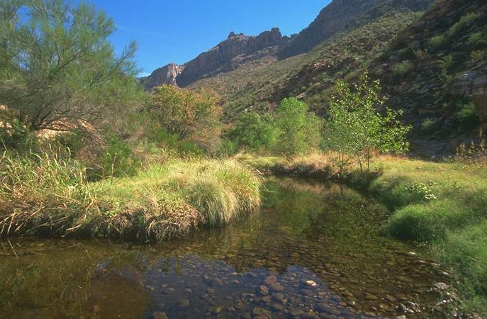
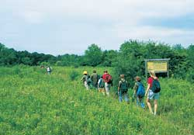
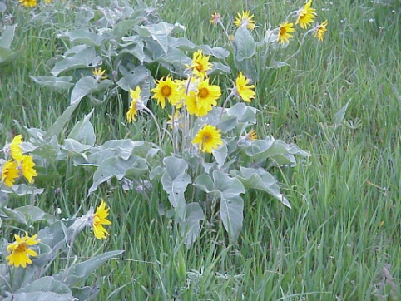
Rangelands are Important
Forage
Wildlife Habitat
Livestock Production
Water
Recreation
Open Space
Native Plants

Slide 15
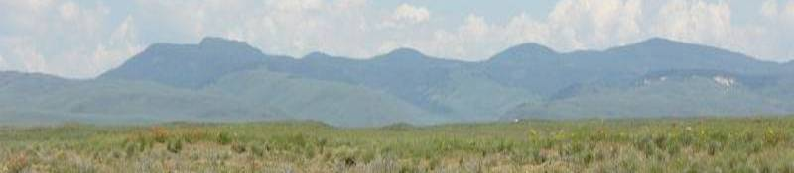
Rangelands are Challenged
Many forces that threaten rangeland integrity!

Slide 16
Rangelands are Challenged
Many forces that threaten rangeland integrity!
  Unsustainable grazing practices
  Damaging fire regimes
  Invasive plant species
  Global climate change
  Human development

