Slide 1
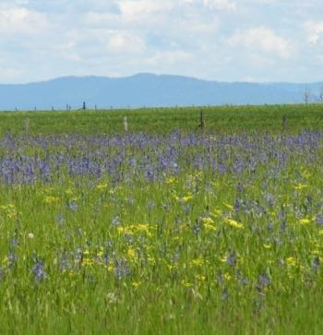
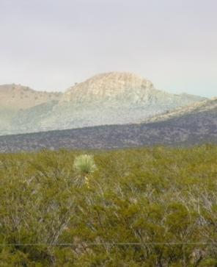
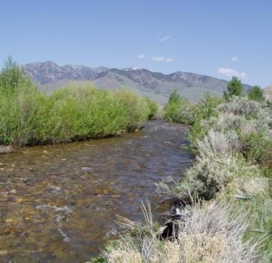
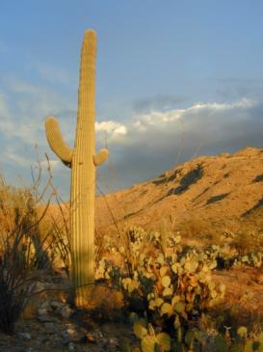
Rangelands of the U.S.
Photos by K. Launchbaugh
Notes:
All photos in this presentation were taken from open source websites including EcoLibrary (http://ecolibrary.org/) , Pics4Learning (http://pics.tech4learning.com/)

Slide 2
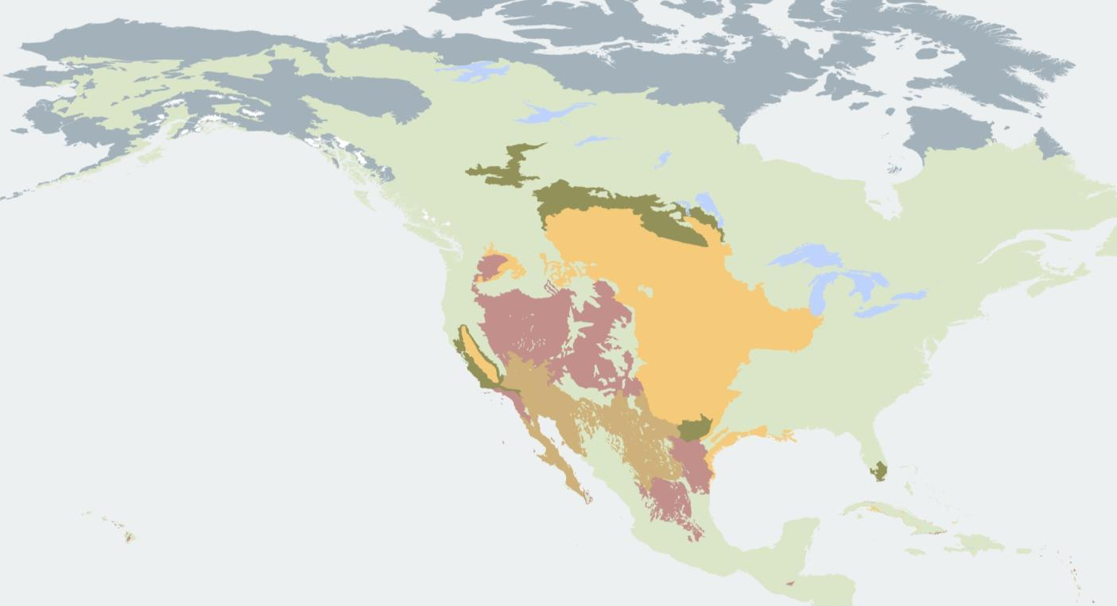
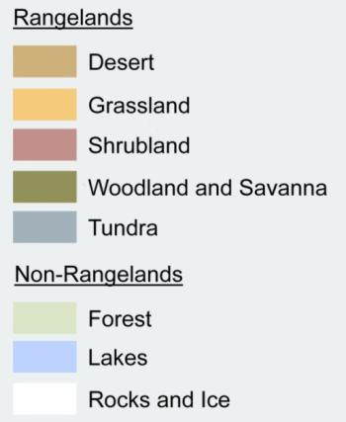
Rangelands of the North America
Notes:
Map created by Dr. Eva Strand and Karen Launchbaugh of the University of Idaho based on a global database created by the World Wildlife Fund http://www.worldwildlife.org/science/ecoregions/item1847.html

Slide 3
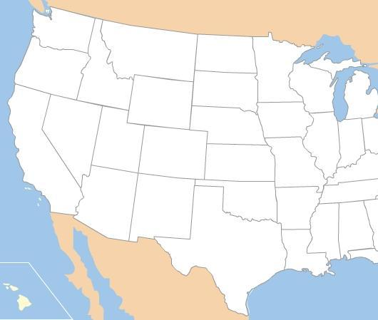
Rangelands of the U.S. - Simplified
Intermountain Grasslands
Shortgrass Prairie
Sagebrush Steppe
Mixed Prairie
Tallgrass Prairie
Oak Woodlands
Annual Grasslands
Salt Desert Shrubland
Oak Woodlands
Pinyon-Juniper Woodlands
Desert Shrubland & Grasslands
Notes:
Generalized map of rangeland vegetation types of the United States. Based mostly on A. S. Kuchler 1964. Potential natural vegetation of the conterminous Unites States. American Geographical Soc. Publ. #36.

Slide 4
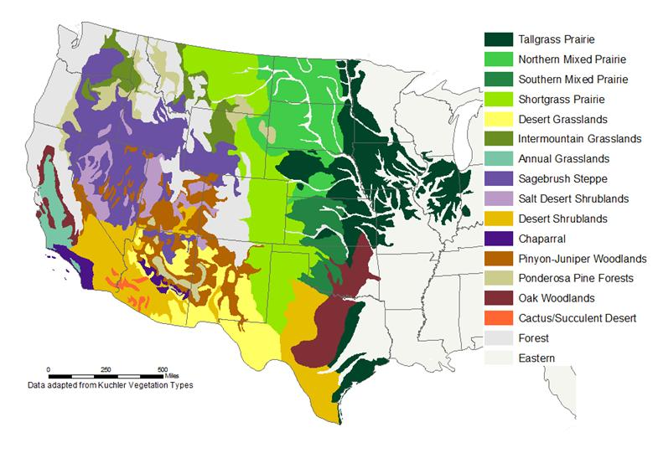
Rangelands of the U.S. - Detailed
Notes:
Map simplified from A. S. Kuchler 1964. Potential natural vegetation of the conterminous Unites States. American Geographical Soc. Publ. #36.

Slide 5
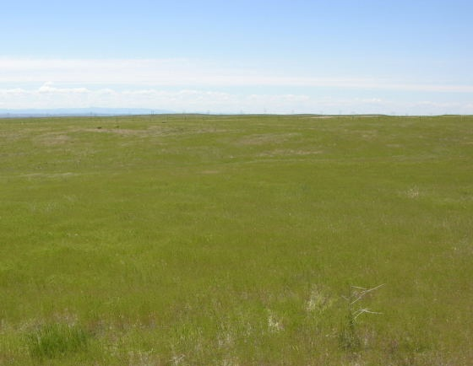
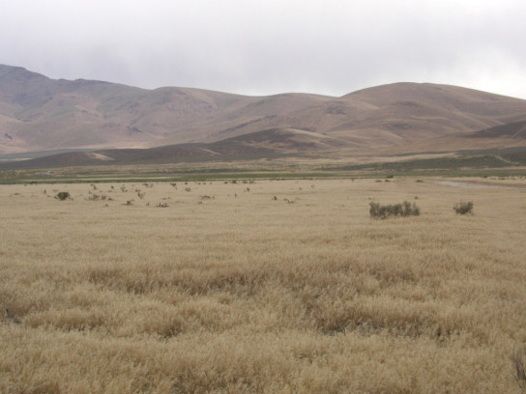
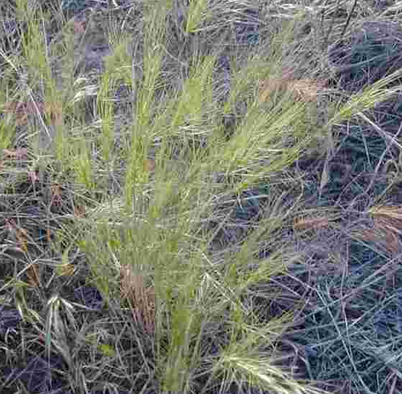
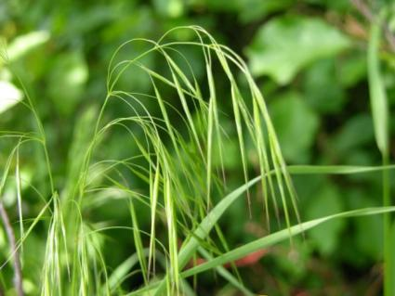
Annual Grasslands
Once this region was a subset of the Pacific Bunchgrass dominated by needlegrasses.
The Mediterranean climate (warm dry summers/cool wet winters) were well adapted to exotic annual plants such as cheatgrass and medusahead.
These plants were introduced at a time when heavy grazing was occurring the gold rush & western development. The region was quickly converted from perennial bunchgrasses to annual plans. Nearly all range plants in this region are annual and exotic.
Today more than half of the region is farmed.
Jennifer Peterson
Medusa head
Jennifer Peterson
Cheatgrass
www.werc.usgs.gov
Lovina Roselle
Jennifer Peterson

Slide 6
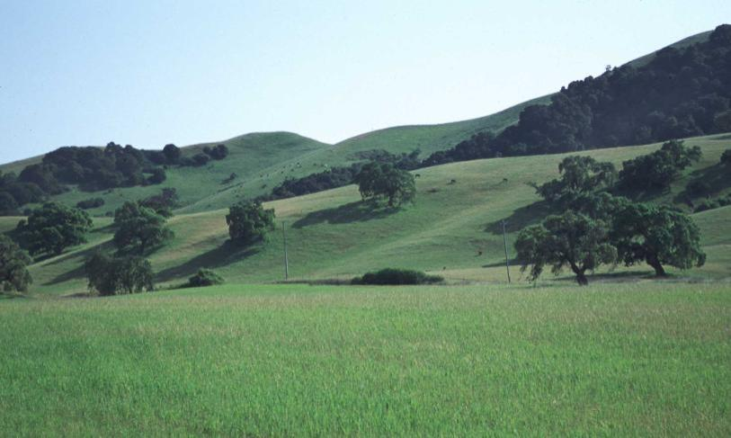
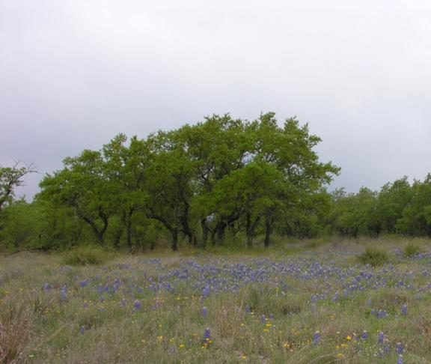
Oak Woodlands
Several types: oak savanna, Gambel oak woodlands, shinnery oak shrublands, and live oak woodlands.
Moderate climates, depending on region.
Understory of grasses - can be true savanna.
Important wildlife habitat (including acorns).
Fire important to maintain savannas

Slide 7
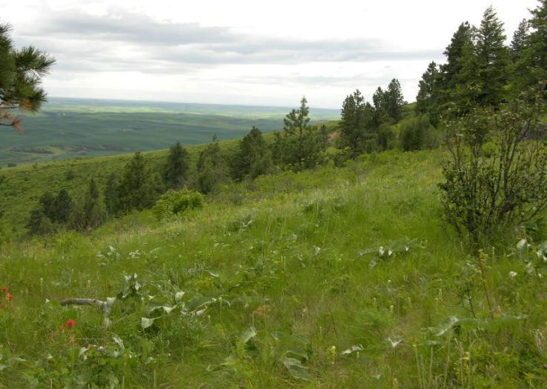
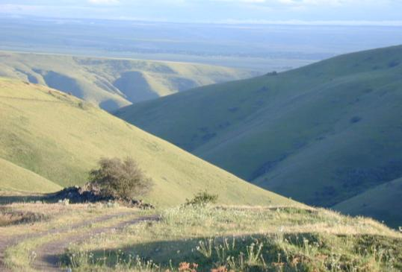
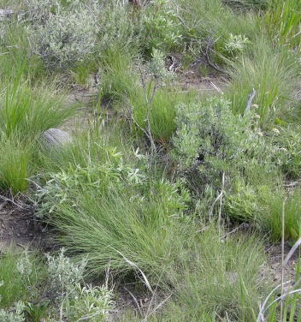
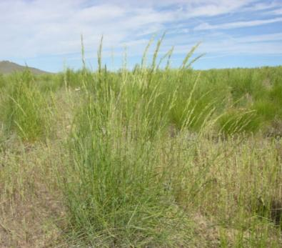
Intermountain Bunchgrass
This region includes the Palouse Prairie and Canyon Grasslands of ID, WA, OR & MT.
Major grasses include bunchgrasses such as bluebunch wheatgrass and Idaho fescue.
Late summer rains are uncommon in this region and therefore lightening-ignited wildfire was historically uncommon. Invasion of trees and shrubs into the grasslands was reduced because of the long, dry summers that make establishment of trees difficult.
The Palouse is a unique are of loess soils that is great for farming – therefore only about 1% of the original prairie exists today.
K. Launchbaugh
Idaho Fescue
Bluebunch Wheatgrass
Jennifer Peterson
Jennifer Peterson
Jennifer Peterson
Notes:
Photos by Karen Launchbaugh & Jennifer Peterson (www.cnr.uidaho.edu/range_tour/photo_search.asp)

Slide 8
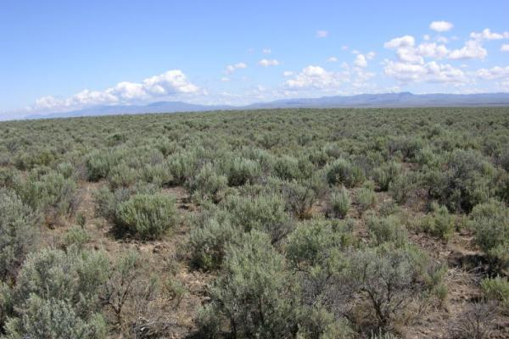
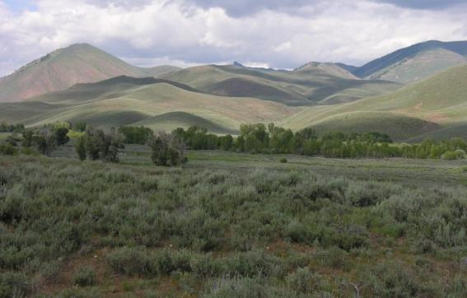
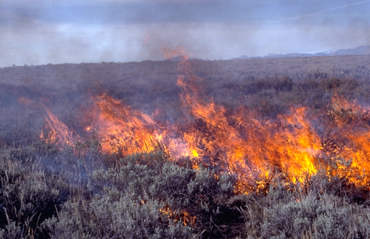
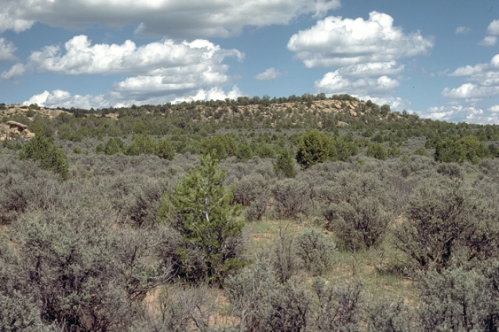
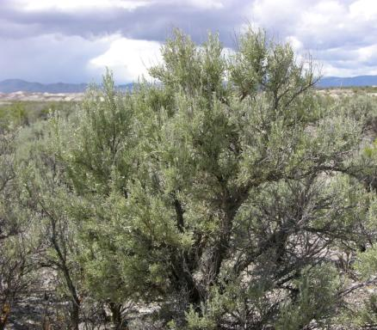
Sagebrush Steppe
One of the most extensive range types in Western North America.
Mostly public ownership (65% public/35% private)
Semiarid climate (precip. 8-20 in./yr). Dry summers.
Fire historically patchy when shrubs would burn and perennial grasses would grow till shrubs took over again.
Invasion of annual grasses changed fire regime at lower elevations such that fire occurs so frequently the native grasses and shrubs are severely reduced.
At higher elevation, invasive juniper plants reduce sagebrush communities because of reduced fire frequency.
K. Launchbaugh
Jennifer Peterson
Jennifer Peterson
Big Sagebrush
S.C. Bunting
Jennifer Peterson
Jennifer Peterson
Notes:
Map from Branson 1985. Vegetation Changes on Western Rangelands. Published by the Society for Range Management. Range Monograph No. 2.

Slide 9
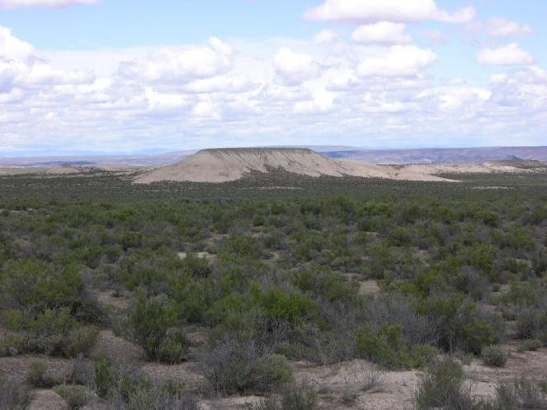
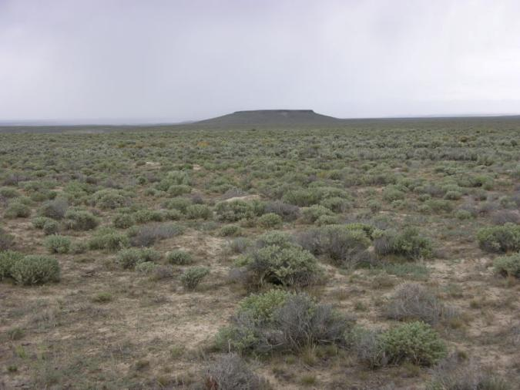
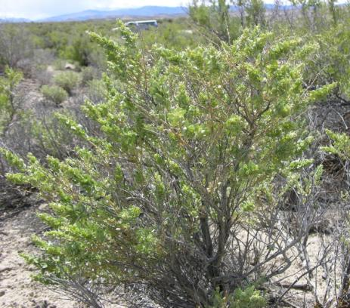
Salt Desert Shrub
Very dry climate (3-10 in./yr precip.) with Aridisols
Often located parts of landscape that accumulate salts. Therefore, the region occurs in bands an strips on the landscape.
Plants mostly shrubs of the Chenopodiaceous adapted to salty soils (i.e., shadscale saltbrush).
The shrubs, like most shrubs, are nutritious in the winter and this vegetaton type is important for winter grazing by sheep, cattle, and wildlife.
Invasive annual plants are the greatest threat to this ecosystems.
Jennifer Peterson
Shadscale Saltbrush
Jennifer Peterson
Jennifer Peterson
Notes:
Map from Branson 1985. Vegetation Changes on Western Rangelands. Published by the Society for Range Management. Range Monograph No. 2.

Slide 10
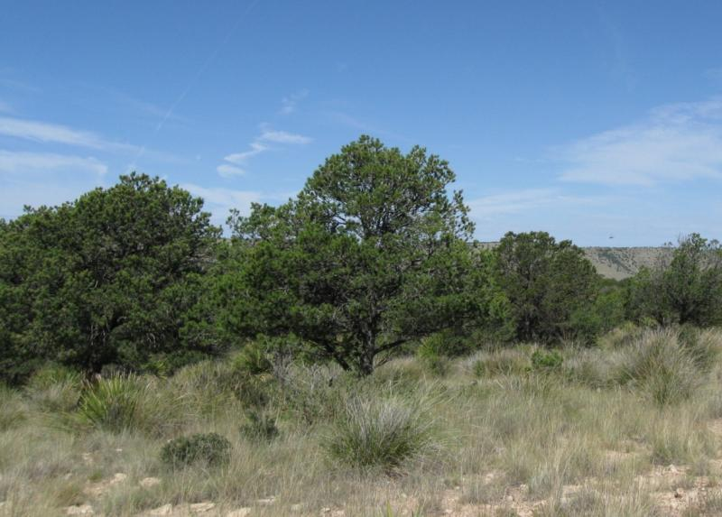
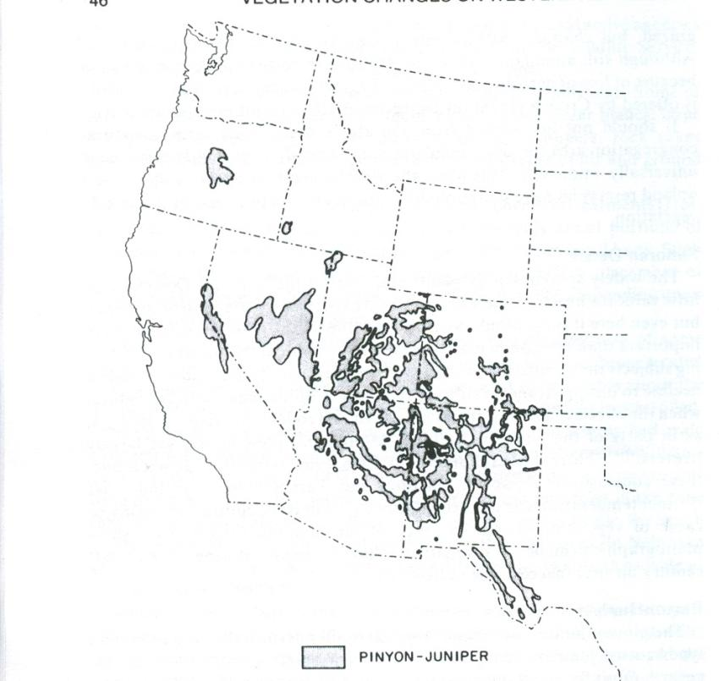
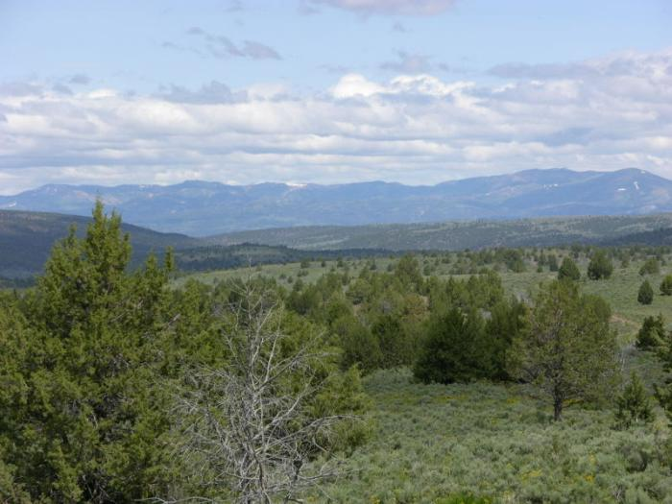
Pinyon-Juniper Woodlands
Widely spread region occurs at mid-elevation.
Has many forms from mostly pinion pine solid stands of Juniper woodlands.
Expansion in recent decades because of reduced fire frequency largely because of human fire suppression.
K. Launchbaugh
Jennifer Peterson
Notes:
Map from Branson 1985. Vegetation Changes on Western Rangelands. Published by the Society for Range Management. Range Monograph No. 2.

Slide 11
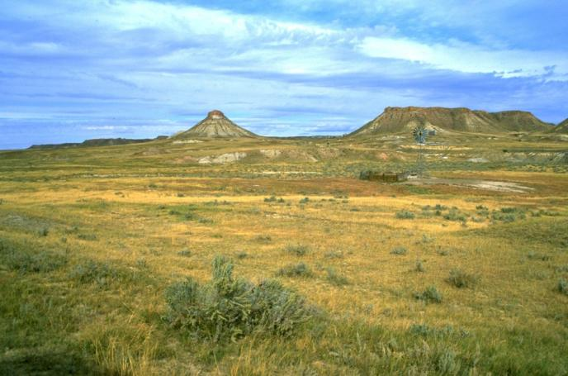
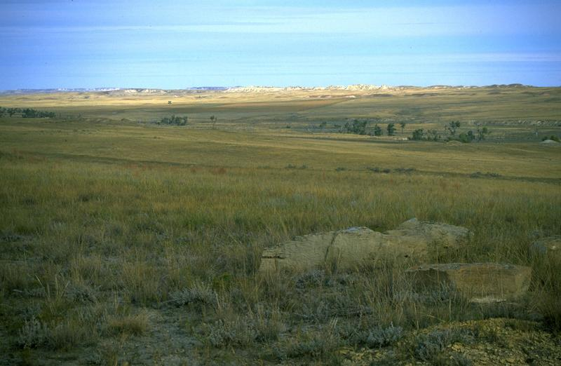
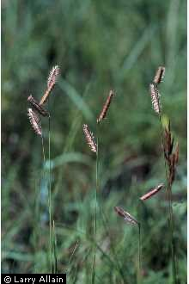
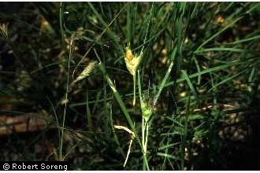
Shortgrass Prairie
www.blm.gov
Low rainfall because this prairie is in the rain shadow of the Rocky Mountains.
Native plants are well adapted to drought and heavy grazing.
Fire is not a major force in this ecosystem - often vegetative biomass is not sufficient for large fires.
The signature grasses are short grasses (i.e., blue grama and buffalograss)
Blue Grama
Buffalograss
www.blm.gov
Larry Allain
Robert Soreng
Notes:
Plant photos from the USDA Plants Data base: http://www.plants.usda.gov/ used with permission.
Landscape photos from the USDI BLM photo gallery : http://www.blm.gov/wo/st/en/bpd.html

Slide 12
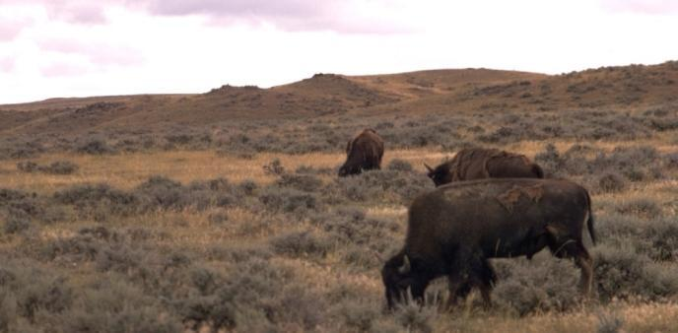
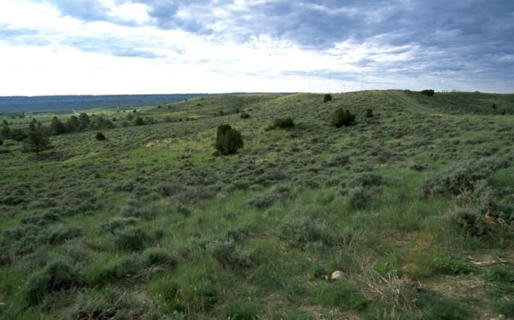
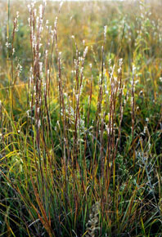
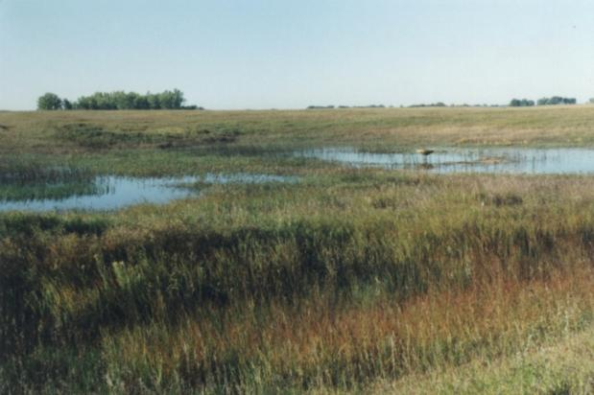
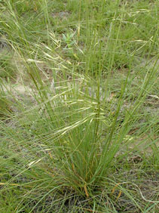
Mixed Prairie
The mixed prairie is exactly that “Mixed”
Mix of tall, mid, and short grasses
Mix of cool season and warm season plants
Mix of plant communities on the landscape
Wetlands in throughout the plains important for migratory waterfowl (i.e., Prairie Pothole and Playas).
Precipitation 14-20” per year
Soils mostly mollisols but not as fertile as Tall Grass Prairie.
Plants evolved with grazing by bison – therefore most are well adapted to grazing.
Fire were also common on the Mixed-Grass Prairie
www.blm.gov
Needle-and-Thread
www.blm.gov
Little Bluestem
Mike Haddock
Mike Haddock
www.fws.gov
Notes:
BLM photos from: http://www.blm.gov/wo/st/en/bpd.html
Plant photos by Mike Haddock: http://kswildflower.org

Slide 13
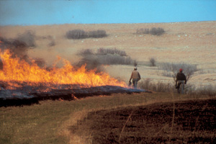
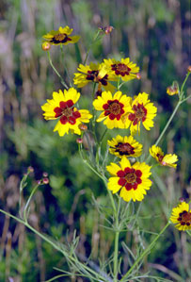
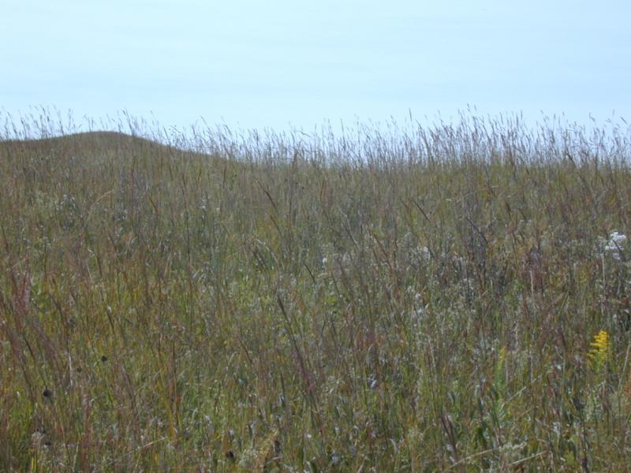
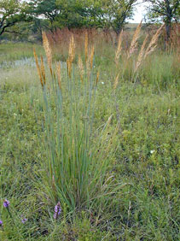
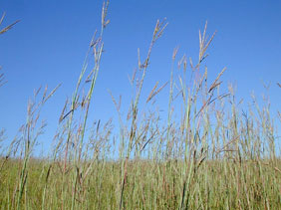
Tallgrass Prairie
Coreopsis
Only about 5% remaining of what originally existed (Konza Prairie in Kansas is one of the largest pieces).
The grasses created very productive soil (rich mollisols) that were easily plowed and converted to croplands.
Fire & drought is very important in maintaining the grasslands – the fires reduce invasion by shrubs.
This prairie evolved with grazing and major grasses are adapted to grazing.
Signature grasses of the Tallgrass Prairie are Indian Grass and Big Bluestem.
http://www.konza.ksu.edu/
Indian Grass
Mike Haddock
Big Bluestem
K. Launchbaugh
Mike Haddock
Mike Haddock
Notes:
Of course, tall grasses like Indian grass and Big Bluestem dominate the prairie. However, many flowering forbs are also present. Many of the forbs are members of the Asteraceae family like Plains Coreopsis.

Slide 14
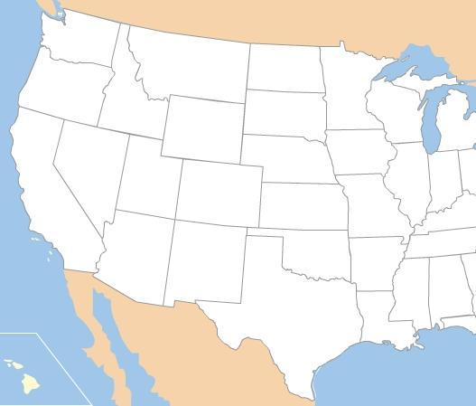
North American Deserts
Great Basin
Mojave
Chihuahuan
Sonoran

Slide 15
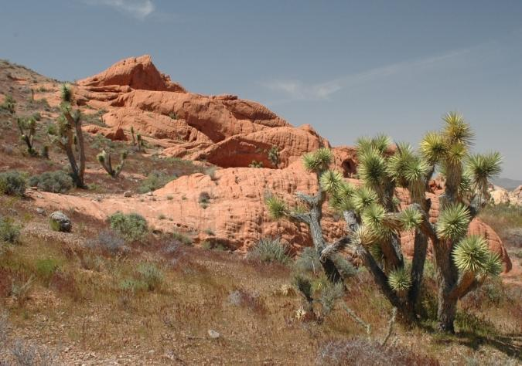
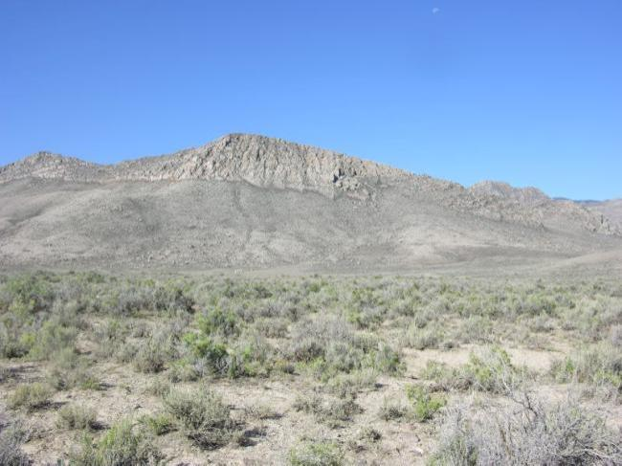
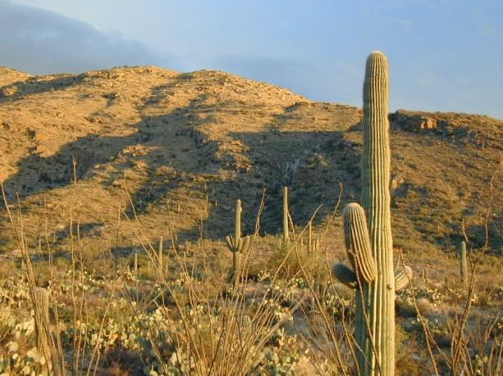
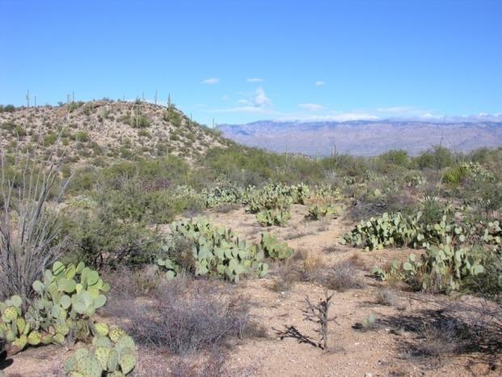
North American Deserts
Mojave
Great Basin
www.BLM.gov
K. Launchbaugh
Sonoran
Chihuahuan
K. Launchbaugh
K. Launchbaugh

Slide 16
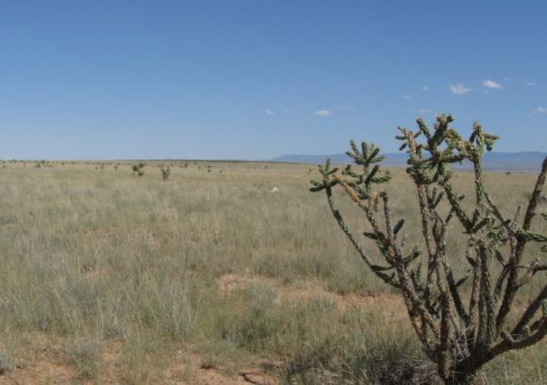
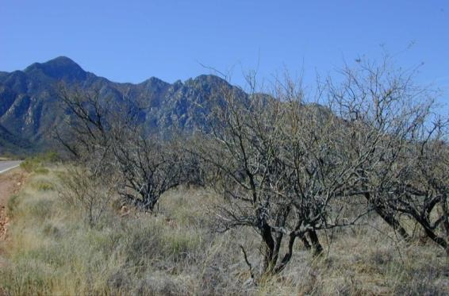
Desert Shrublands & Grasslands
Much of the Chihuahuan desert of the Southwest is a mix of shrubs, such as mesquite and creosote bush, with stretches of grasslands common on deeper soils.
A few centuries ago, much of this these vegetation type was a grassland dominated by warm season grasses such as black grama. Heavy grazing and several drought converted much of the are from a grassland to a shrubland.
K. Launchbaugh
Creosote Bush
K. Launchbaugh
Honey Mesquite
K. Launchbaugh
K. Launchbaugh
K. Launchbaugh

Slide 17
Rangelands of the U.S.
Photos by K. Launchbaugh
Notes:
All photos in this presentation were taken from open source websites including EcoLibrary (http://ecolibrary.org/) , Pics4Learning (http://pics.tech4learning.com/)

