Slide 1
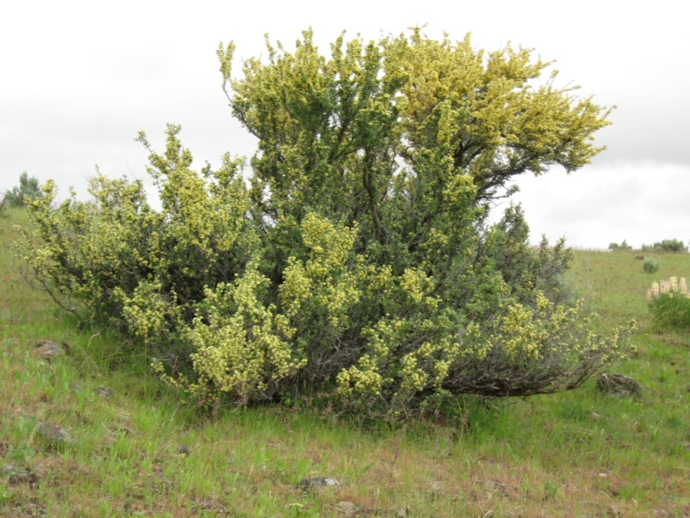
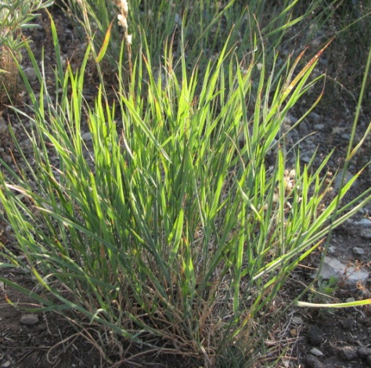
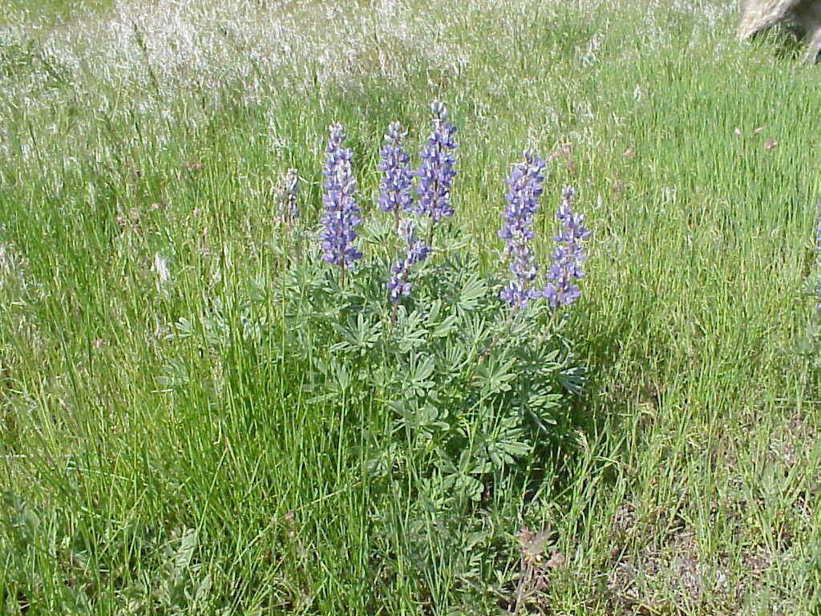
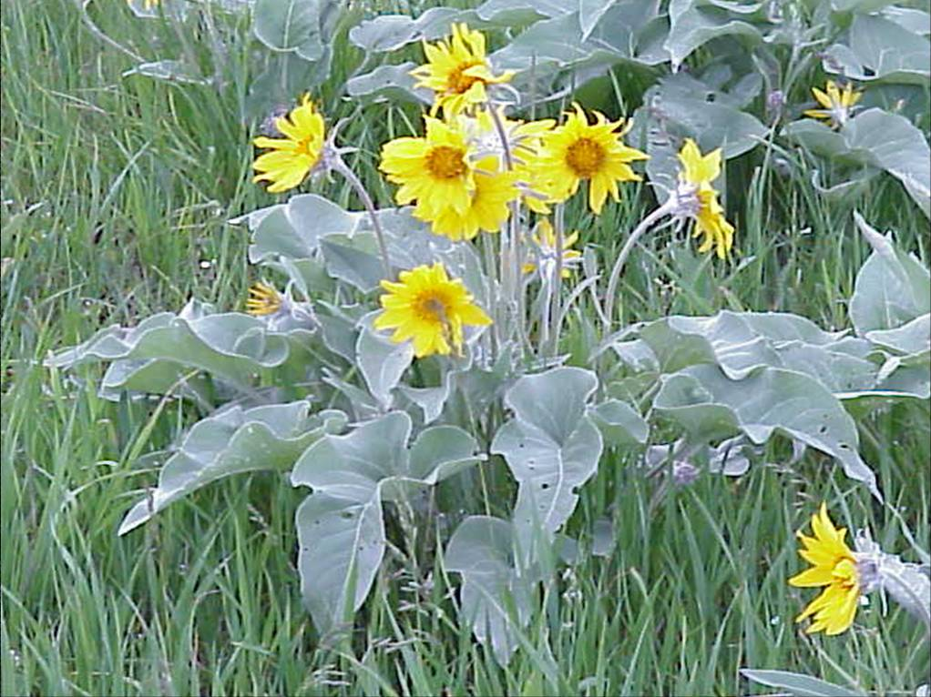
Forage Value of Range Plants ~ Grasses, Shrubs, and Forbs

Slide 2
Based on the most limiting nutrients on rangelands in the western U.S.
Energy –
Structural carbohydrates (e.g. cellulose)
Sugars & Starch
fats (to a limited degree, but important for birds and rodents).
Nutrients –
Protein - Nitrogenous compounds
Phosphorus = generally most limiting mineral on rangelands
Vitamins = Carotene or Vitamin A
Notes:
When we talk about animals, we talk about energy requirements. In this presentation we are going to go more indepthly into energy and nutrients. Phosphorus and Vitamin A are two nutrients that are not as readily available in rangelands environments.

Slide 3
The 3 major factors determining nutritive value in plants:
Cell structure: (Ratio of Cell Wall to Contents)
Degree of Lignifications
Secondary Compounds or “Anti-quality” factors
Notes:
The ratio of cell wall to cell contents describes the cell structure. Lignin is the component that binds cellulose and makes plants woody. Things that are poisonous and not very digestible are called secondary compounds, or anti-quality factors.

Slide 4
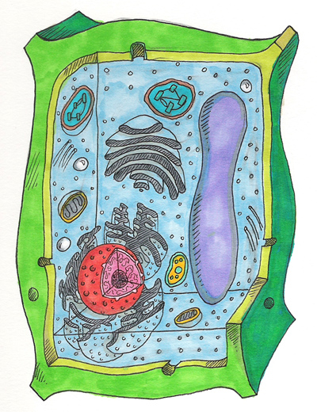
Cell structure: (Wall:Contents)
Cell solubles
Soluble carbohydrates (sugars)
Starch
Organic acids
Protein
Cell wall
Pectin
Cellulose
Hemicellulose
Lignin
Cutin
Silica
Notes:
Mammals cannot deal with any of the components of the cell wall. All the things in the cell contents can be digested by mammals. So anytime you have cells with more cell contents, that cell is going to be more nutritious. What are some of the things that affects the

Slide 5
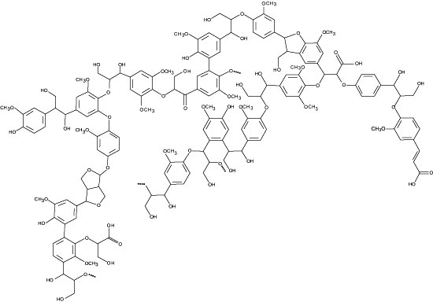
Degree of Lignification
Lignin - indigestible portions of cell walls that impregnates cellulose to form wood.
Lignin Structure is complex
Notes:
Lignin is a polymorphic carbon compound that has a complex structure. This structure binds up the cellulose.

Slide 6
Secondary Compounds or “Anti-quality” Factors
Plants may contain compounds or toxins that reduce forage quality or adversely affect the herbivore
Notes:
We will talk more about some of these antiquality factors.

Slide 7
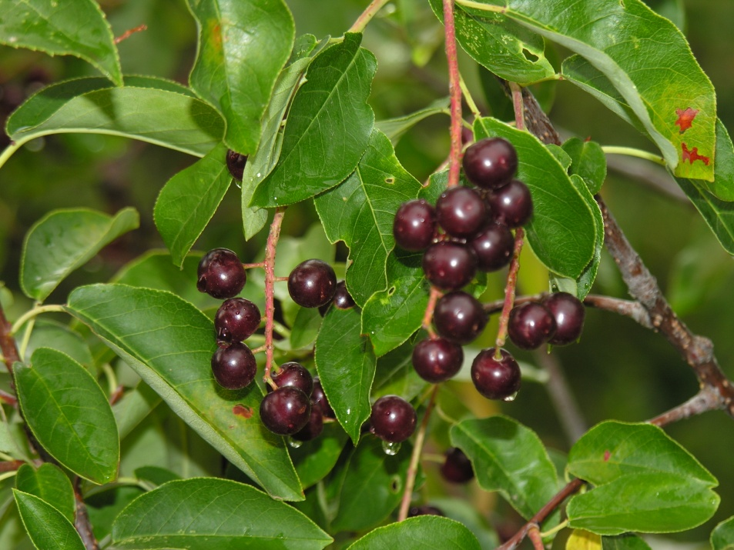
Comparative Nutritive Value of Plant Parts
Fruits, seeds, root-crowns and flowers generally have higher levels of cell contents (cell solubles) and are therefore more nutritious than leaves or stems.
Seeds can also contain significant levels of fats
Notes:
Mast, or the seeds and berries of a plant. These fruits are the most valuable parts of a plant.

Slide 8
Comparative Nutritive Value of Plant Parts
Leaves are more nutritious than stems.
Why?
More cell contents
Less structural CHO's
In shrubs, current seasons growth is generally more nutritious than old growth.
Why?
as stem age they become LIGNIFIED
Notes:
The leaves are more nutritious because they have less lignin. Their function is to capture sun for photosynthesis. The same for the newer growth of woody plants. As the plant gets older, it puts on more and more lignin and the amount of cell contents is greatly reduced. The reason they are preferred is because they provide positive feedback to the browsing animal.

Slide 9
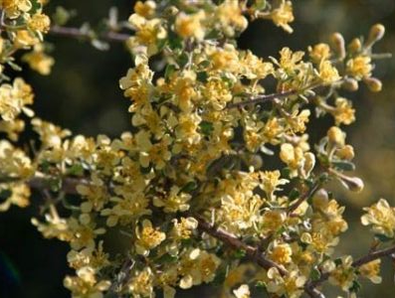
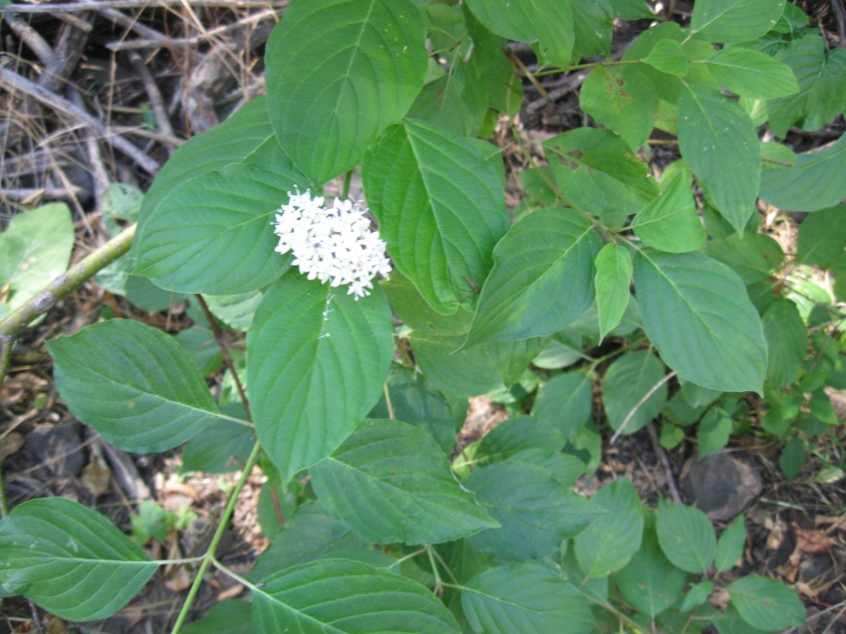
Comparative Nutritive Value of Grasses, Forbs, and Shrubs
What is browse?
The portion of shrubs used for forage. Generally, leaves & current seasons twigs.

Slide 10
Maturation Effects on Nutritive Quality:
Most range plants are highly nutritious when young. Even plants that are normally considered undesirable (such as cheatgrass) are nutritious when young.
As plants mature nutritive value decreases.
Increased structural CHO's
Lignification
Increasing Stem:Leaf Ratio
Leaching of nutrients by rain in dormancy.
Leaching is when rain washes soluble nutrients out of the plant into the soil. Plants that resist leaching due to dry climate, morphology, or range site are said to "cure" well.
Notes:
As plants mature, they develop a higher proportion of stem materials to leaf material. Leaching is very important in areas where rainfall occurs and plants leach out their nutrients. For example, in the annual grasslands in CA, when the rains come in the fall, the plant nutrition is greatly reduced. Plants that resist leaching are said to cure well.

Slide 11
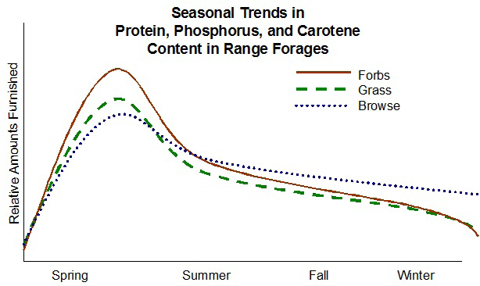
Comparative Nutritive Value of Grasses, Forbs, and Shrubs
Nutrients
Figure adapted from Parker 1969
Notes:
The browse holds their nutrients well into the fall and winter. Why is this? Herbaceous plants send all their nutrients to the roots over the winter. The stems of woody plants are alive over the winter so the plant is maintaining those cells in the stem during the cold months. That’s why shrubs are such an important plant species in the winter.

Slide 12
Comparative Nutritive Value of Grasses, Forbs, and Shrubs
During growing season - forbs are more nutritious than grasses (which are more nutritious than shrubs).
This is because the cell wall of grasses is thicker than the cell wall of forbs.
During dormant season - browse are important for nutrients.

Slide 13
Cool-Season vs Warm-Season Grasses
Warm-Season grasses
(C4) are less
nutritious than
Cool-Season grasses
(C3)
Because they
contain more
schlerenchyma,
epidermis, vascular
tissue and cell walls
are more lignified.
Notes:
Idaho has mostly cool season grasses, very few warm season. C3 grasses have less cell contents, so therefore is more nutritious.

Slide 14
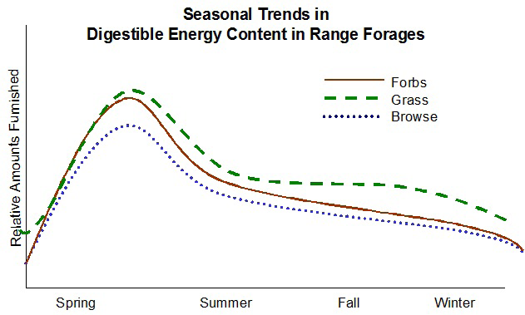
Comparative Energy Levels of Grasses, Forbs, and Shrubs
Energy
Figure adapted from Parker 1969
Notes:
The dead materials remaining in grasses still provides substantial energy.

Slide 15
Comparative Energy Levels of Grasses, Forbs, and Shrubs
During growing season - grasses, forbs, and shrubs all provide good amounts of energy
During dormant season - grasses provide a stable source of energy.
Notes:
During the growing season, all types of vegetation provide good amounts of energy. In the fall and winter, animals can get their energy from grasses but need the nutrients found in shrubs.

Slide 16
Anti-quality Agents:
Most common in shrubs and forbs.
Rarely a problem in grasses
Inhibitors - may cause illness but also inhibit digestion
React with dietary proteins to form complexes resistant to microbial degradation.
Inhibit digestion inhibiting microbial growth.
Toxins - cause illness or death (i.e., alkaloids)
Notes:
A wide variety of compounds in plant inhibit digestion or cause illness and death.

Slide 17
Recap:
Forbs are important sources of protein and carotene during the growing season.
Shrubs are important to maintain phosphorus and protein levels in winter (dormant season).
Grasses are important sources of energy (structural CHO's) throughout the year.
Forbs and shrubs may contain anti-quality agents which decrease their nutritive value.
Notes:
What type of hay is really important to the dairy industry? Alfalfa..because it is a forb and provides high nutrition to lactating cows.

