Slide 1
Morphology of Range Plants

Slide 2
Plant Morphology
Describes the physical form and external structures of a plant

Slide 3
Leaves
Important characteristics
Type
Arrangement
Shape
Margin
Veination

Slide 4
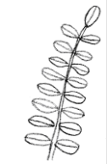
Leaf Types
Simple
Compound
Compound - Palmate
Compound - Pinnate

Slide 5
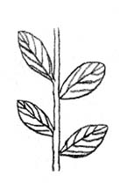
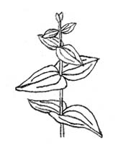
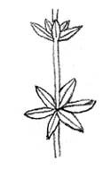
Leaf Arrangements
Alternate
Opposite
Whorled

Slide 6
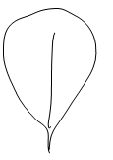
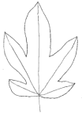
Leaf Shapes
Linear
Elliptic
Lanceolate
Oblanceolate
Ovate
Obovate
Palmate
Wedge-shaped
Arrow-shaped

Slide 7
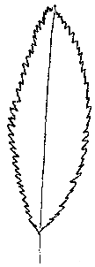
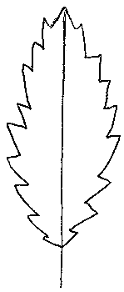
Leaf Margins
Lobed-pinnate
Lobed-palmate
Entire
Serrated
Scalloped
Toothed

Slide 8
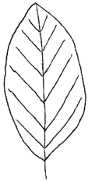
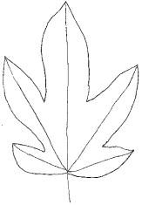
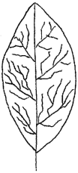
Leaf Veinations
Parallel
Pinnate
Palmate
Netted

Slide 9
Stems
Grasses
Grass-likes
Forbs
Shrubs
(Sedges)
(Rushes)
Hollow or Pithy
Solid Not Jointed
Solid
Woody Solid

Slide 10
Roots

Slide 11
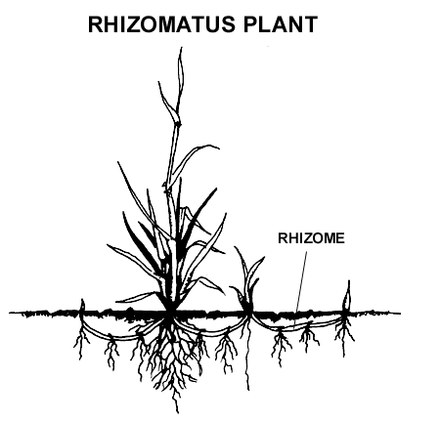
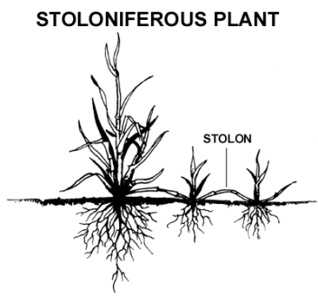
Structure for Plant Propagation
Rhizomes are underground modified stems that give rise to new plants. Stolons are aboveground modified stems that give rise to new plants.
Both are forms of asexual reproduction. “Sod-forming” plants have rhizomes or stolons

Slide 12
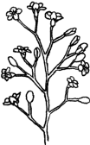
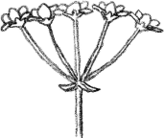
Flowers
Inflorescence types
Spike
Raceme
Panicle
Umbel
Head

Slide 13
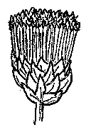
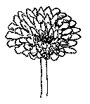
Flowers
Composite Heads
Ray Flowers
Disk Flowers
Ray and Disk Flowers

Slide 14
Grass Morphology
www.fsl.orst.edu/forages/

