Slide 1
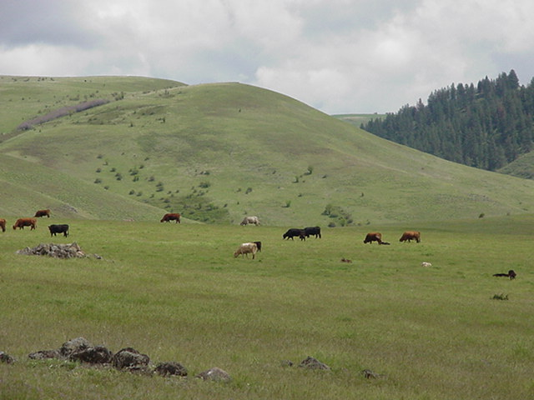
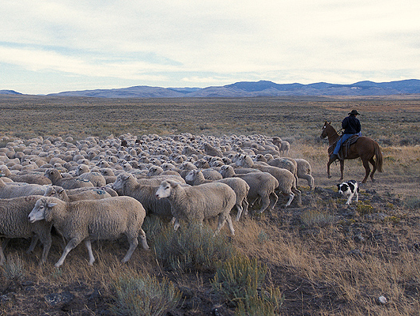
Grazing Management
Principles

Slide 2
Natural &
Human
Resources
Grazing
Management
Decisions
Community
Response
Climate
Topography
Veg. Community
Wildlife
Mgmt. Philosophy
& Goals
Livestock
Species
cattle, sheep, goats or horses
Stocking Rate
how many animals
Grazing System
season of grazing
season of rest
duration of grazing
Vegetation Community
Livestock Production
Wildlife Community
Important point: Once grazing management decisions are made, there are continual interactions between livestock, wildlife, & vegetation
Notes:
Remember that there are only 3 decisions that managers can make.

Slide 3
Grazing Principles
Which animal(s)? -Animal Species & Class
How many animals? -Stocking Rate
When to grazing or not graze? -Grazing Season
How long to graze or rest? - Duration of Grazing
Where animals graze on landscape? -Distribution
Notes:
Here again are the main principles

Slide 4
Grazing Principles
Which animal(s)? -Animal Species & Class
How many animals? -Stocking Rate
When to grazing or not graze? -Grazing Season
How long to graze or rest? - Duration of Grazing
Where animals graze on landscape? -Distribution
Grazing System
Notes:
The season and duration are the principles managed by grazing systems

Slide 5
  A Good Grazing System Should
Take into account plant physiology and life history
Be suited to kinds of plants present
Be adapted to soil conditions
Improve range condition and forage production by favoring desired plants
Not be detrimental to animal gains
Be practical to implement in a ranching operation
Notes:
We don’t always consider the soils, but some soils can be very sensitive in the spring when wet.

Slide 6
Objectives for good grazing system:
Restoration of forage plant vigor
Allowing plants to produce seeds
Heavier and more uniform utilization
Increased animal production
Notes:
What are some of the key components we are managing for?

Slide 7
Objectives for good grazing system:
Restoration of forage plant vigor
Allowing plants to produce seeds
Patchy or more uniform utilization
Increased animal production
Notes:
These are the key points that we need to keep in mind when we are managing grazing systems.

Slide 8
Grazing Management Principles
Which animal(s)? -Animal Species & Class
How many animals? -Stocking Rate
When to grazing or not graze? -Grazing Season
How long to graze or rest? -Duration of Grazing
Where animals graze on landscape? -Distribution
Now for the Details….

Slide 9
Animal Species & Class
Kind of animal (species)
  Cattle, sheep, goat, horse, wildlife species
Class of animal (age, sex, physiological status)
  Reproductive -- pregnant or open
  Age -- mature or young
  Lactating or dry
Adaptation to climate and forage quality
  Breed of animal
  Genetic potential for growth and lactation
Notes:
Species, class, and breed are the main things we have to consider

Slide 10
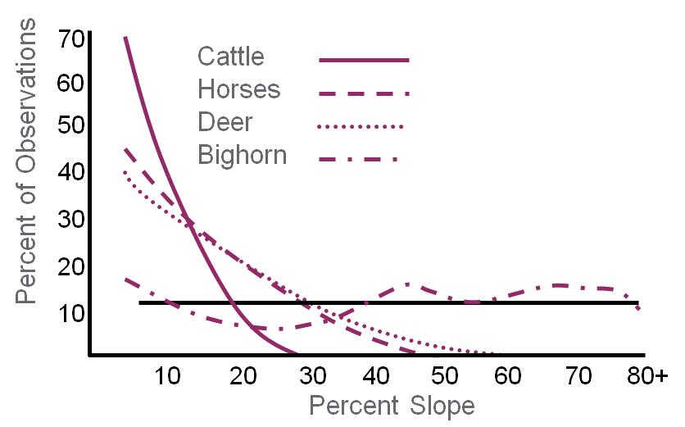
Animal Species & Class
Variation in dietary preferences
Variation in landscape use
Concentrate Feeder (browse)
Intermediate Feeder (forbs)
Roughage Feeder (grass)
Notes:
Remember that animals eat differently and use the landscape differentl

Slide 11
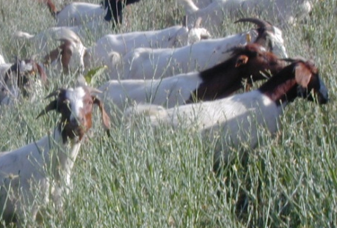
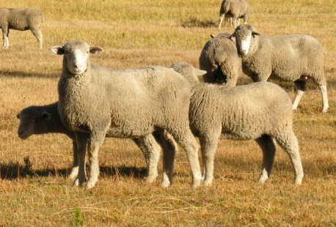
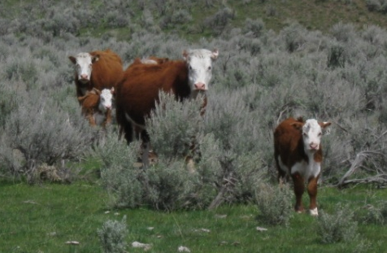
Chose Animal Species & Class
Match animal genetics with forage quality
Match the grazing animal with the landscape and the kinds of vegetation
Notes:
Match the animal to the landscape

Slide 12
Stocking Rate
Balance Forage Supply with Forage Demand
Notes:
You’ve got to balance your forage supply and forage demand

Slide 13
Grazing Principles
Which animal(s)? -Animal Species & Class
How many animals? -Stocking Rate
When to grazing or not graze? -Grazing Season
How long to graze or rest? - Duration of Grazing
Where animals graze on landscape? -Distribution
Grazing System

Slide 14
Grazing systems
Controlled grazing management practices that manipulate livestock to systematically control periods of grazing, deferment, or rest.
Designed to control the effects of grazing at the individual plant level by controlling:
  Season of grazing
  Frequency of defoliation by controlling the length of the grazing period
Notes:
Remember that grazing systems ystematically control grazing, deferment, or rest. Often you would think we would manage at the landscape level, but grazing systems are designed ot control the individual plant.

Slide 15
Season of Use = Grazing Season
Yearlong
  Grazed for the whole calendar year.
    Used primarily in tropical & sub-tropical climates
Seasonal
  Graze during growing season
    Temperate to cold climates – grazing in dormant season restricted by snow.
Rotational
  Grazing Systems control periods of grazing
Notes:
Here in the west, the grazing season is seasonal because we have snow. We are concerned with the rest and deferment.

Slide 16
Timing of Grazing
Effect of grazing varies according to:
  Season of use -- Plants are more resistant to intense grazing during dormancy than in active growth.
  Phenological stage of plant -- Defoliation in spring when plants start growth may be less harmful than in fall when plants are flowering and maturing.
  Opportunity for regrowth – Will plants be able to produce new leaves and develop strong root systems prior to entering dormancy following defoliation?
Notes:
Remember how much attention you need to give to the timing of grazing.

Slide 17
Grazing Season vs Growing Season
Rangelands– Grazing season is generally longer than the growing season. This requires stockpiling forage for use during the non-growing season. This frequently involves very light use during the peak growing season.
Introduced (or Tame) Pasture – Grazing season is matched the growing season to harvest forage near maximum quality. Stockpiling forage usually involves shortening the grazing period during active growth.
Notes:
The principles of grazing are the same for rangelands and pastures. But generally pastures have a different set of rules, and stockpiling forage becomes a very critical component.

Slide 18
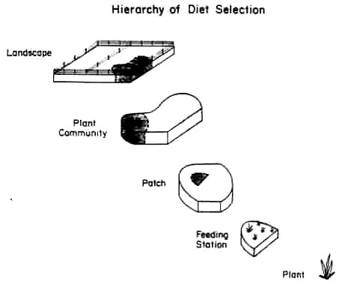
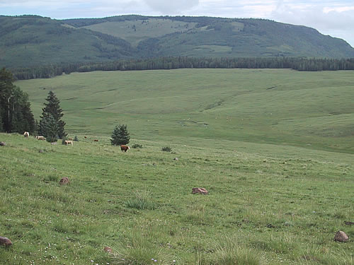
Grazing Distribution
Where Animals Graze
(Heitschmidt and Stuth, 1991)
Notes:
Remember that it is important to manage for distribution across the landscape. Animals graze in a patchy manner.

Slide 19
Grazing Distribution
Where Animals Graze
Area distribution
  Landscape
  Patch
  Feeding station
Distribution affected by characteristics along a gradient of spatial scales
…... From leaf to landscape
Notes:
What kinds of ways can we entice animals to use different areas or forages?

Slide 20
Area Selection
Factors affecting area selection include:
  Distance from Water
  Vegetation Type
  Topography (Slope)
  Range Site (Soils)
  Weather
  Animal pests such as flies
  Animal Species and Class
  Management practices such as supplementation

Slide 21
Distance from Water
Recommended distances between watering points vary according to terrain, species of animal, and breed of livestock
General recommendations:
  Rough country: ≈ 0.5-mile max
  Rolling country: 1.0-mile max
  Flat sandy country: ≈ 1.5-mile max
  Flat country ≈ 2.0-mile max
  Often see very little use beyond these max distances

Slide 22
Vegetation Type
Herbivores select areas with vegetation that best meets their nutritional needs
  Bulk grazers prefer open grasslands
    Cattle, Buffalo, White rhinos
  Browsers prefer wooded areas
    Mule deer, Giraffes, Black rhinos

Slide 23
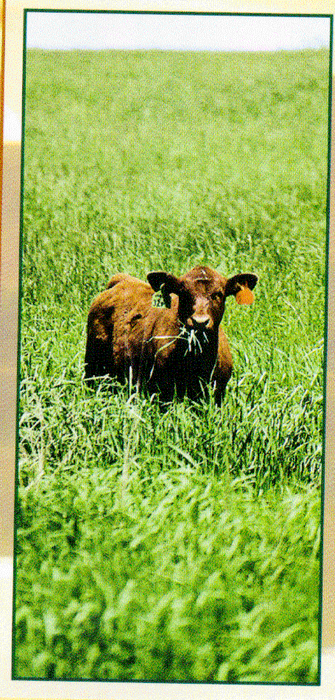
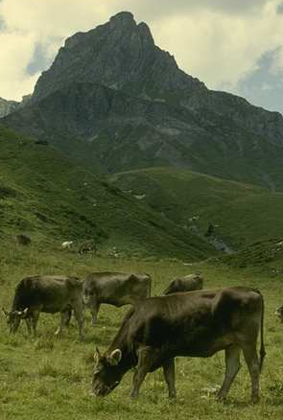
How do we change livestock distribution?

Slide 24
Improving Livestock Distribution
Provide supplemental feeds/mineral licks
  Cattle move from water to grazing to salt:
    Change location of salt-mineral licks
    Place salt away from water in areas that grazing animals are avoiding
Grazing systems that reduce pasture size and significantly increase animal density may improve livestock grazing distribution.

Slide 25
Improving Livestock Distribution
Prescribed burning
  Removal of previous years’ growth
    Greater access to new plant growth
  Early spring fires can
    Increase soil temperature
    Initiate growth
    Improve forage quality
    Encourage earlier grazing

Slide 26
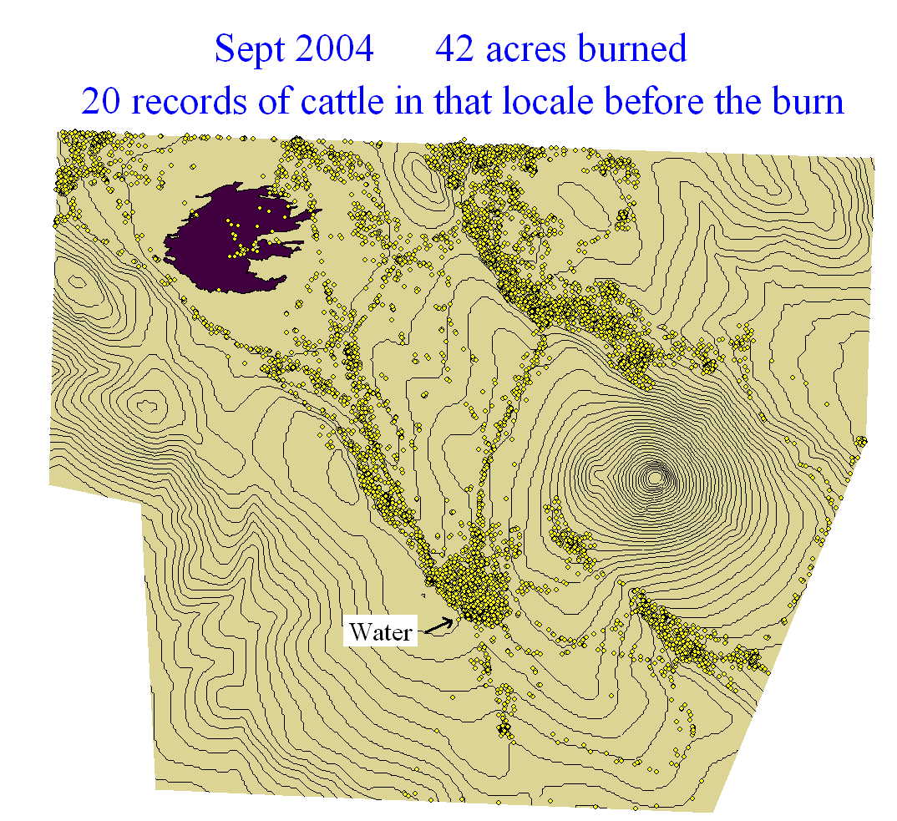
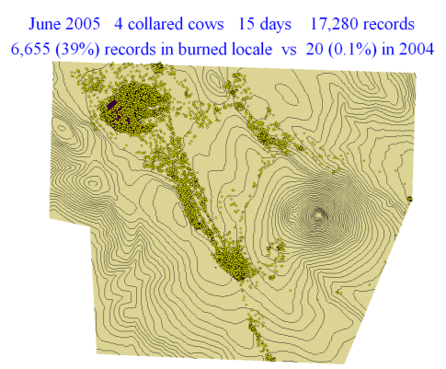
Improving Livestock Distribution
Prescribed burning
Livestock observations in 2,000 acre pasture showing distribution for 15 days pre-burn (2004) and the subsequent June (2005). – David Ganskopp – ARS Eastern Oregon Agricultural Research Center
Notes:
In this study, the collared animals were hanging out near water and in the level areas of the landscape. The distribution really shifted the burned area.

Slide 27
Improving Livestock Distribution
Adjust kind/class of livestock
  Changing animal species can improve livestock distribution depending on:
    Vegetation composition
    Water distribution
    Topography
  Because of non-uniform plant composition, multi-species animal production systems can increase:
    Herbivore distribution
    Vegetation use
    Animal production

Slide 28
Improving Livestock Distribution
Fencing can be used to control:
  Area selective grazing
  Season of use
  Rotational grazing systems
  Use of high-value forages such as hay crops
  Movement of wildlife

Slide 29
Livestock Distribution
Negative Aspects of Fencing
  Cost prohibitive where productivity is low
  Electric fences are less costly to construct than standard barbed wire but more expensive to maintain
  Restrict movement of some wild species
  High-fencing to control game species

Slide 30
Steps in a Grazing Mgmt Plan:
Research past grazing history and issues
Determine current conditions & resources
Identify goals and concerns of land owner
Consider grazing strategies to address goals & concerns including other land mgmt. goals:
  Wildlife
  Fire
  Weeds
  Water
Notes:
It is very important to consider the goals. What are you managing for?

Slide 31
Steps in a Grazing Mgmt Plan:
Develop grazing plan
  what species and type of animal
  how many
  season of grazing
  how long and how often
Consider laws and policies
  Clean Water Act
  Endangered Species Act
  Agency Policies (i.e., NEPA)
Notes:
After you develop the plan, you must also be very careful to take into consideration the laws and policies that may influence your grazing management plan.

Slide 32
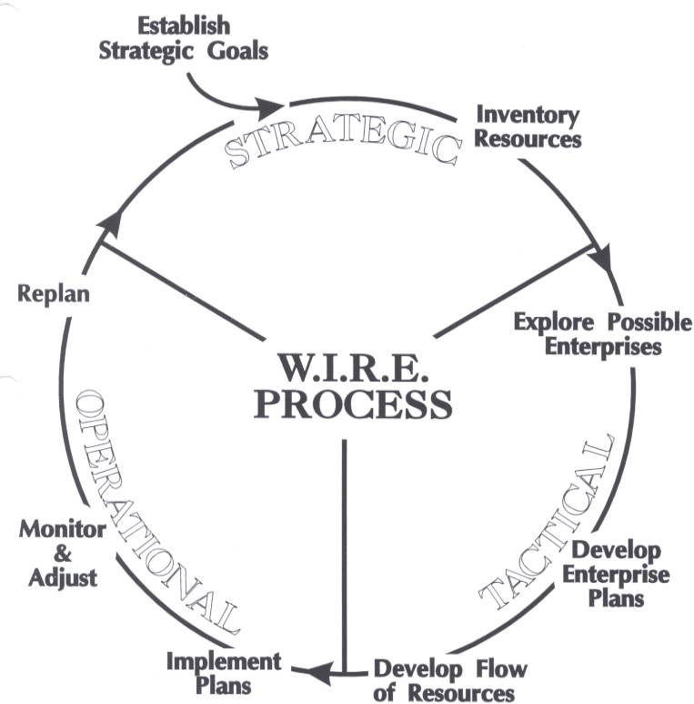
Steps in a Grazing Mgmt Plan:
One Example of a
Planning Model
Re-evaluate plan throughout season and adjust on regular basis
Notes:
You an do all your planning, but then you have to do our assessment and monitoring, or reevaluate

