Slide 1
25 Major Rangeland Plants
Forbs and Woody Plants
By Karen Launchbaugh

Slide 2
Forbs & Woody Plant
FORBS
 | Desert Merigold | Perennial | Native
 | Leafy Spurge | Perennial | Introduced & Noxious
 | Tailcup Lupine | Perennial | Native
 | Tall Larkspur | Perennial | Native
 | Spotted Knapweed | Perennial | Introduced & Noxious
 | Western Yarrow | Perennial | Native
WOODY PLANTS
 | Big Sagebrush | Perennial | Native
 | Coyote Willow | Perennial | Native
 | Creosote | Perennial | Native
 | Deerbrush | Perennial | Native
 | Honey Mesquite | Perennial | Native
 | Juniper | Perennial | Native
 | Salt Cedar | Perennial | Introduced & Noxious
 | Shadscale Saltbrush | Perennial | Native
 | Winterfat | Perennial | Native

Slide 3
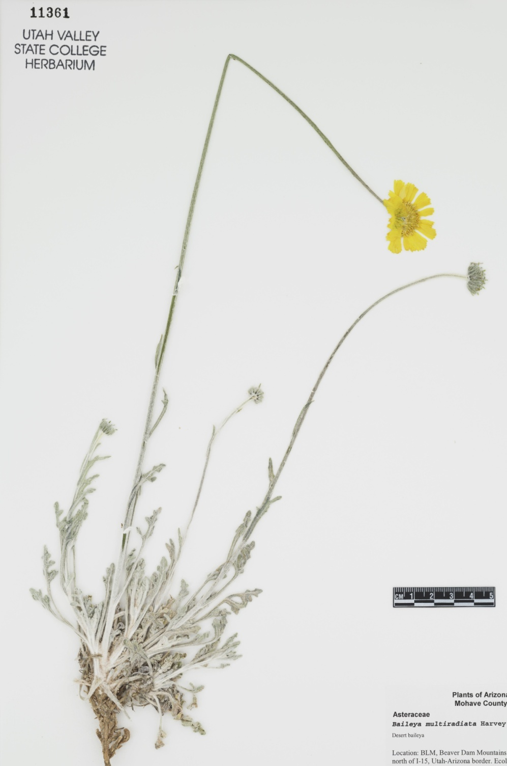
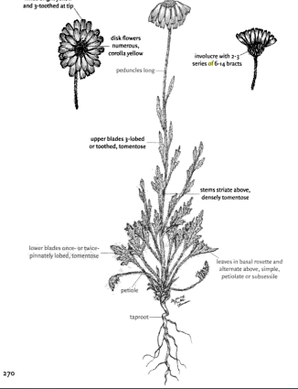
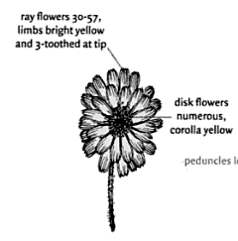
Desert Marigold
Perennial
Native
Composite flower with Disk flowers and Ray flowers
Hairy Leaves
Mostly Basal Leaves
Page from North American Wildland Plants by Stubbendieck, Hatch and Landholt
Notes:
Hairly leaves help with water conservation.

Slide 4
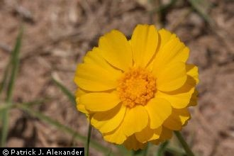
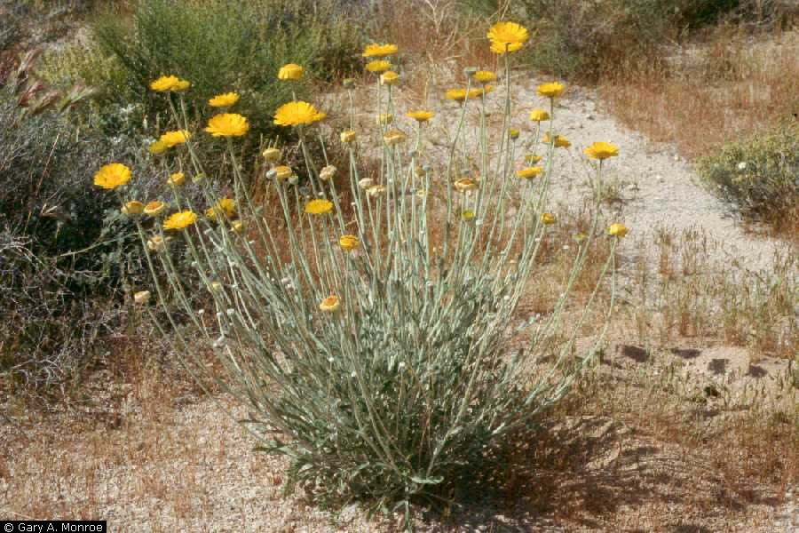
Desert Marigold
Desert wildflower
High ornamental value
Composite flower with Disk flowers and Ray flowers
High ornamental value
Notes:
Hairly leaves help with water conservation.

Slide 5
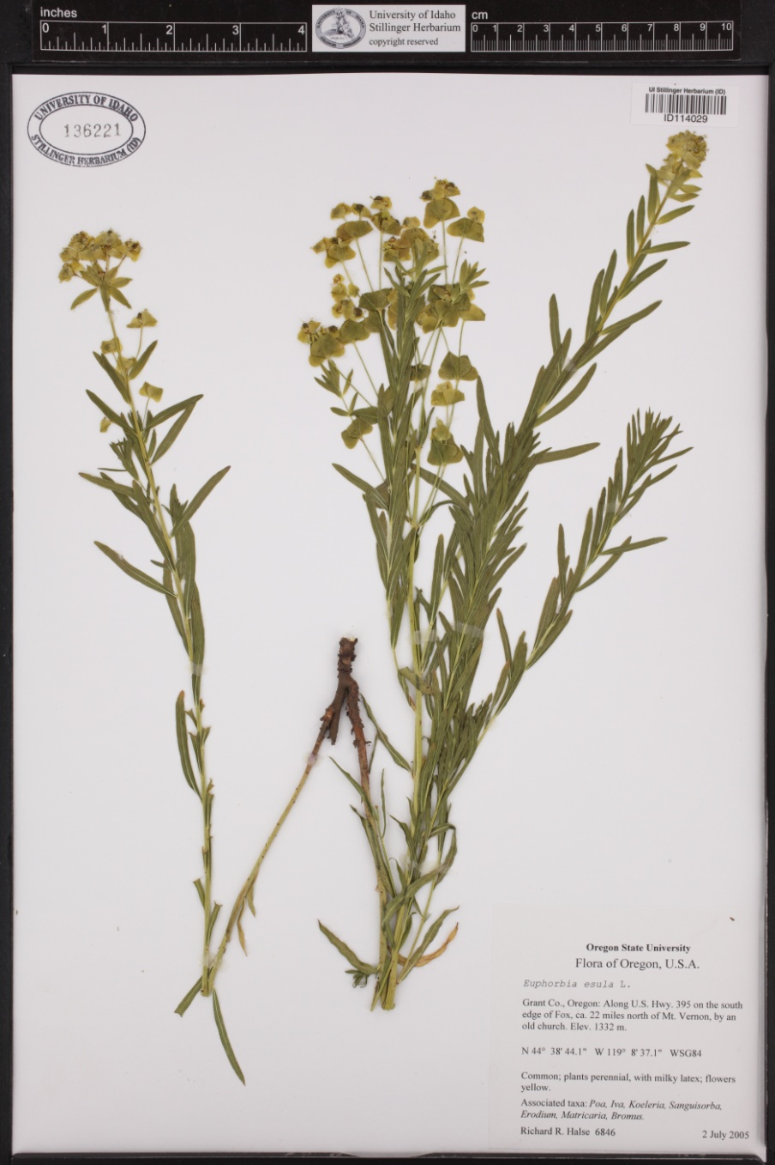
Leafy Spurge
Introduced
Perennial
http://www.ag.ndsu.edu
University of Idaho Stillinger Herbarium (http://www.pnwherbaria.org)

Slide 6
Leafy Spurge
Milky resin
Noxious Weed
Thad Berrett
Thad Berrett

Slide 7
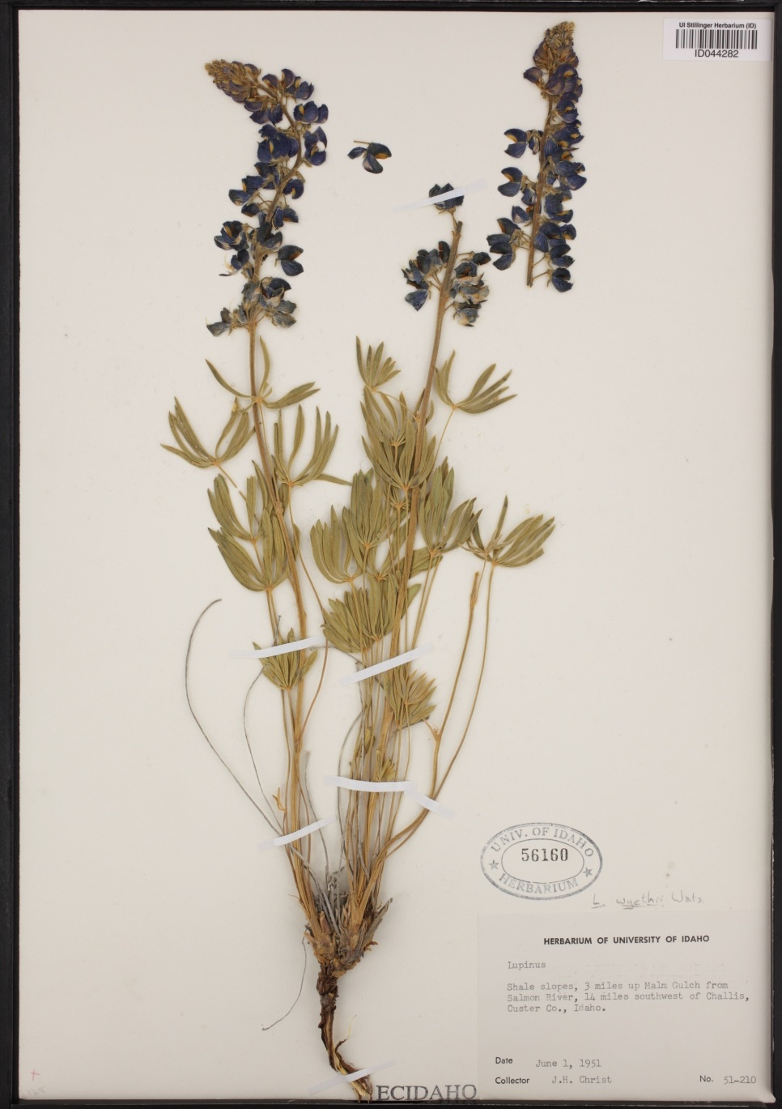
Tailcup Lupine
Perennial
Native
Raceme seed heads
Palmate compound leaves
University of Idaho Stillinger Herbarium (http://www.pnwherbaria.org)
Idaho Rangeland Resource Commission – drawing by Beverly Jaquish
Notes:
Raceme flower. Causes crooked calf syndrome.

Slide 8
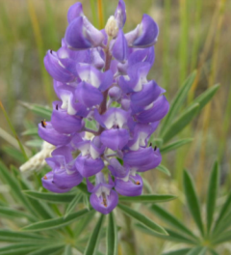
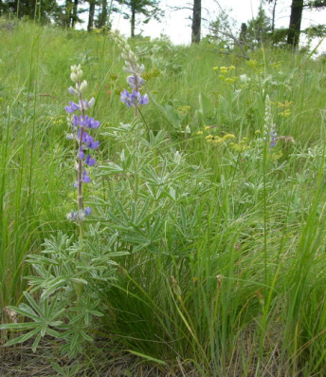
Tailcup Lupine
Poisonous plant contains alkaloids
Jennifer Peterson
Jennifer Peterson
Notes:
Raceme flower. Causes crooked calf syndrome.

Slide 9
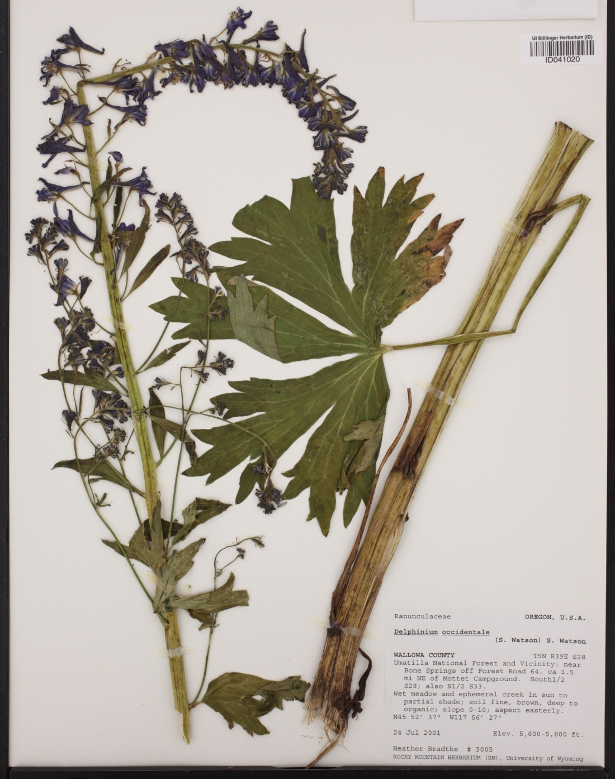
Tall Larkspur
Perennial
Native
Raceme seed heads
Palmate divided
leaves
Backpack Guide to Idaho Range Plants
University of Idaho Stillinger Herbarium (http://www.pnwherbaria.org
Notes:
Responsible for more livestock death than any other plant in the N. America. Flowers have a spur on them which is where the name “larkspur” comes from.

Slide 10
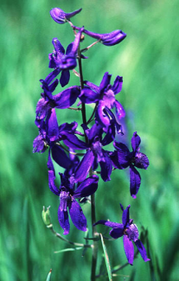
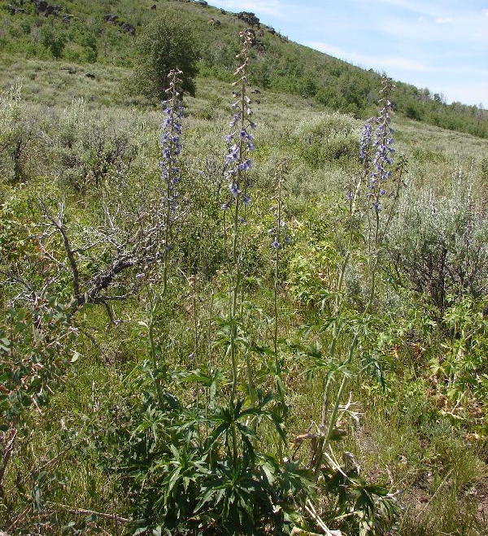
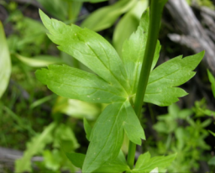
Tall Larkspur
Poisonous plant contains alkaloids
Purple flowers
Palmately divided leaves
** Poisonous – This plant contains a potent alkaloid. More animals die from this plant than from any other in North America
Sheri Hagwood, BLM
Notes:
Responsible for more livestock death than any other plant in the N. America. Flowers have a spur on them which is where the name “larkspur” comes from.

Slide 11
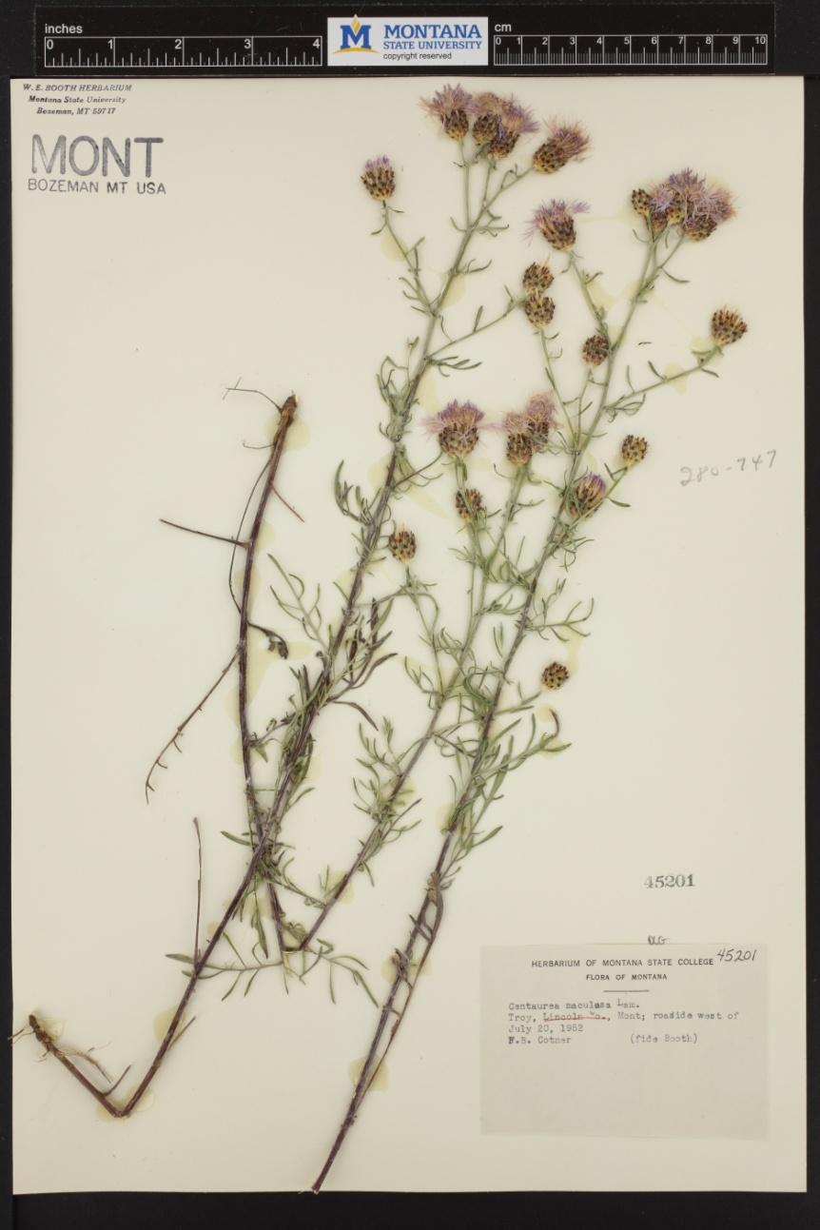
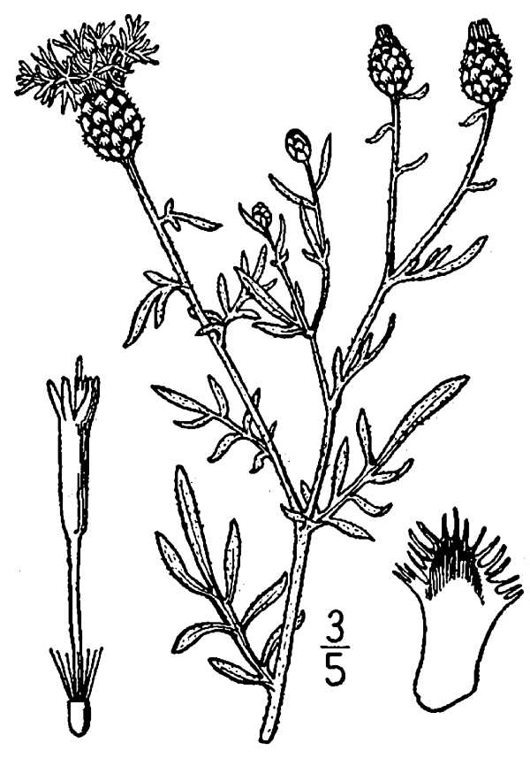
Spotted Knapweed
Perennial
Introduced
Composit Seedhead with Disk flowers
K. Launchbaugh
Montana State University Herbarium (http://www.pnwherbaria.org
K. Launchbaugh
Jen Peterson
www.usu.edu/weeds/plant_species/weedspecies/spottedknap.html

Slide 12
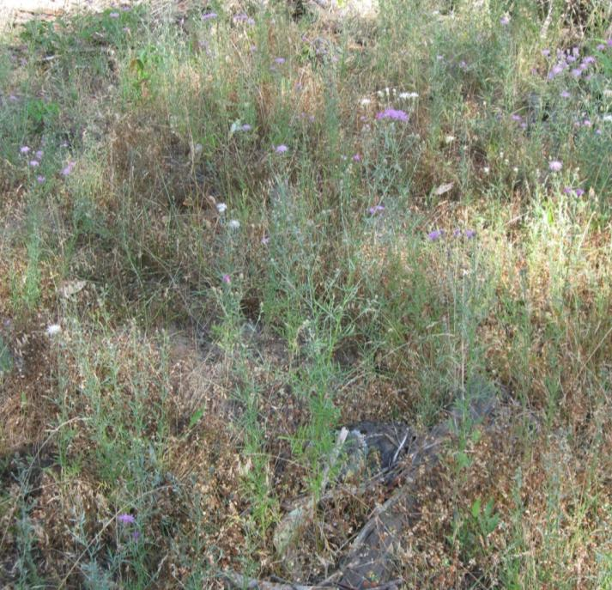
Spotted Knapweed
K. Launchbaugh
Noxious weed
Distinct “spots”
K. Launchbaugh
K. Launchbaugh
Jen Peterson

Slide 13
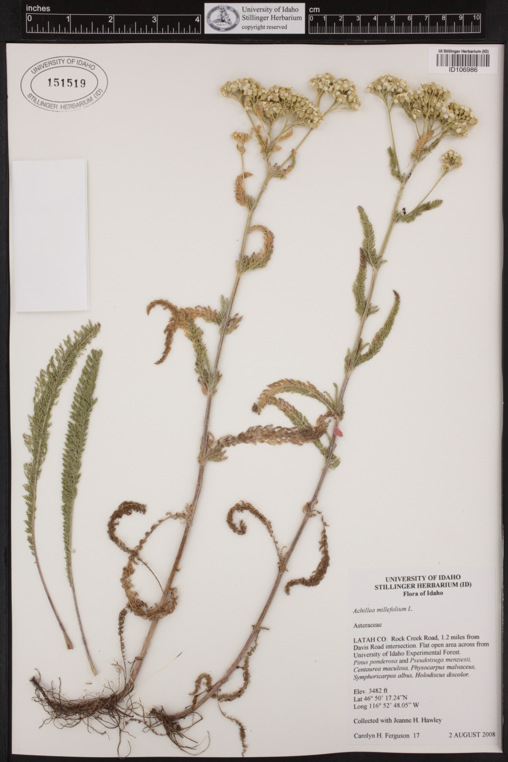
Western Yarrow
Perennial
Native
Umbrella-shaped inflorescence
rhizomatous
Backpack Guide to Idaho Range Plants
University of Idaho Stillinger Herbarium (http://www.pnwherbaria.org
Notes:
One of the most widespread plants found in N. America. Corymb flower. Has a lot of medicinal value because of its antibacterial properties.

Slide 14
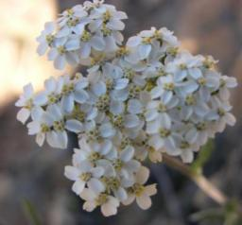
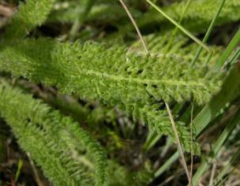
Western Yarrow
Widely range of occurrence
Medicinal Value
J. Peterson
Jennifer Peterson
deeply divided fern-like leaves
Jennifer Peterson
Notes:
One of the most widespread plants found in N. America. Corymb flower. Has a lot of medicinal value because of its antibacterial properties.

Slide 15
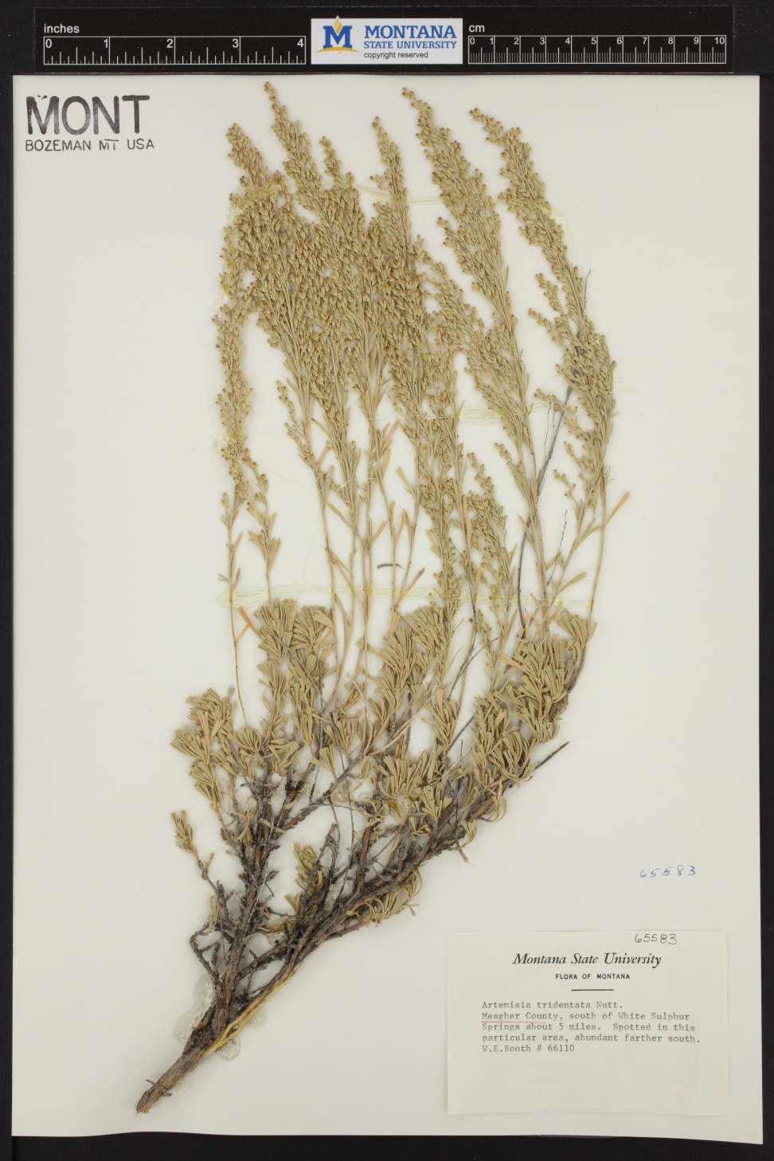
Big Sagebrush
Perennial
Native
Leaves with 3-tipped ends
Backpack Guide to Idaho Range Plants
Montana State University Herbarium (http://www.pnwherbaria.org

Slide 16
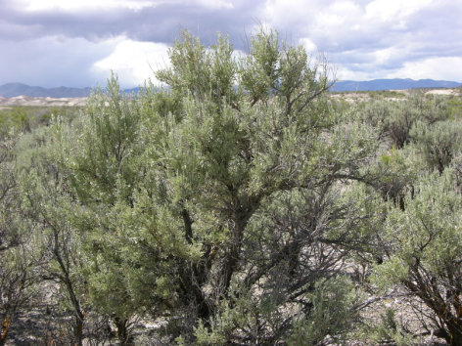
Big Sagebrush
Several sagebrush obligate species like Sage-grouse and Sage Thrashers
Narrow wedge-shaped leaves with 3 tips
Flowers have no petals; same color as leaves

Slide 17
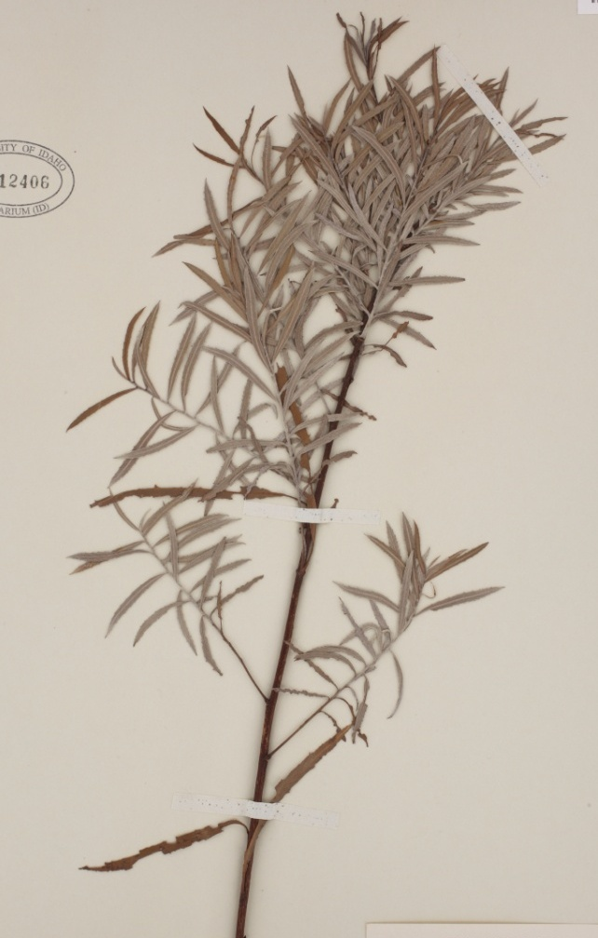
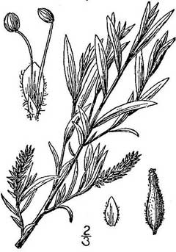
Coyote (Sandbar) Willow
Perennial
Native
K. Launchbaugh
University of Idaho Stillinger Herbarium (http://www.pnwherbaria.org
Britton, N.L., and A. Brown. 1913. An illustrated flora of the northern United States, Canada and the British Possessions. 3 vols. Charles Scribner's Sons, New York. Vol. 1: 594.
K. Launchbaugh
K. Launchbaugh

Slide 18
Coyote (Sandbar) Willow
Important Riparian Plant
K. Launchbaugh
K. Launchbaugh
K. Launchbaugh

Slide 19
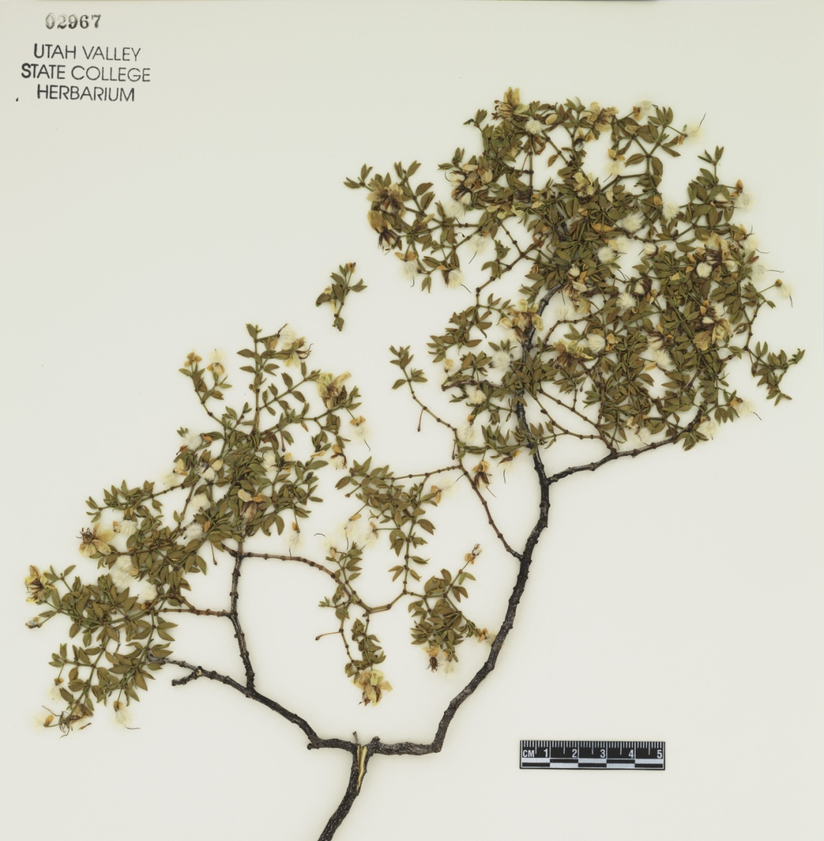
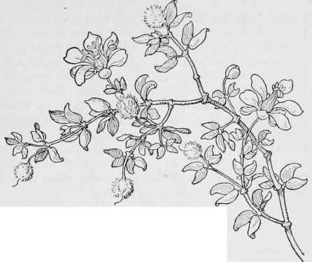
Creosote
Perennial
Native
Leaves with 2 leaflets
Fuzzy Seeds
Field Book Of Western Wild Flowers, by Margaret Armstrong
K. Launchbaugh
Utah Valley Sate College Herbarium (http://www.pnwherbaria.org

Slide 20
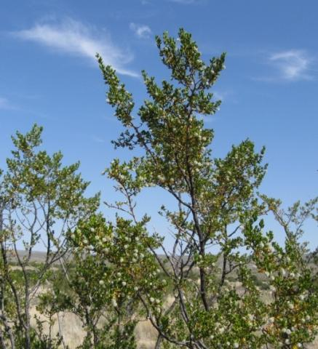
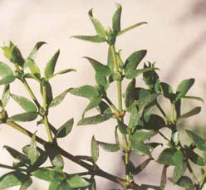
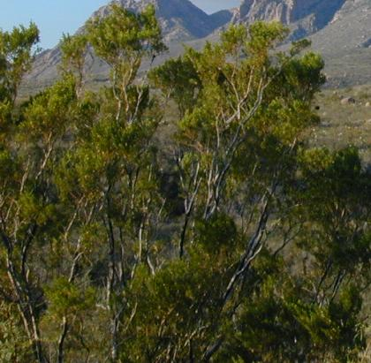
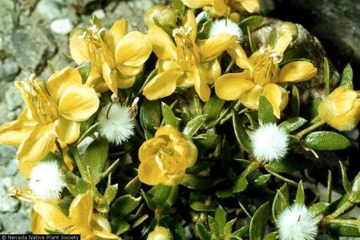
Creosote
Leaves with 2 leaflets
Desert Shrub
K. Launchbaugh
Yellow flowers with hairy seeds
K. Launchbaugh

Slide 21
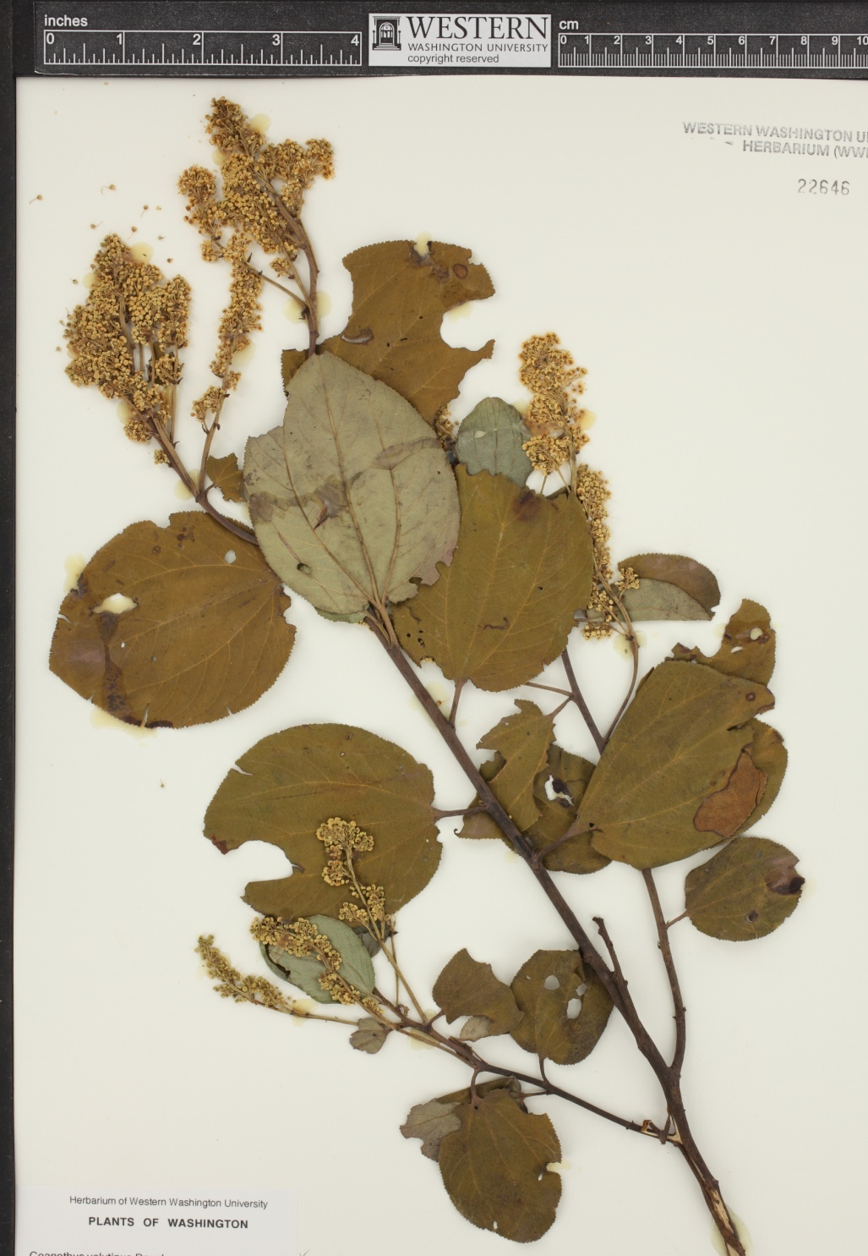
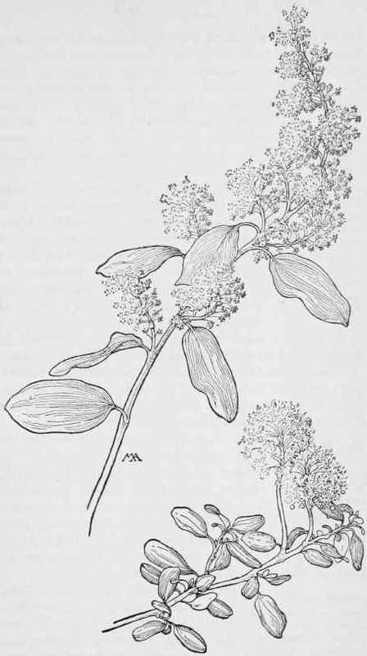
Deerbrush
Perennial
Native
Leaves have 3 main veins
Field Book Of Western Wild Flowers, by Margaret Armstrong
Western Washington University Herbarium (http://www.pnwherbaria.org

Slide 22
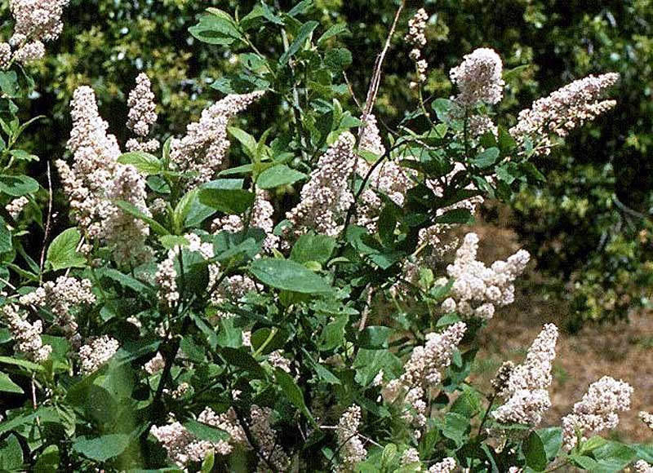
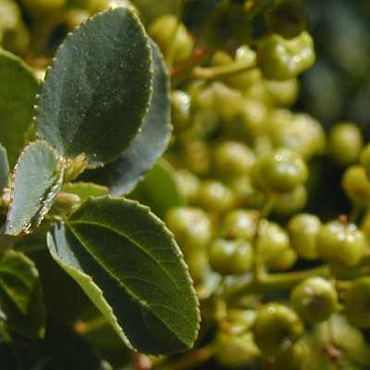
Deerbrush
Chaparral Shrub
www.blm.gov
Sclerophyllous leaves

Slide 23
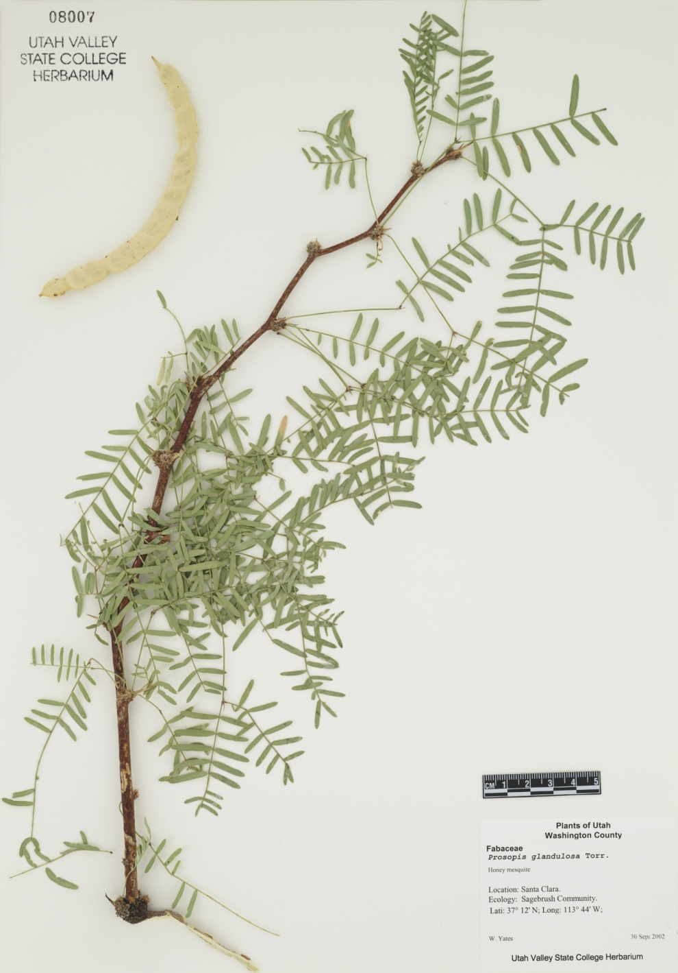
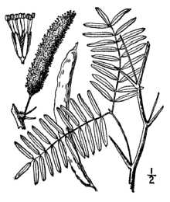
Honey Mesquite
Perennial
Native
Pinately Compound Leaves
Britton, N.L., and A. Brown. 1913. An illustrated flora of the northern United States, Canada and the British Possessions. 3 vols. Charles Scribner's Sons, New York. Vol. 2: 333
Utah Valley State College Herbarium (http://www.pnwherbaria.org

Slide 24
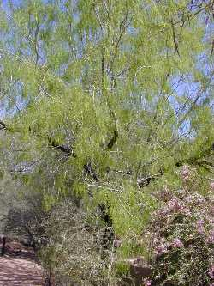
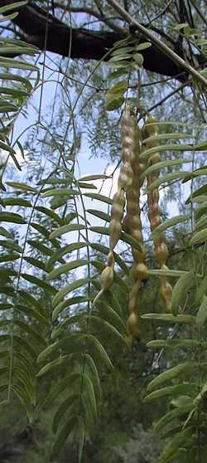
Honey Mesquite
Legume
Shrub of SW Desert
Nutritious Seed Pods

Slide 25
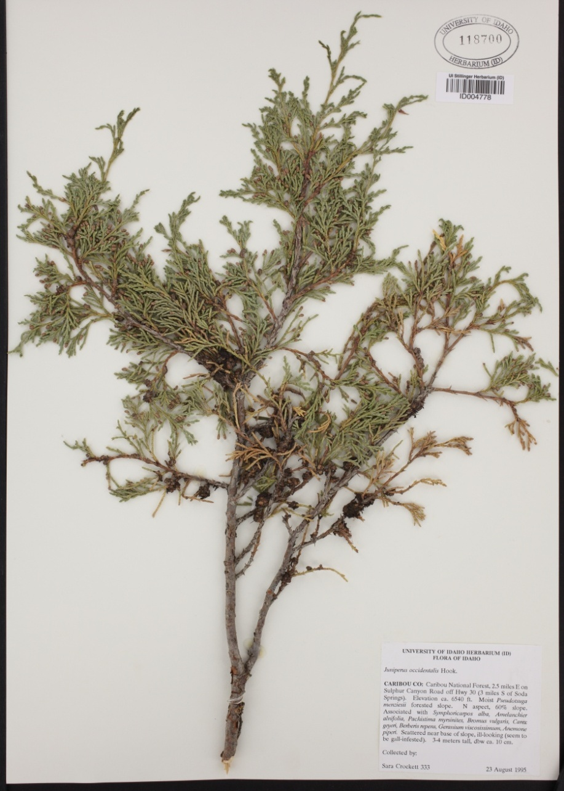
Juniper
Perennial
Native
Leaves look like overlapping scales
Backpack Guide to Idaho Range Plants
University of Idaho Stillinger Herbarium (http://www.pnwherbaria.org

Slide 26
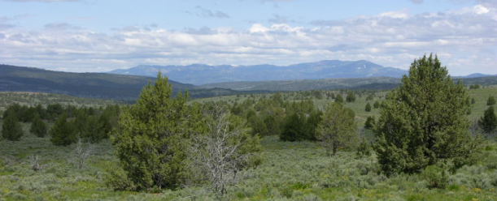
Juniper
Invasive on rangelands
Important winter wildlife habitat
Evergreen (non-deciduous)
Jen Peterson

Slide 27
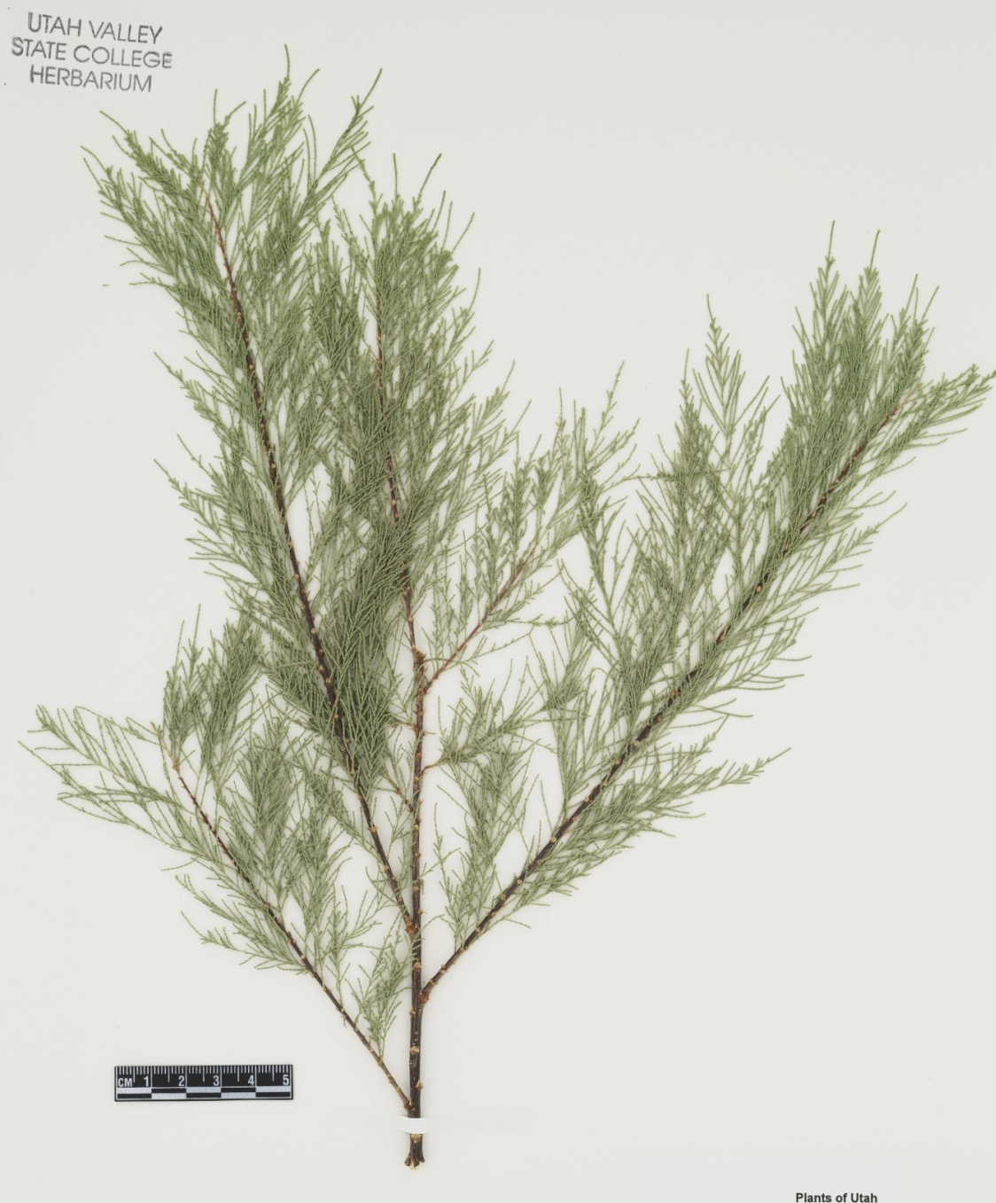
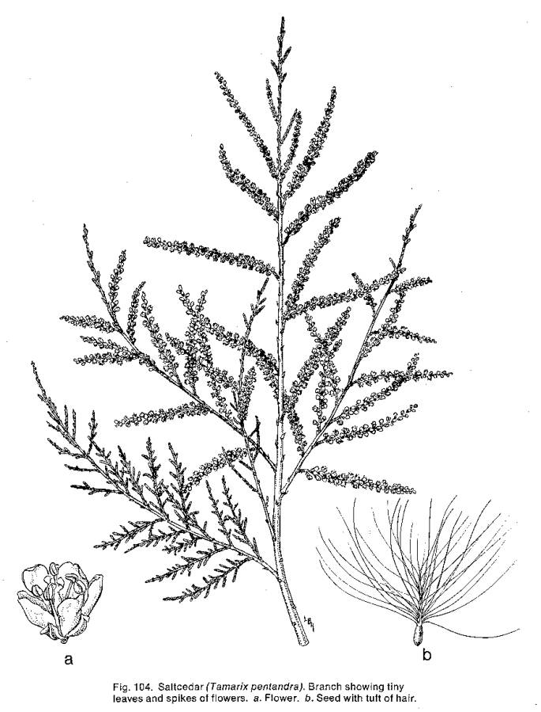
Saltcedar
Perennial
Introduced as ornamental
K. Launchbaugh
K. Launchbaugh
K. Launchbaugh
Utah Valley State College Herbarium (http://www.pnwherbaria.org

Slide 28
Saltcedar
Introduced as ornamental
Highly invasive riparian plant.
K. Launchbaugh
K. Launchbaugh
K. Launchbaugh

Slide 29
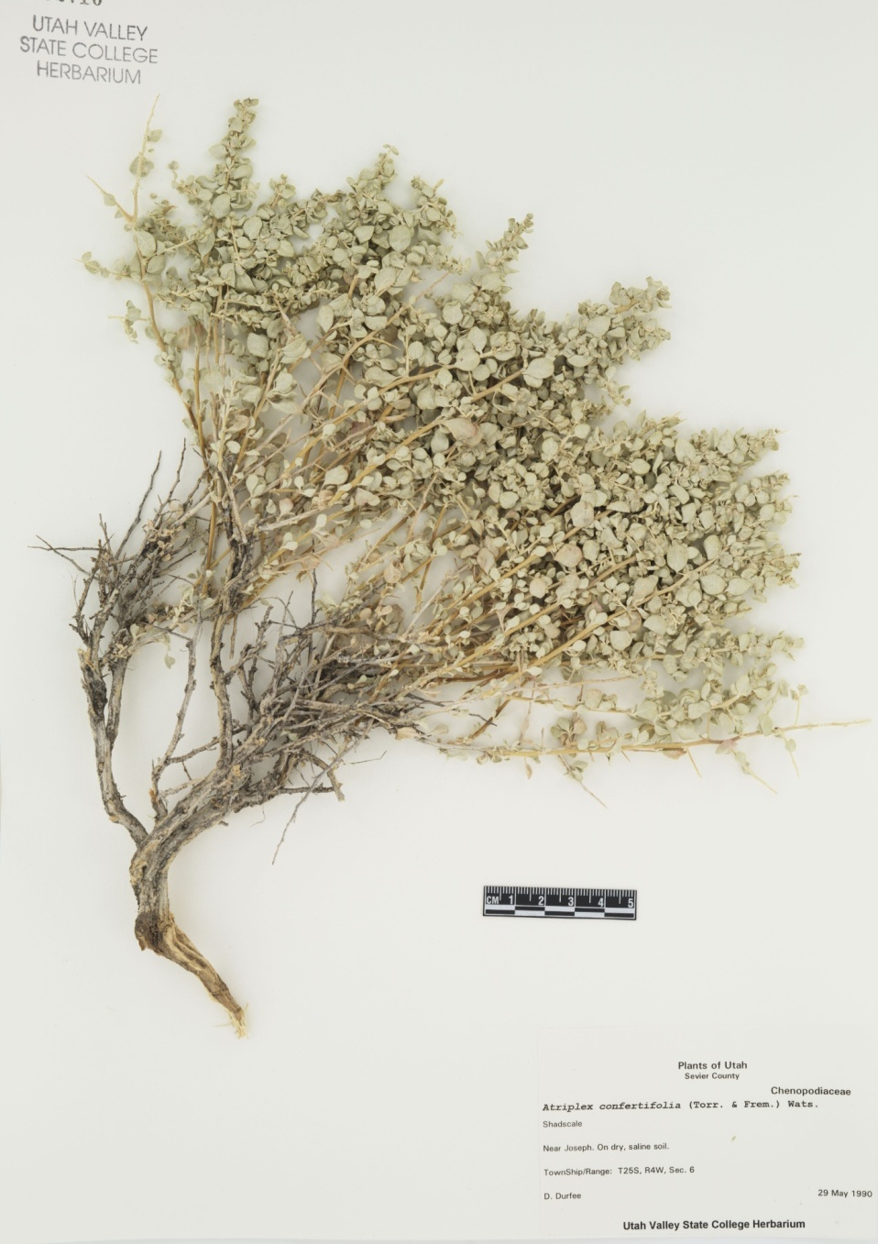
Shadscale Saltbrush
Perennial
Native
Alternate leaves
Idaho Rangeland Resource Commission – drawing by Beverly Jaquish
University of Idaho Stillinger Herbarium (http://www.pnwherbaria.org

Slide 30
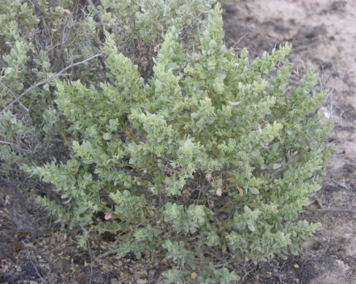
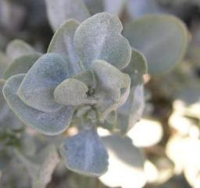
Shadscale Saltbrush
Major plant of salt-desert shrub region
Ovate or obovate leaves; circular like a rounded scale

Slide 31
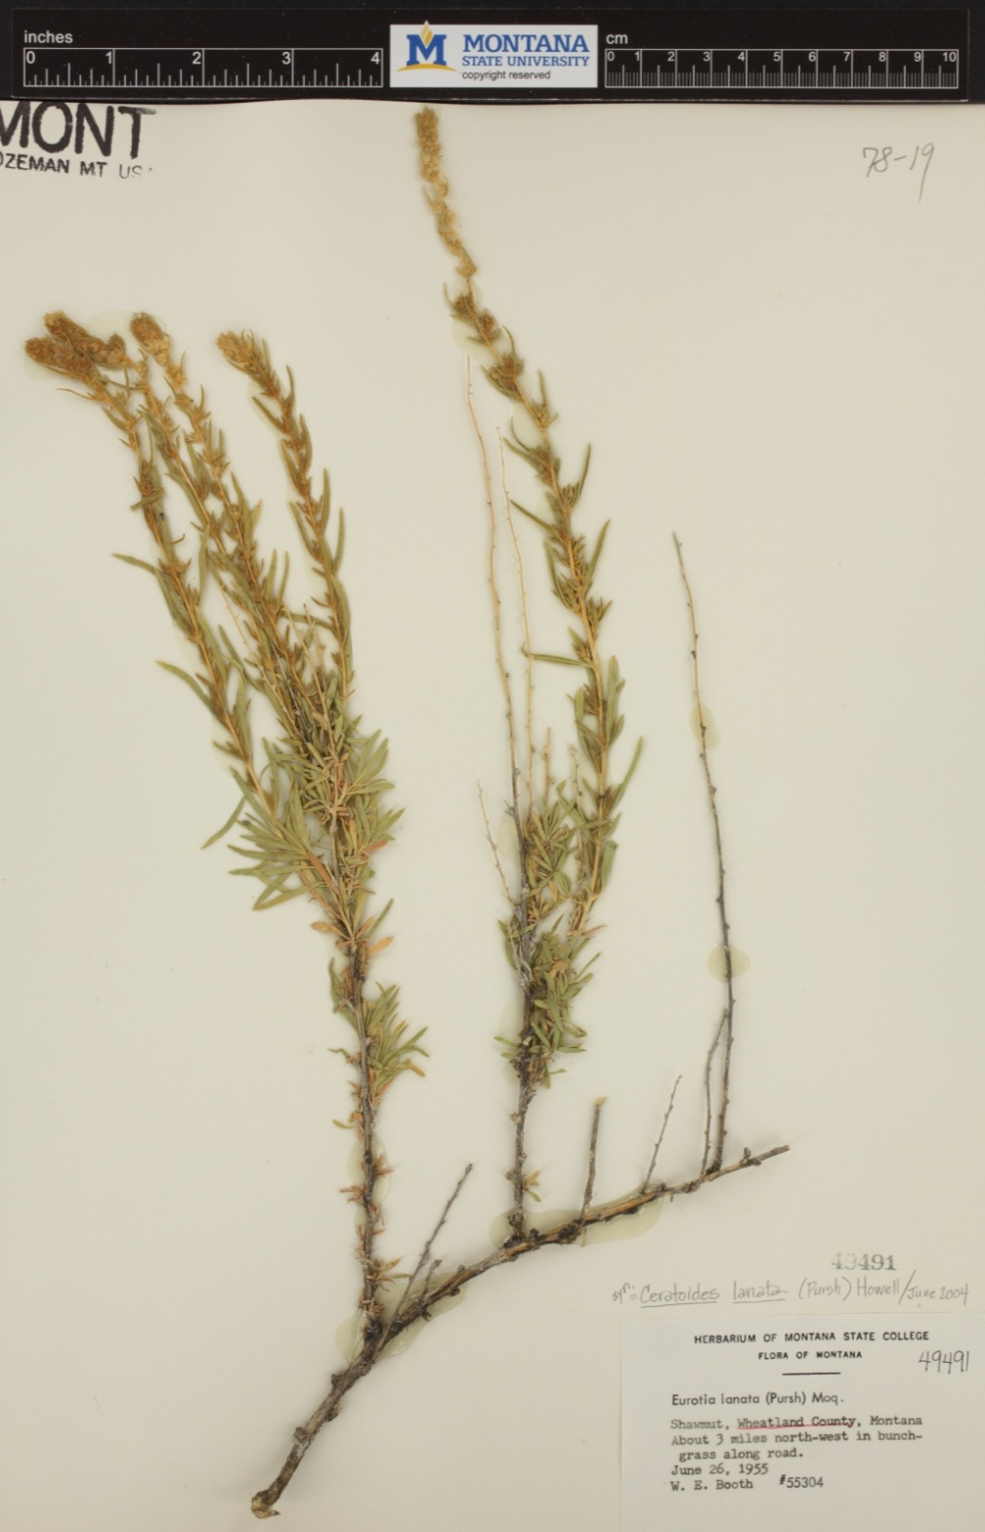
Winterfat
Perennial
Native
Suffrutescent (“half-shrub”) that dies back to woody base each season
Backpack Guide to Idaho Range Plants
Montana State University Herbarium (http://www.pnwherbaria.org

Slide 32
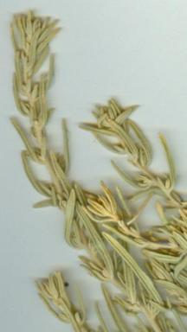
Winterfat
Enrolled leaf margin
Important half-shrub for winter forage value
Hairy leaf surface

