Slide 1
Major Rangeland Plant Flashcards
Woody Plants
By Karen Launchbaugh

Slide 2
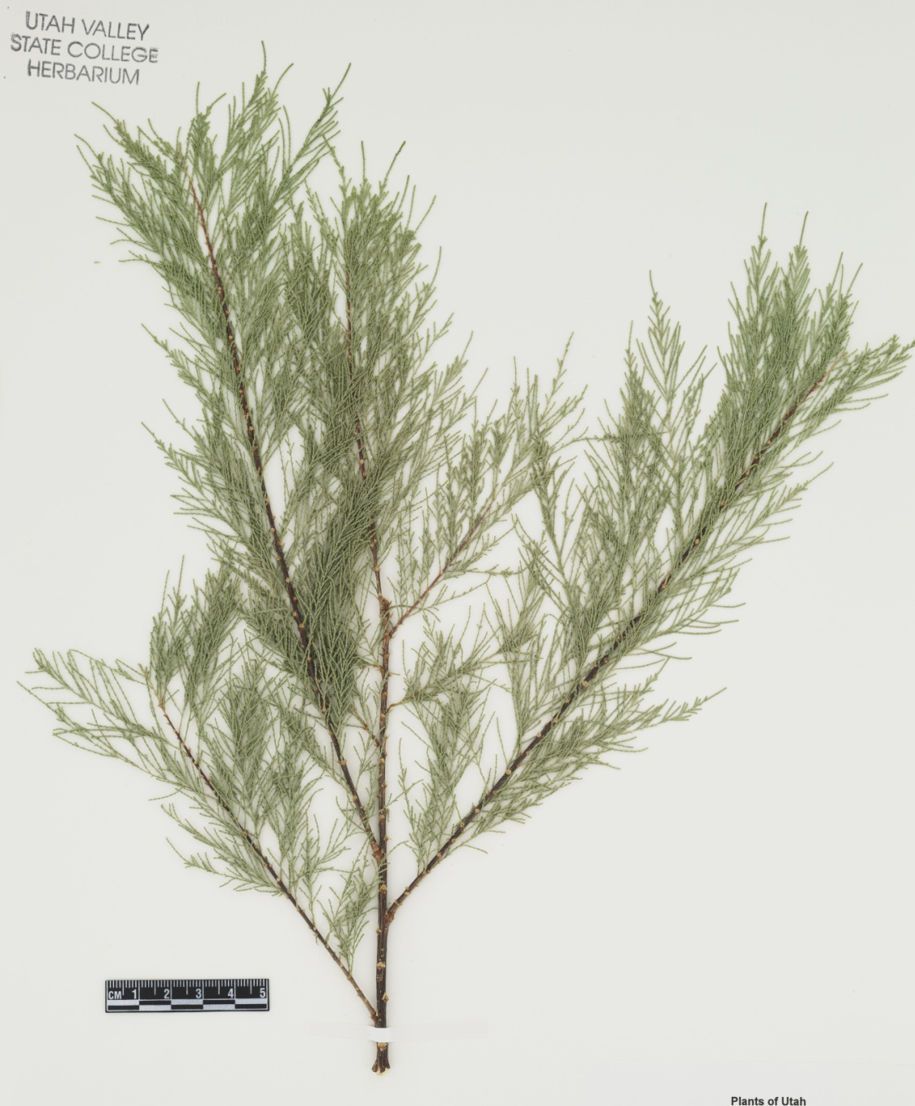
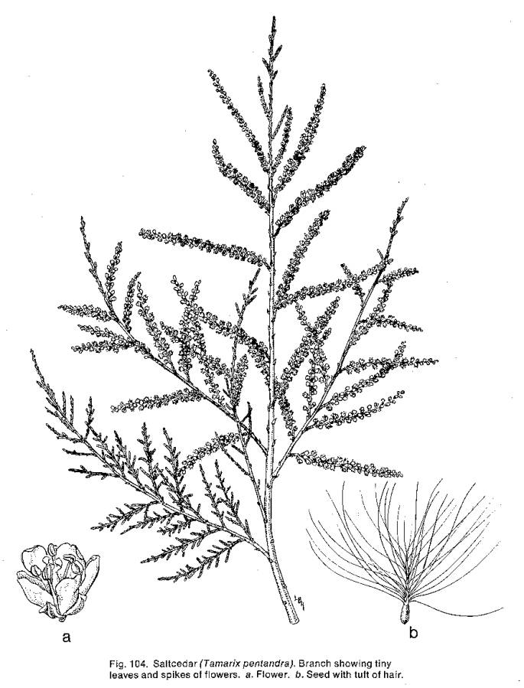
K. Launchbaugh
K. Launchbaugh
K. Launchbaugh
Utah Valley State College Herbarium (http://www.pnwherbaria.org

Slide 3
Saltcedar
Perennial
Introduced
K. Launchbaugh
K. Launchbaugh
K. Launchbaugh
Utah Valley State College Herbarium (http://www.pnwherbaria.org

Slide 4
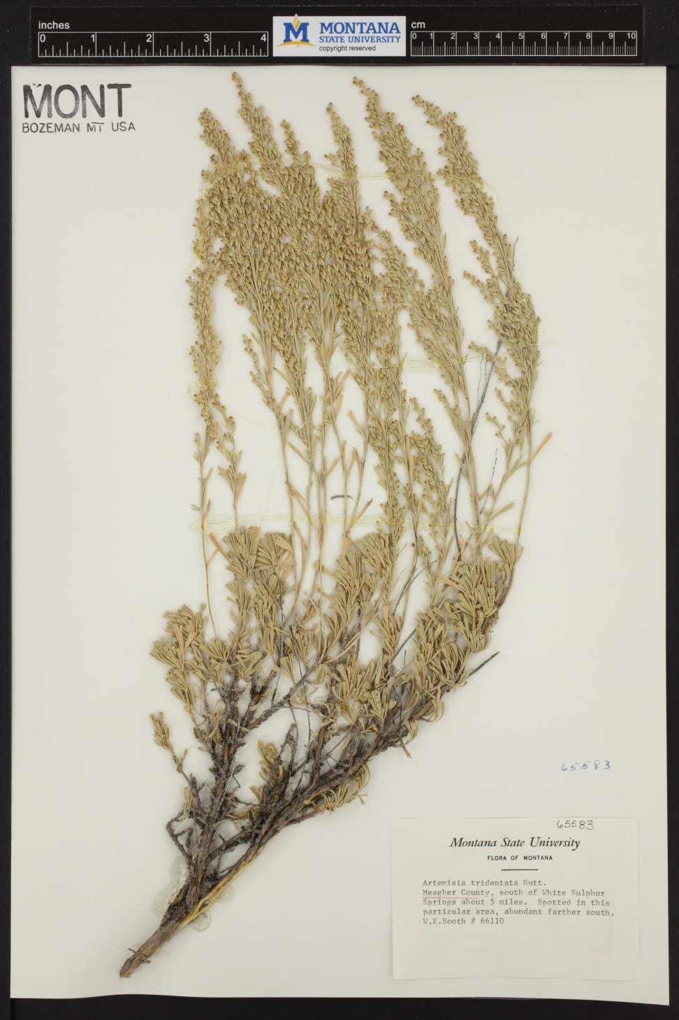
Montana State University Herbarium (http://www.pnwherbaria.org

Slide 5
Big Sagebrush
Perennial
Native
Montana State University Herbarium (http://www.pnwherbaria.org

Slide 6
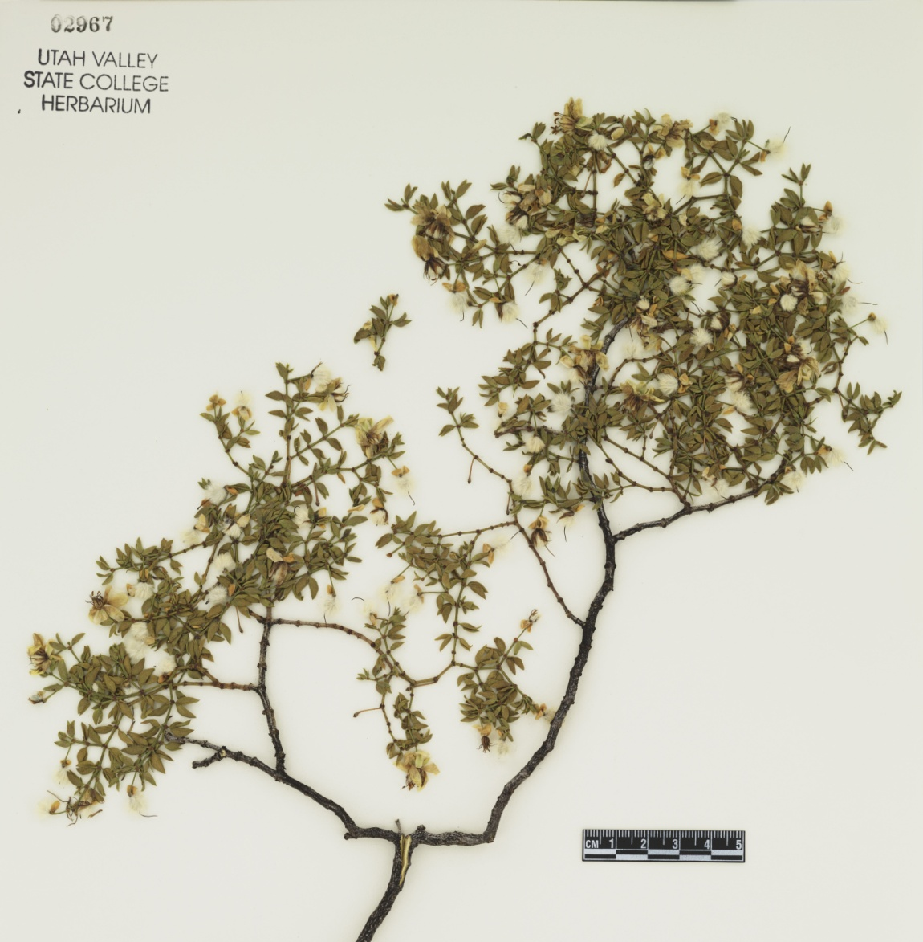
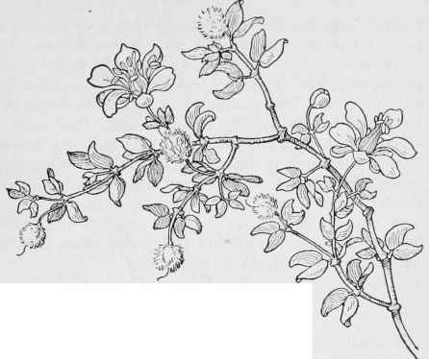
Field Book Of Western Wild Flowers, by Margaret Armstrong
K. Launchbaugh
Utah Valley Sate College Herbarium (http://www.pnwherbaria.org

Slide 7
Creosote
Perennial
Native
Field Book Of Western Wild Flowers, by Margaret Armstrong
K. Launchbaugh
Utah Valley Sate College Herbarium (http://www.pnwherbaria.org

Slide 8
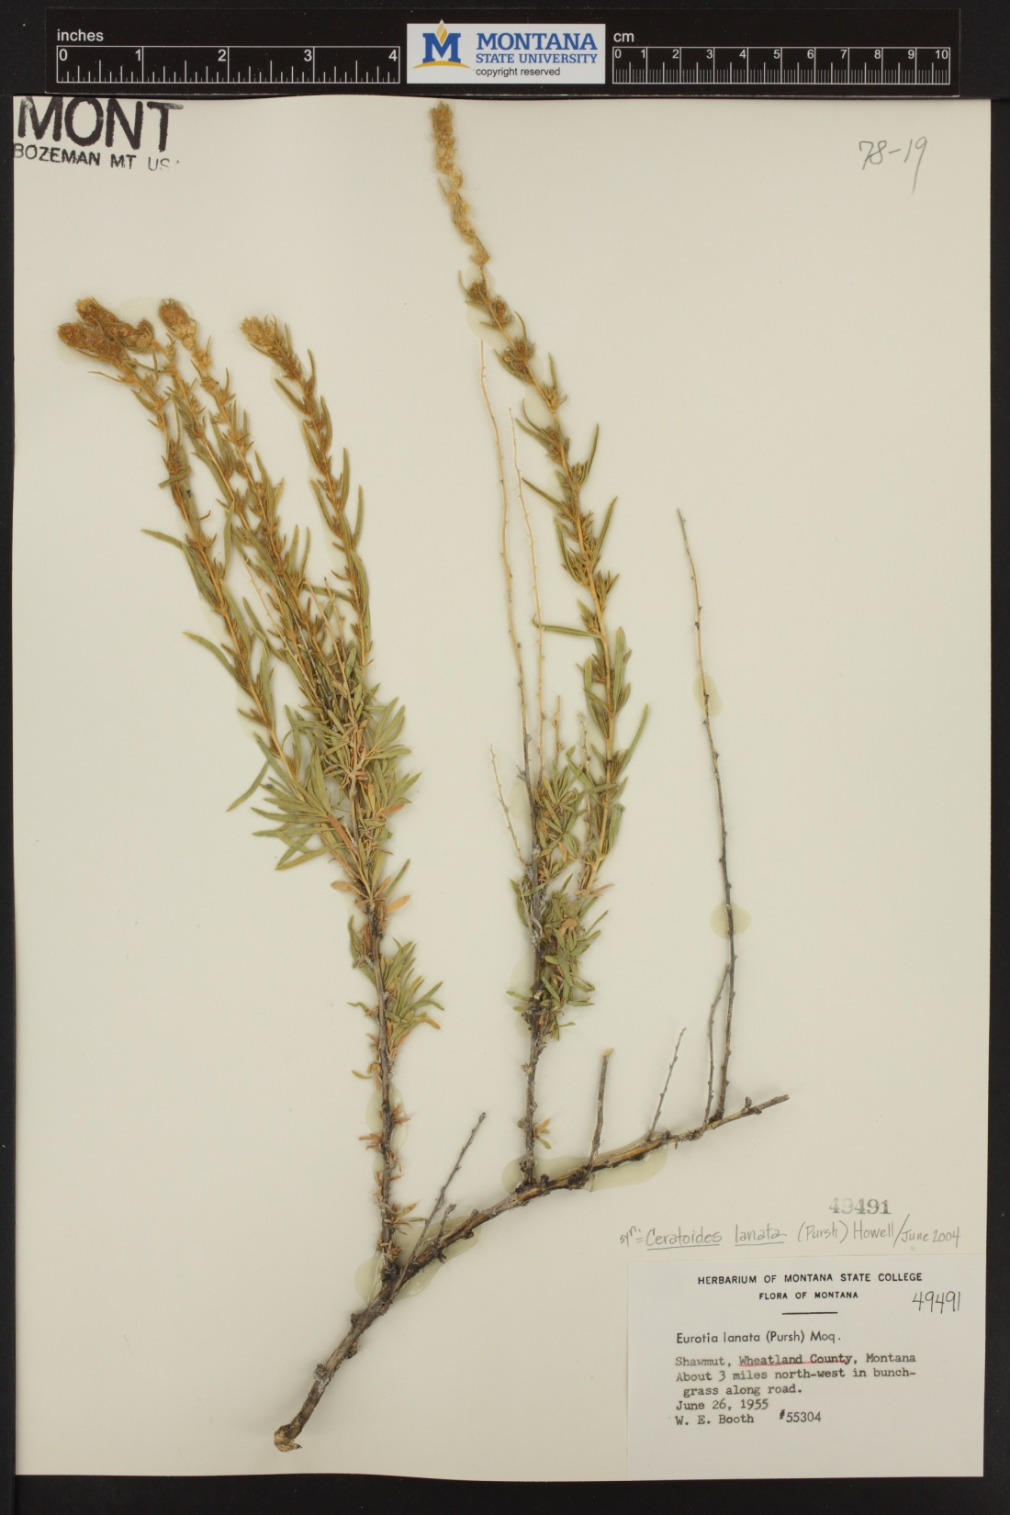
Montana State University Herbarium (http://www.pnwherbaria.org

Slide 9
Winterfat
Perennial
Native
Montana State University Herbarium (http://www.pnwherbaria.org

Slide 10
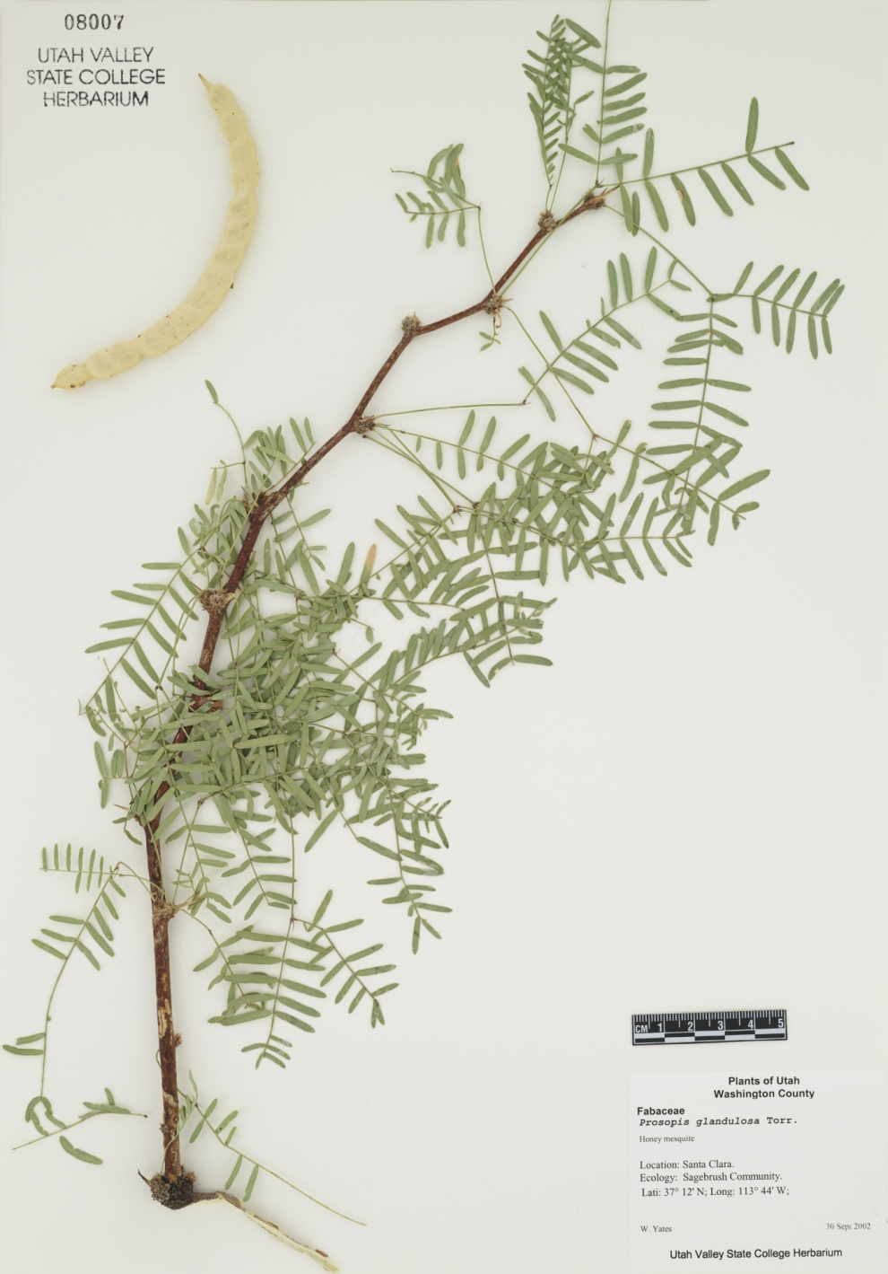
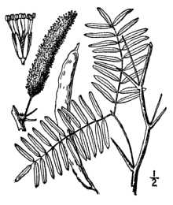
Utah Valley State College Herbarium (http://www.pnwherbaria.org

Slide 11
Honey Mesquite
Perennial
Native
Utah Valley State College Herbarium (http://www.pnwherbaria.org

Slide 12
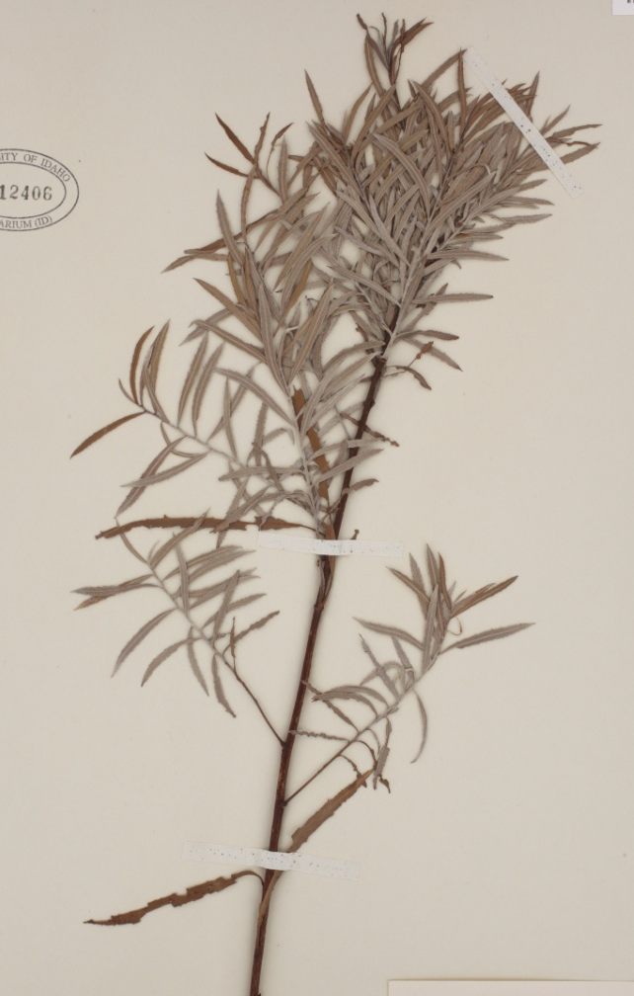
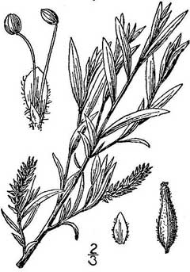
K. Launchbaugh
K. Launchbaugh
K. Launchbaugh
University of Idaho Stillinger Herbarium (http://www.pnwherbaria.org

Slide 13
Coyote (Sandbar) Willow
Perennial
Native
K. Launchbaugh
University of Idaho Stillinger Herbarium (http://www.pnwherbaria.org
K. Launchbaugh
K. Launchbaugh

Slide 14
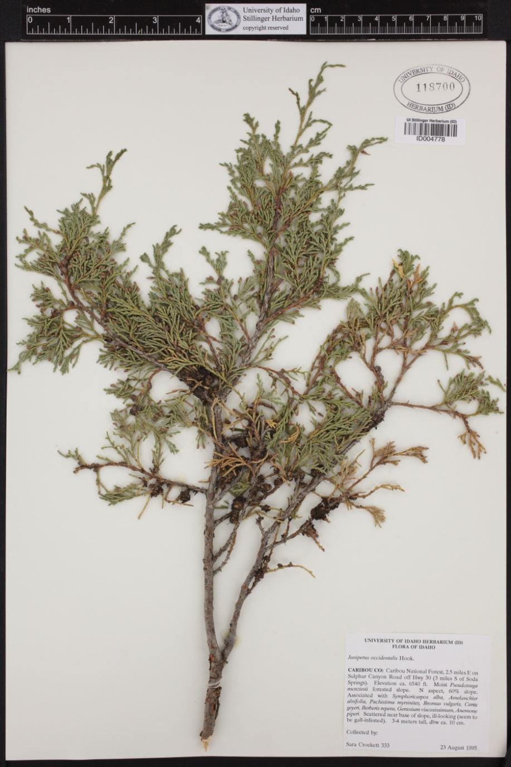
University of Idaho Stillinger Herbarium (http://www.pnwherbaria.org

Slide 15
Juniper
Perennial
Native
University of Idaho Stillinger Herbarium (http://www.pnwherbaria.org

Slide 16
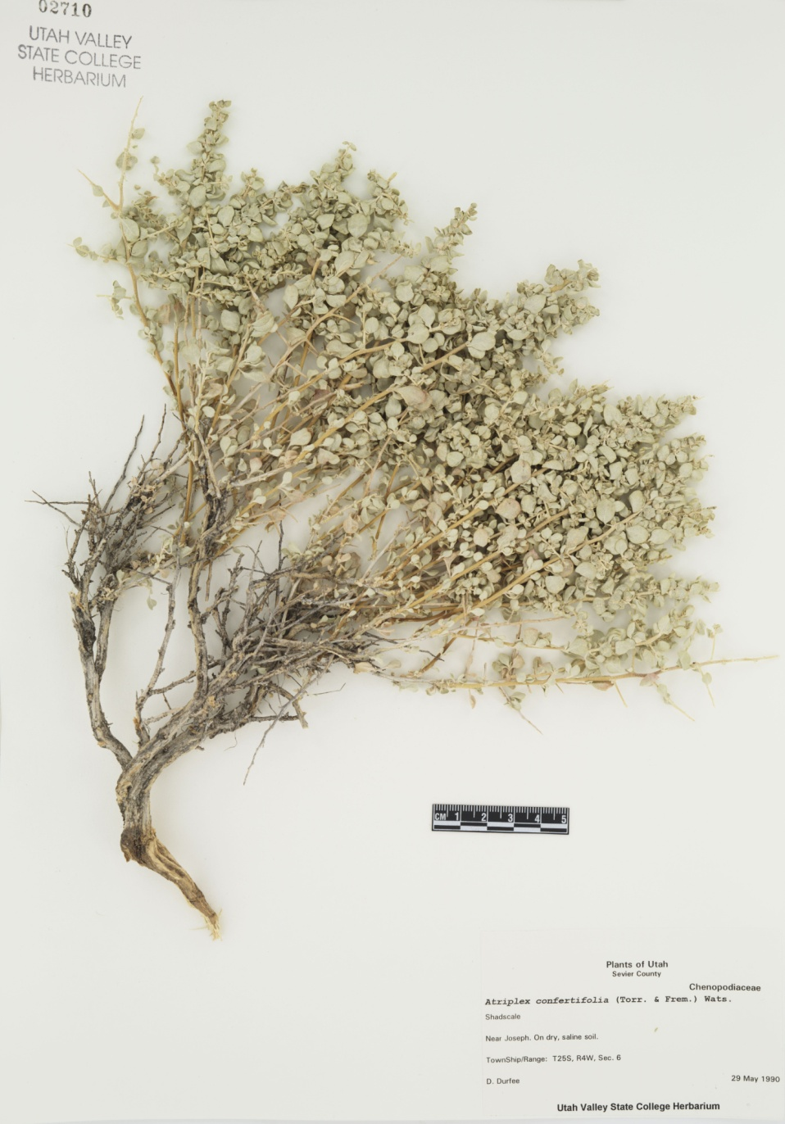
Idaho Rangeland Resource Commission – drawing by Beverly Jaquish
University of Idaho Stillinger Herbarium (http://www.pnwherbaria.org

Slide 17
Shadscale Saltbrush
Perennial
Native
Idaho Rangeland Resource Commission – drawing by Beverly Jaquish
University of Idaho Stillinger Herbarium (http://www.pnwherbaria.org

Slide 18
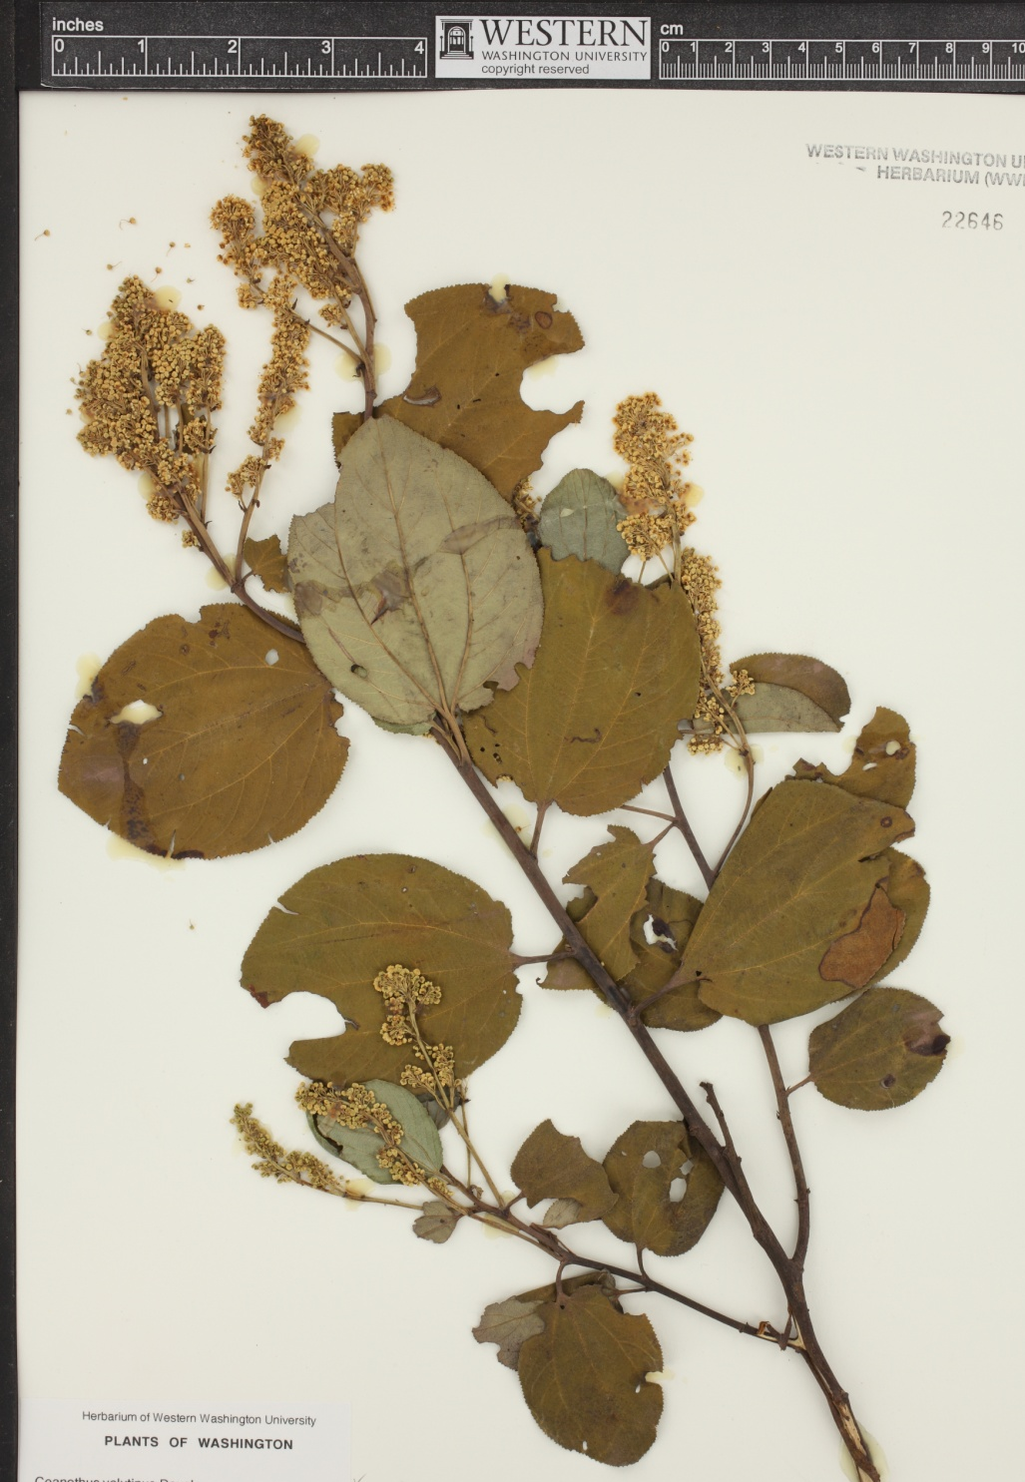
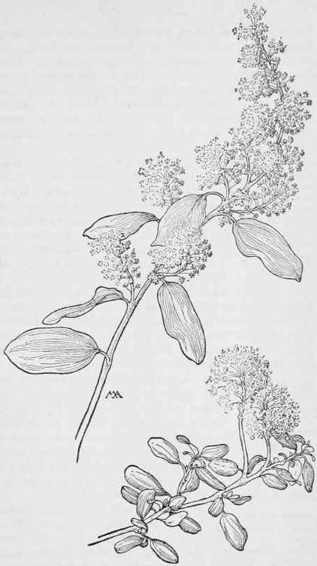
Field Book Of Western Wild Flowers, by Margaret Armstrong
Western Washington University Herbarium (http://www.pnwherbaria.org

Slide 19
Deerbrush
Perennial
Native
Field Book Of Western Wild Flowers, by Margaret Armstrong
Western Washington University Herbarium (http://www.pnwherbaria.org

